Slide 1

SQL Queries
&
Programming
Ahmed Moosa
MCPD / MCTS (Web Developer )
http://weblogs.asp.net/ahmedmoosa
http://ahmedmoosa.wordpress.com

Slide 2
What is SQL ?
SQL (Structured Query Language)
SQL is a computer language aimed to store, manipulate, and retrieve data in relational databases.

Slide 3
Introduction to Databases

Slide 4
Database Fundamentals

Slide 5
Database concepts
Database
  Linking data tables through relationships
  Controlling data storing and retrieving
  Maintaining data integrity and accuracy
  Avoiding data redundancy and inconsistency
  Sorting and filtering data

Slide 6
Relational Database
a relational database is a set of tables
Each table keeps information about one thing

Slide 7
Relational Database Management System (RDBMS)
is an application that creates, organizes and edits databases
  Microsoft SQL Server
  Oracle
  Microsoft Access

Slide 8
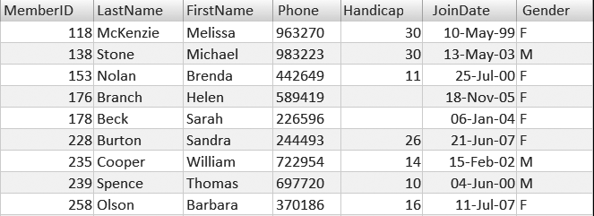
Table Elements

Slide 9
Data Types

Slide 10
Data Type Categories
Numeric Data Type
Date and Time Data Type
Character Data Type
Binary Data Type

Slide 11
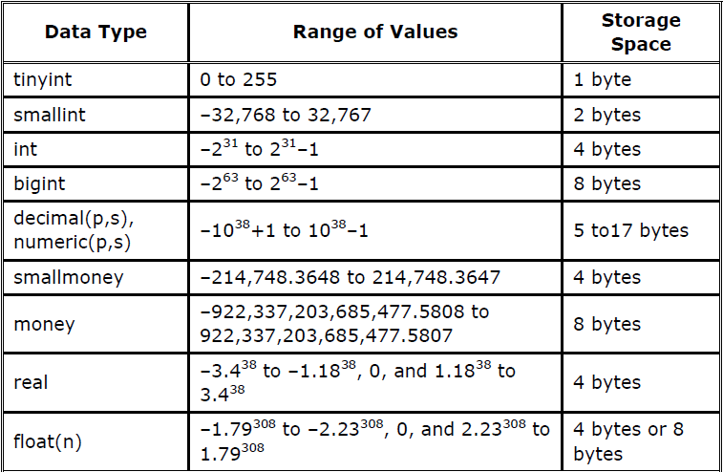
Numeric Data Type

Slide 12
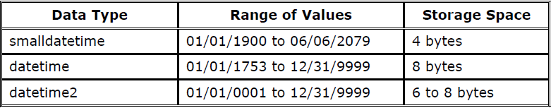
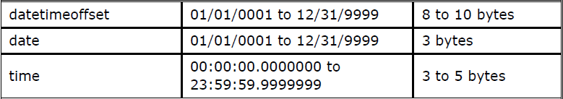
Date and Time Data Type

Slide 13
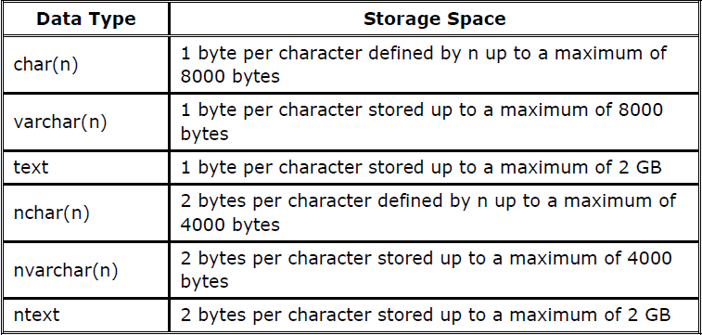
Character Data Type

Slide 14
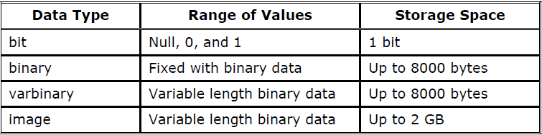
Binary Data Type

Slide 15
Database Constraints

Slide 16
Not null Constraints
A null value is an unknown
Null value is not as zero or space.

Slide 17
Unique Constraints
every value in a column or set of columns must be unique.
When there is not the primary key.
Example
  no two employees can have the same phone number

Slide 18
Primary key
The primary key value must be unique and not null.
Multiple UNIQUE constraints and only one Primary key in a Table .

Slide 19
Foreign key
FOREIGN KEY in one table points to a PRIMARY KEY in another table.
prevents that invalid data form being inserted into the foreign key column

Slide 20
Check Constraints
used to limit the value range that can be placed in a column.
Example :
  A column must only include integers greater than 0

Slide 21
DEFAULT Constraint
used to insert a default value into a column

Slide 22
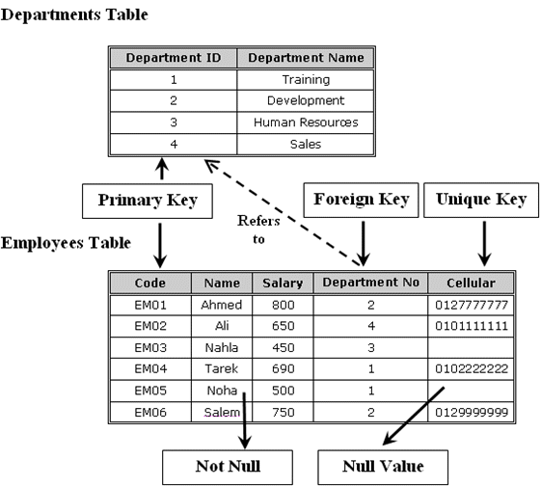

Slide 23
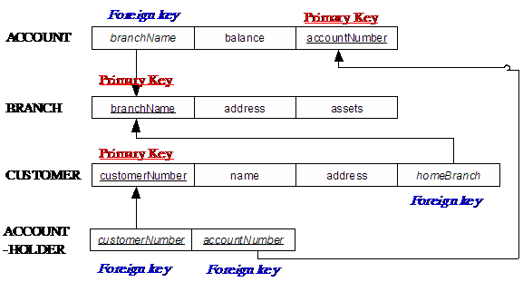

Slide 24
Database Relationships

Slide 25
Relationship Types
One-to-one relationship
One-to-many relationship
Many-to-many relationship
Recursive relationship
Referential integrity

Slide 26
One To One Relationships
One Record
One Record

Slide 27
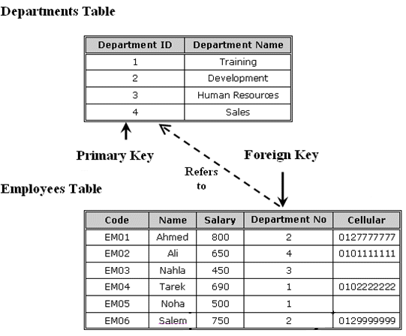
One To Many Relationships

Slide 28
One To Many Relationships
One Record
Record 1
Record 2
Record 3

Slide 29
Many To Many Relationships
Record 1
One Record
Record 1
Record 2
Record 2
Record 3
Record 3

Slide 30
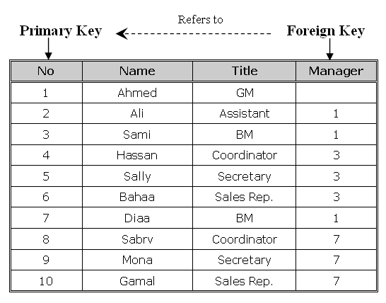
Recursive relationship

Slide 31
Referential integrity
You cannot add a value in a foreign key without a matching value in a primary key.
it prevents deleting a primary key that there is a foreign key related to it

Slide 32
Database Normalization

Slide 33
Normalization Overview
Definition
  the process of organizing data to minimize redundancy
  the process of decomposing large, inefficiently structured tables into smaller, more efficiently structured tables without losing any data in the process .
  the process of reducing tables to a set of columns where all the non-key columns depend on the primary key column

Slide 34
First normal form
rules
  Table must describe only a single object.
  A single field must not contain multiple data values.
  Table must not include repeated fields in the same column.
  Repeated fields must be removed to a related table.
  Create separate tables for each group of related data.
  Identify each row with a unique identifier (primary key).

Slide 35
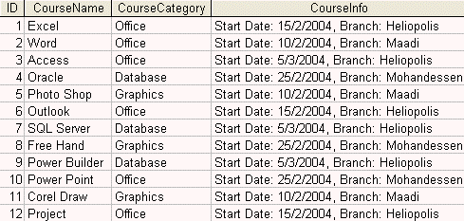
Example : First Normal Form

Slide 36
Problem
  The CourseCategory column contains repeated values for the rows.
  The CourseInfo column contains multiple data values in each field
Solution
  CourseCategory > to separate table (Categories)
    One-Many relationships (Category to Course )
  CourseInfo > to two columns(start date , branch)
    You need to create branches Tables .

Slide 37
Second normal form
rules
  Meet all the requirements of the first normal form.
  Data in all non-key columns must fully depend on the value of the primary key column or the composite primary key columns.

Slide 38
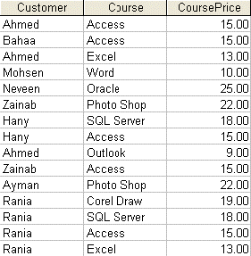
Example

Slide 39
Problem
  CoursePrice depending only on the course column
Solution
  CoursePrice column > Course Table

Slide 40
Third normal form
Rules
  Meet all the requirements of the first normal form.
  Meet all the requirements of the second normal form.
  Data in all non-key columns must fully describe the value of the primary key column or the composite primary key columns.

Slide 41
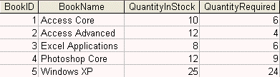
Example

Slide 42
Problem
  QuantityInStock column and the QuantityRequired
Solution
  QuantityInStock column and the QuantityRequired column must be removed to the book transactions table that fully describes the stock control for the books rather than describing the book itself as an object

Slide 43
Denormalization
Definition
  the opposite of normalization
Why
  to optimize the performance of a database
    if many relations are joined, it may be too slow then to retrieve information

Slide 44
SQL Queries

Slide 45
Working with SQL Server 2008

Slide 46
SQL Server Management Studio
Object Explorer
Text Editor
Create Databases
Create Tables

Slide 47
Introduction to Transact-SQL

Slide 48
Transact-SQL Commands
Data Definition Language (DDL)
  Create , Alter , Drop , Truncate
    meant to deal with the structure of the database objects (the object itself) like tables, views, procedures and so on.
Data Manipulation Language (DML)
  Insert , Delete , Update , SELECT
    deal with the contents of the tables rather than the structure of the tables
Data Control Language (DCL)
  GRANT , DENY , REVOKE
    maintain security of the database objects access and use

Slide 49
Data Definition Language (DDL)
CREATE
  adding a new database object to the database
ALTER
  changing the structure of an existing database object
DROP
  removing a database object from the database permanently
TRUNCATE
  removing all rows from a table without logging the individual row deletions

Slide 50
Data Manipulation Language (DML)
SELECT
  retrieving data from the database by specifying which columns and rows to be retrieved
INSERT
  adding a new row (and not column) into the table
UPDATE
  modifying the existing data in the tabl
DELETE
  removing an existing data from the table

Slide 51
Data Control Language (DCL)
GRANT
  giving privileges to the users
DENY
  denies permissions from a security account in the current database and prevents the security account from inheriting the permission through its group or role memberships
REVOKE
  removing privileges from the users that are previously granted those permissions

Slide 52
Retrieving Data

Slide 53
SELECT
Definition
  Retrieve data from database
Syntax
SELECT * | column1 [, column2, …….]
FROM table

Slide 54
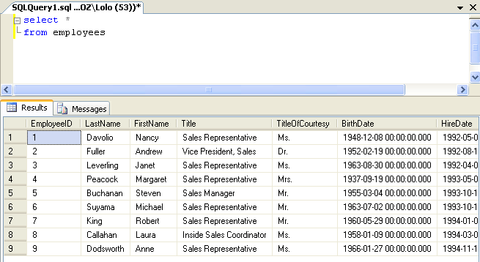
Example

Slide 55
WHERE
Definition
  Specify a condition to limit the result
Syntax
SELECT * | column1 [, column2, …….]
FROM table
[WHERE conditions]

Slide 56
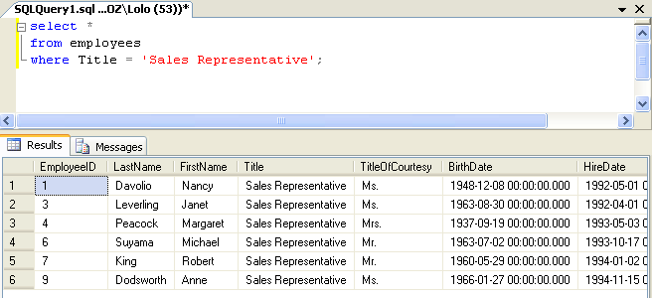
Example

Slide 57
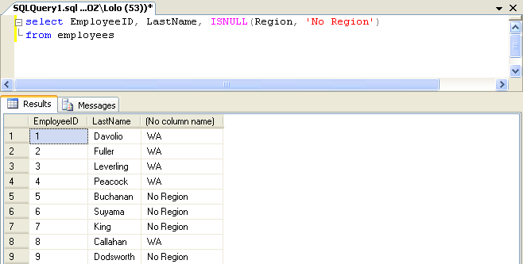
IS Null Function

Slide 58
Customizing Data

Slide 59
Order BY
Definition
  sort the retrieved rows by a specific column or set of columns
Syntax
SELECT * | column1 [, column2, …….]
FROM table
[WHERE conditions]
[ORDER BY column1 [, column2, ……..] ASC, DESC]

Slide 60
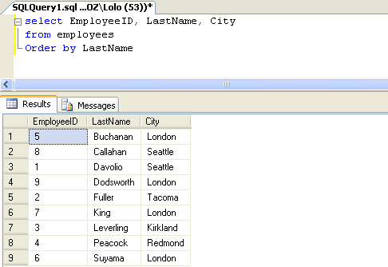
Example

Slide 61

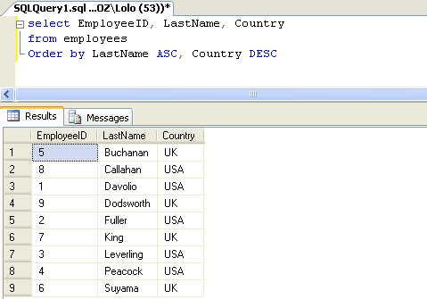
Examples : Sort Descending
1
2

Slide 62
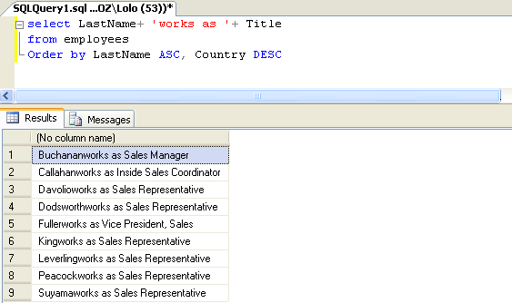
Concatenate

Slide 63
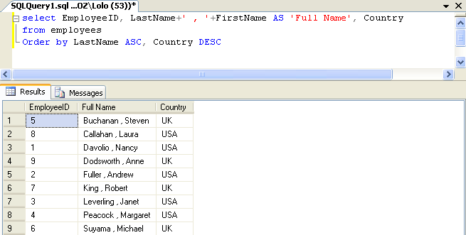
Aliases (as)

Slide 64
Distinct
eliminates duplicate row values from the results
Example : the Next Slide

Slide 65
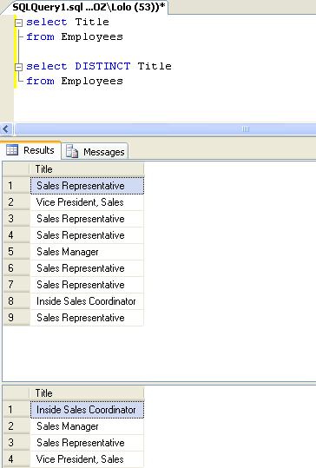
Example: Distinct

Slide 66
Grouping Data

Slide 67
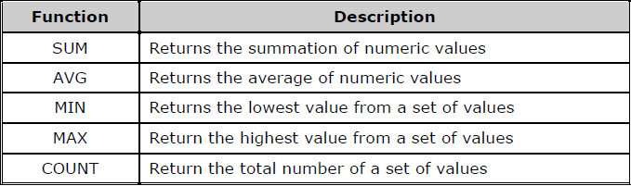
Grouping Functions

Slide 68
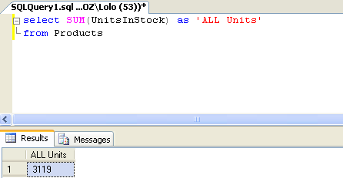
Example 1: SUM

Slide 69
Example 2 : SUM

Slide 70
Group By
Definition
  used to divide the rows in a table into smaller groups
Syntax
SELECT * | column1, group_function (column2), …….
FROM table
[WHERE conditions]
[GROUP BY column1, ……..]
[ORDER BY column1 [, column2, ……..] ASC, DESC]

Slide 71
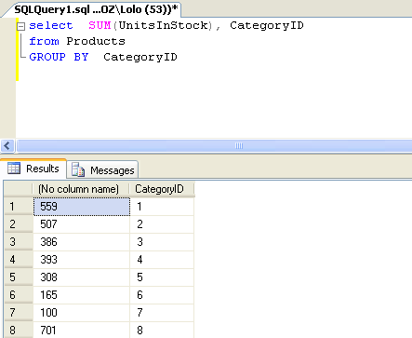
Example : Group By

Slide 72
Having
Definition
  used to restrict the group results
Syntax
SELECT * | column1, group_function (column2), …….
FROM table
[WHERE conditions]
[GROUP BY column1, ……..]
HAVING [conditions]
[ORDER BY column1 [, column2, ……..] ASC, DESC]

Slide 73
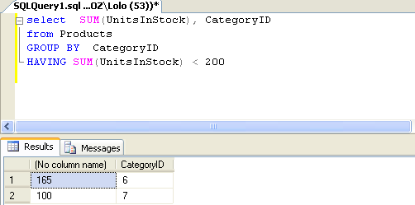
Example : Having

Slide 74
SQL Operators

Slide 75
Using SQL Operators
Arithmetic operators
Comparison operators
Logical operators
Set Operators
Other operators

Slide 76
Arithmetic operators
addition (+)
subtraction (-)
multiplication (*)
division (/).

Slide 77
Comparison operators
compare two or more values
Description | Operator
Equal | =
Lease than | <
Greater than | >
Less than or equal | <=
Greater than or equal | >=
Not Equal | <>

Slide 78
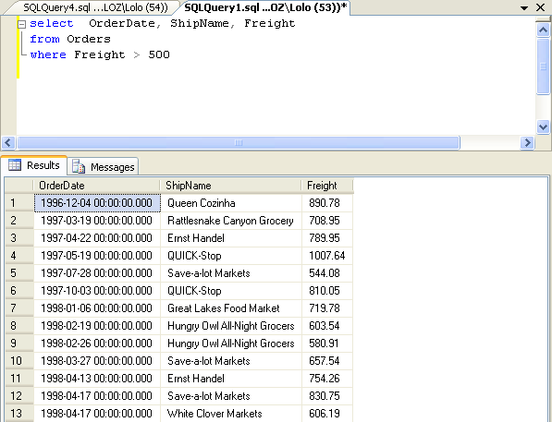
Example

Slide 79
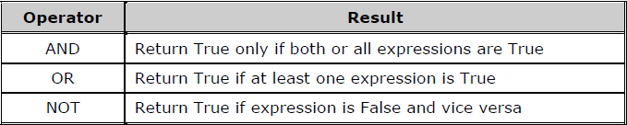
Logical operators
Used to get a logical value (True or False)

Slide 80
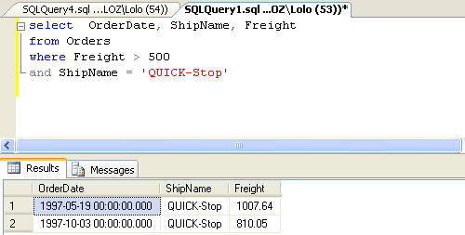
Example

Slide 81
Set Operators
Definition
  combine the results of two or more queries into one result
Keywords
  UNION/ UNION ALL
  INTERSECT
  EXCEPT

Slide 82
UNION & Intersect & Except
EmpLacation
Egypt
Canada
Egypt
VacLocation
Egypt
Canada
France
Union
Egypt
Canada
France
Intersect
Egypt
Canada
Except
France

Slide 83
Union Operator
Create a Single Result Set from Multiple Queries
Each Query Must Have:
  Similar data types
  Same number of columns
  Same column order in select list
USE northwind
SELECT (firstname + ' ' + lastname) AS name
,city, postalcode
FROM employees
UNION
SELECT companyname, city, postalcode
FROM customers
GO

Slide 84
INTERSECT Operator
Definition
  returns only the records that have the same values in the selected columns in both tables.
Syntax
USE northwind
SELECT (firstname + ' ' + lastname) AS name
,city, postalcode
FROM employees
INTERSECT
SELECT companyname, city, postalcode
FROM customers
GO

Slide 85
EXCEPT Operator
Definition
  return rows returned by the first query that are not present in the second query
Syntax
USE northwind
SELECT (firstname + ' ' + lastname) AS name
,city, postalcode
FROM employees
EXCEPT
SELECT companyname, city, postalcode
FROM customers
GO

Slide 86
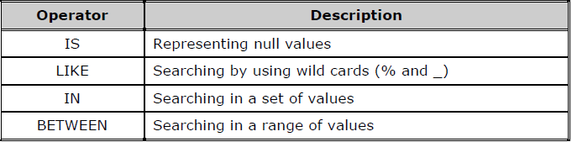
Other operators

Slide 87
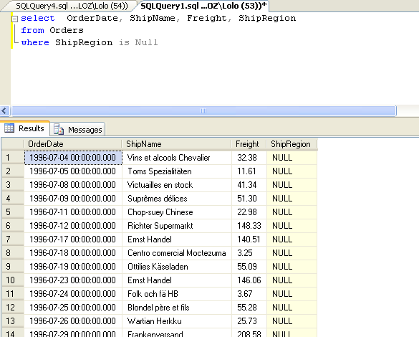

Slide 88
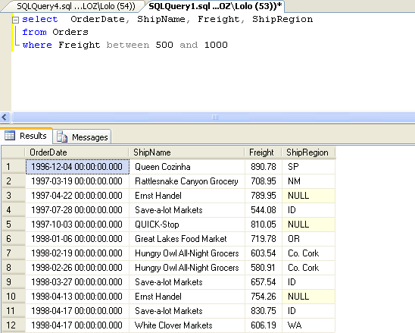

Slide 89
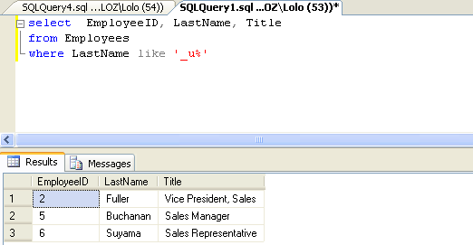

Slide 90
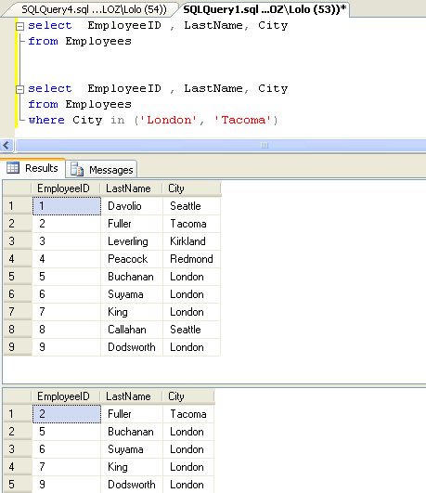

Slide 91
Joining Data

Slide 92
Using Aliases for Table Names
Example 1 (without an alias name)
Example 2 (with an alias name)
USE joindb
SELECT buyer_name, sales.buyer_id, qty
FROM buyers INNER JOIN sales
ON buyers.buyer_id = sales.buyer_id
GO
USE joindb
SELECT buyer_name, s.buyer_id, qty
FROM buyers AS b INNER JOIN sales AS s
ON b.buyer_id = s.buyer_id
GO
This slide from 2071b from Microsoft

Slide 93
Combining Data from Multiple Tables
Introduction to Joins
Using Inner Joins
Using Outer Joins
Using Cross Joins
Joining More Than Two Tables
Joining a Table to Itself

Slide 94
Introduction to Joins
Selects Specific Columns from Multiple Tables
  JOIN keyword specifies that tables are joined and how to join them
  ON keyword specifies join condition
Queries Two or More Tables to Produce a Result Set
  Use primary and foreign keys as join conditions
  Use columns common to specified tables to join tables

Slide 95
Inner Join
Definition
  return rows only when there is at least one row from both tables that matches the join condition
Syntax
SELECT <select list>
FROM table1 inner join table2
ON (table1.column1 = table2.column2)

Slide 96
Using Inner Joins
USE joindb
SELECT buyer_name, sales.buyer_id, qty
FROM buyers INNER JOIN sales
ON buyers.buyer_id = sales.buyer_id
GO
Example 1
buyers
sales
buyer_name
buyer_id
buyer_id
prod_id
qty
Adam Barr
1
1
2
15
Sean Chai
2
1
3
5
Eva Corets
3
4
1
37
Erin O’Melia
4
3
5
11
Result
4
2
1003
buyer_name
buyer_id
qty
Adam Barr
1
15
Adam Barr
1
5
Erin O’Melia
4
37
Eva Corets
3
11
Erin O’Melia
4
1003

Slide 97
Left Outer Join
Definition
    includes all rows in the left table in the results whether or not there are matching values on the common column in the right table. in addition to the matching values in Both table.
    In other words: All rows from the Left table are returned
Syntax
SELECT <select list>
FROM table1 left outer join table2
ON (table1.column1 = table2.column2)

Slide 98
Using Outer Joins
USE joindb
SELECT buyer_name, sales.buyer_id, qty
FROM buyers LEFT OUTER JOIN sales
ON buyers.buyer_id = sales.buyer_id
GO
Example 1
buyers
sales
buyer_name
buyer_id
buyer_id
prod_id
qty
Adam Barr
1
1
2
15
Sean Chai
2
1
3
5
Eva Corets
3
4
1
37
Erin O’Melia
4
3
5
11
Result
4
2
1003
buyer_name
buyer_id
qty
Adam Barr
1
15
Adam Barr
1
5
Erin O’Melia
4
37
Eva Corets
3
11
Erin O’Melia
4
1003
Sean Chai
NULL
NULL

Slide 99
Right Outer join
Definition
  the reverse of LEFT OUTER joins
  All rows from the right table are returned
    Null values are returned for the left table any time a right table row has no matching row in the left table.
Syntax
SELECT <select list>
FROM table1 right outer join table2
ON (table1.column1 = table2.column2)

Slide 100
Full Join
returns all the rows from the left table , and all the rows from the right table
Also it returns rows in the left table that do not have matches in the right table, or if there are rows in right table that do not have matches in the left table.

Slide 101
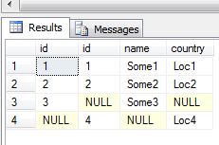
Name | ID
Some1 | 1
Some2 | 2
Some3 | 3
Country | ID
Loc1 | 1
Loc2 | 2
Loc4 | 4
SELECT a.id ,b.id, a.name , b.country
FROM LeftTable as a
Full Join RightTable as b
On a.id = b.id
Full Join

Slide 102
Self- Join
Definition
  Join table with it self
Syntax
SELECT a.column , b.column
FROM Table1 as a
JOIN Table1 as b
ON a.column = b.column

Slide 103
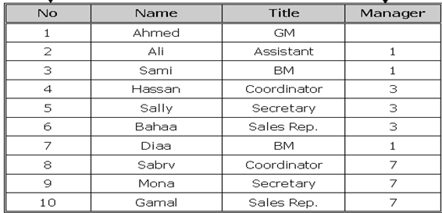
Problem
I want Every Employee Name with his Manager

Slide 104
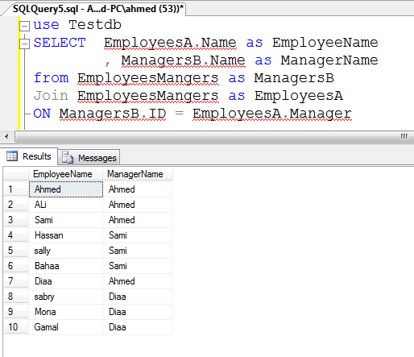
Solution

Slide 105
Cross Join
return all rows from both tables
Each row from the left table is combined with all rows from Second Table
the number of rows in the left table multiplied by the number of rows in the right table.
  Table1 >> 2 rows,
  Table2 >> 5 rows,
  Result >>10 rows
Example :
  Possible ways

Slide 106
Name
Ali
Islam
Country
Egypt
Cairo
Country | Name
Egypt | Ali
Cairo | Ali
Egypt | Islam
Cairo | Islam
Cross Join

Slide 107
Using Cross Joins
USE joindb
SELECT buyer_name, qty
FROM buyers
CROSS JOIN sales
GO
Example 1
buyers
sales
Result
buyer_id
buyer_name
buyer_id
prod_id
qty
buyer_name
qty
1
Adam Barr
1
2
15
Adam Barr
15
2
Sean Chai
1
3
5
Adam Barr
5
3
Eva Corets
4
1
37
Adam Barr
37
4
Erin O’Melia
3
5
11
Adam Barr
11
4
2
1003
Adam Barr
1003
Sean Chai
15
Sean Chai
5
Sean Chai
37
Sean Chai
11
Sean Chai
1003
Eva Corets
15
...
...

Slide 108
Example
All of the possible ways that suppliers can ship their products

Slide 109
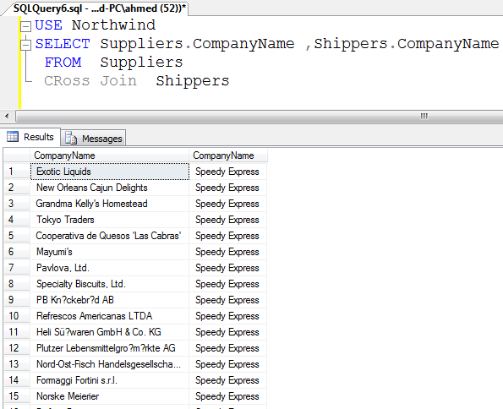

Slide 110
Data Manipulation Language

Slide 111
Inserting Data

Slide 112
INSERT Statement
Definition
  is responsible for adding a new row into the table
Syntax
INSERT [INTO] table
[column1, column2, ………..]
VALUES (value1, value2, ………….. )

Slide 113
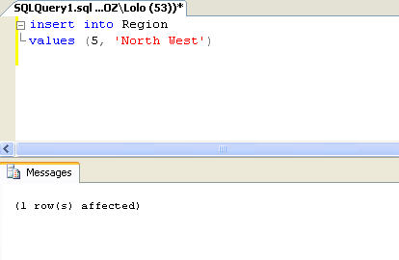
Example 1
Inserting Data without columns name

Slide 114
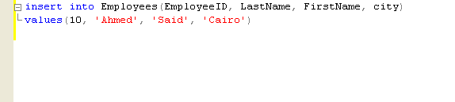
Example 2
Inserting Data with columns name
Note: You can verify the result by write SELECT statement.

Slide 115
The SELECT INTO statement
SELECT …… <select_list>
INTO <new_table>
FROM <table_name>
[WHERE <search_condition>]

Slide 116
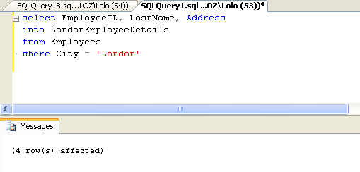
Example

Slide 117
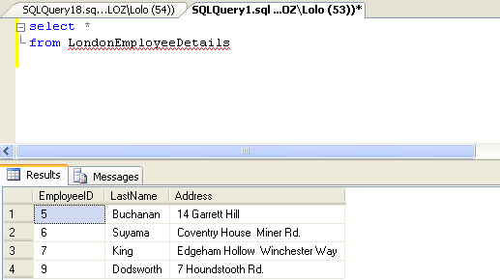
verify the result

Slide 118
Updating and Deleting Data

Slide 119
Update Statement
Definition :
  is responsible for modifying the existing data in the table
Syntax
Note :
  What happened without where ?
UPDATE <table>
SET column1 = value1 [, column2 = value2, ……]
WHERE [conditions]

Slide 120
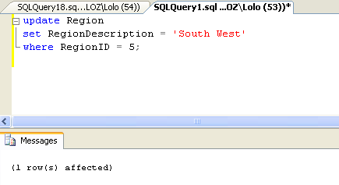
Example

Slide 121
Delete Statement
Definition
  is responsible for removing an existing data from the table
Syntax
Note :
  What happened without Where ?
DELETE <table>
WHERE [conditions]

Slide 122
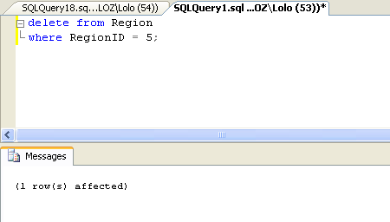
Example

Slide 123
Truncate Statement
Definition:
  removes all rows from a table
Syntax
TRUNCATE Table <table>

Slide 124
MERGE statement
Definition
  is new statement in SQL Server 2008
  INSERT, UPDATE, and DELETE in a single statement . Based on Condition

Slide 125
Merge Syntax
MERGE INTO table_name table_alias
USING (table|view|sub_query) alias
ON (join condition)
WHEN MATCHED THEN
UPDATE SET
col1 = col_val1,
col2 = col2_val
WHEN NOT MATCHED THEN
INSERT (column_list)
VALUES (column_values);

Slide 126
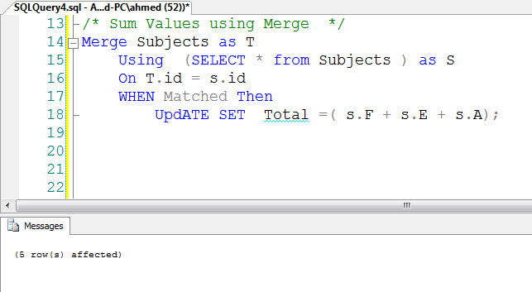
Example1 : Subjects Total

Slide 127
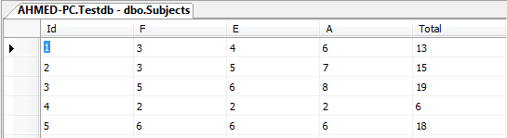
Result

Slide 128
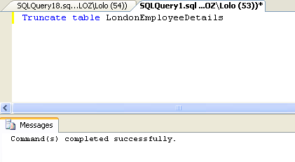
Example

Slide 129
Data Definition Language
&
Working with Tables

Slide 130
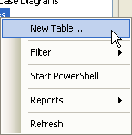
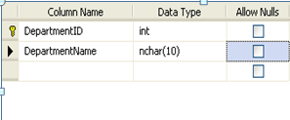
Creating Table
Creating a new table
    Using User Interface

Slide 131
CREATE TABLE statement
Definition
  create new tables
Syntax
CREATE TABLE <table_name>
(
column1 datatype ,
column2 datatype ,
...............
(

Slide 132
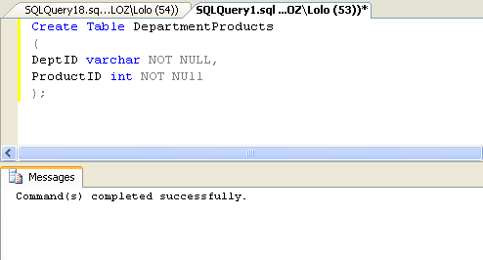
Example

Slide 133
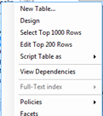
Modifying Tables
Altering an existing table
  Using User Interface

Slide 134
ALTER TABLE statement
Definition : modify existing tables
Syntax
Add Column
ALTER TABLE <table_name>
Add colum_name datatype
Modify Column
ALTER TABLE <table_name>
ALTER COLUMN colum_name datatype
Drop Column
ALTER TABLE <table_name>
DROP COLUMN colum_name datatype

Slide 135

Example: Add Column

Slide 136

Example: Modify column
Disallow null , and decrease length

Slide 137

Example: Drop Column

Slide 138

Removing Tables
Dropping an existing table

Slide 139

Example : Drop Table

Slide 140
DROP TABLE statement
Definition
  drop existing tables
Syntax
Note : Don’t forget to Press Refresh
DROP TABLE <table_name>

Slide 141
Working with Views

Slide 142
View Description
Definition
  is simply a SELECT statement that has been given a name and stored in a database
Advantages
  Restricting data access
  Making complex queries easy

Slide 143
Create View
Syntax
Example :
CREATE VIEW <view_name>
AS <select_statement>
Create View LondonEmployees
as
SELECT EmloyeeId , LastName , FirstName ,City , Address
FROM Employees

Slide 144


Slide 145

Alter View

Slide 146
WITH CHECK OPTION
Any changes to View that may cause a record disappear from the view , will raises runtime error .
Example :
Create view SomeOrders
as
SELECT * FROM Orders where Orders.ShipCity = 'London‘
With Check Option

Slide 147

Drop View

Slide 148
Working with Constraints

Slide 149
Constraint Types
Column- level constraints
Table-level constraints

Slide 150

Dealing with Constraints
Creating tables with constraints

Slide 151

Example: Relationship

Slide 152

Inserting Data

Slide 153

Violating constraints

Slide 154

Example: Enter ID Not Exists

Slide 155

Example: TraineeName Not Null

Slide 156

Example

Slide 157

Adding and dropping constraints
add a new constraint

Slide 158

drop a constraint

Slide 159
Dealing with Databases

Slide 160
Creating Databases
Create a new Database >> New Database
Attach Existing Database >> Attach

Slide 161
Moving Database
removes the database entry from the instance
closes all files associated to the database
releases all operating system locks
Detaching a database

Slide 162

Detaching a database

Slide 163
Database Diagrams
Definition
  Database diagrams graphically show the structure of the database
Create One
  Select your database from the Databases node in the Object Explorer.
  Right-click the Database Diagrams folder.
  Select the New Database Diagram

Slide 164

Step 2 : Adding Table

Slide 165

Step 3 : drag and Drop

Slide 166


Slide 167
Interacting with Scripts

Slide 168

Generating database scripts

Slide 169

Generating table scripts

Slide 170

Saving and loading script files
Files with Extension (.sql )
  Example : script1.sql

Slide 171
Using Database Tools

Slide 172

Backing up a database

Slide 173

Restoring a database

Slide 174
Database Transactions

Slide 175
Transaction
Transaction :
  a sequence of operations performed as a single logical unit of work.
  all of its data modifications are performed or none of them is performed.

Slide 176
Starting Transaction
Autocommit transactions
    The default for SQL Server
    Each individual DML or DDL statement is committed when it Completes
    You do not have to specify any statements to control transactions
Implicit transactions
  SET IMPLICIT_TRANSACTIONS ON
  Each Transact-SQL statement (INSERT,UPDATE,DELETE) execute as a Transaction
Explicit transactions
  Starting with BEGIN TRANSACTION Statement

Slide 177
Ending Transaction
Successful : The COMMIT statement.
Error : The ROLLBACK statement .

Slide 178
Errors during transaction processing
Fatal Error >> automatically Rollback
  If it prevents the successful completion of a transaction
Non Fatal Error >> need to Check @@Error
  constraint violation (Check Constraint )

Slide 179

Example

Slide 180

Begin Transaction

Slide 181


Slide 182
Save Point
Definition
  Define a location to which a transaction can return
  like save point in any game
Syntax
SAVE TRANSACTION <savepoint_name>
ROLLBACK TRANSACTION <savepoint_name>

Slide 183

Step1 : Saving transactions Point

Slide 184

STEP 2 : already deleted

Slide 185

Step 3 : Rollback to Save point

Slide 186

Step4 : Check if it Deleted

Slide 187
Basic Concepts of Stored Procedure

Slide 188
Stored procedure definition
You Can :
    Contains Statement that Perform Operations
    Accept input Parameters
    Return Status Value
      success or failure
    Return Multiple Output parameters

Slide 189
Stored procedure benefits
They are registered (permanently stored) at the server.
They can have security attributes (such as permissions).
They can enhance the security of your application.
They allow modular programming.
They are named code and so they allow repeating execution.
They can reduce network traffic.

Slide 190
Stored procedure types
User-defined stored procedures
System stored procedures

Slide 191
Using the CREATE PROCEDURE statement
Syntax
CREATE PROC | PROCEDURE <procedure_name>
[@parameter data_type]
AS <sql_statement>

Slide 192

Example

Slide 193

EXECUTE

Slide 194
Using the ALTER PROCEDURE statement
Syntax
ALTER PROC | PROCEDURE <procedure_name>
[@parameter data_type]
AS <sql_statement>

Slide 195

Using the DROP PROCEDURE statement
Syntax
DROP PROC | PROCEDURE <procedure_name>

Slide 196
Working with Functions

Slide 197
Basic Concepts of Functions
Function definition
  Like functions in programming languages
  accept parameters
  perform an action
  return the result of that action as a value
Function benefits
  They allow modular programming.
  They allow faster execution.
  They always return a value to the calling program.

Slide 198
Function types
User-defined scalar functions
Built-in Functions

Slide 199
Creating and Calling Functions

Slide 200
Using the CREATE FUNCTION statement
Syntax
CREATE FUNCTION <function_name>
[(@parameter data_type)]
RETURNS return_data_type | table
[AS]
BEGIN
function_code
RETURN scalar_expression | select statement
END

Slide 201

Creating a Scalar-Valued function

Slide 202

Return the result

Slide 203
Exercise 1
Create “Say Hello” function

Slide 204
Exercise 2
Create a function to replace Null Value with words ‘Not Applicable’

Slide 205
Creating a Table-Valued function
Definition
  specifies TABLE as a return data type
In other words
  returns a SELECT statement rather than a single value

Slide 206

Example: Creating

Slide 207

Display the result

Slide 208

Creating a Multi-statement Table-Valued function

Slide 209


Slide 210
Modifying and Removing Functions
Using the ALTER FUNCTION statement
  Syntax
ALTER FUNCTION <function_name>
[(@parameter data_type)]
RETURNS return_data_type
[AS]
BEGIN
function_code
RETURN scalar_expression
END

Slide 211

Using the DROP FUNCTION command
Syntax
DROP FUNCTION <function_name>

Slide 212
Working with Triggers

Slide 213
Trigger definition and types
Definition
  a special type of stored procedure.
  Invoked automatically
  Not called directly
Types
  DDL triggers
  DML triggers

Slide 214
DML trigger benefits
They can query other tables and include complex Transact-SQL statements
They can reference columns in other tables
with more complex than check

Slide 215
Managing INSTEAD OF triggers
Definition
  override the standard actions
Syntax
CREATE TRIGGER <trigger_name> on <table | view>
INSTEAD OF INSERT | UPDATE | DELETE
AS
BEGIN
<trigger_code>
END

Slide 216
Creating INSTEAD OF triggers
INSTEAD OF INSERT triggers
INSTEAD OF UPDATE triggers
INSTEAD OF DELETE triggers

Slide 217

Example 1 :
Create a trigger that protects all the data in the Course table from deletion

Slide 218

Test the result

Slide 219

Example: create trigger that insert new trainee when inserting new course

Slide 220

Test it

Slide 221


Slide 222

Modifying and removing triggers
Alter and Drop statements
  Example : Drop trigger

Slide 223
Let us Begin
This is not every thing about Transact-SQL
This is just an introduction
May you read :
  2071B Book (Querying MS SQL Server with Transact-SQL )
  2073A Book(Programming MS SQL Server Database)
  MSDN : http://msdn.microsoft.com/en-us/library/aa299742(v=SQL.80).aspx
  Google

