Slide 1
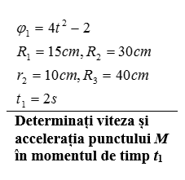


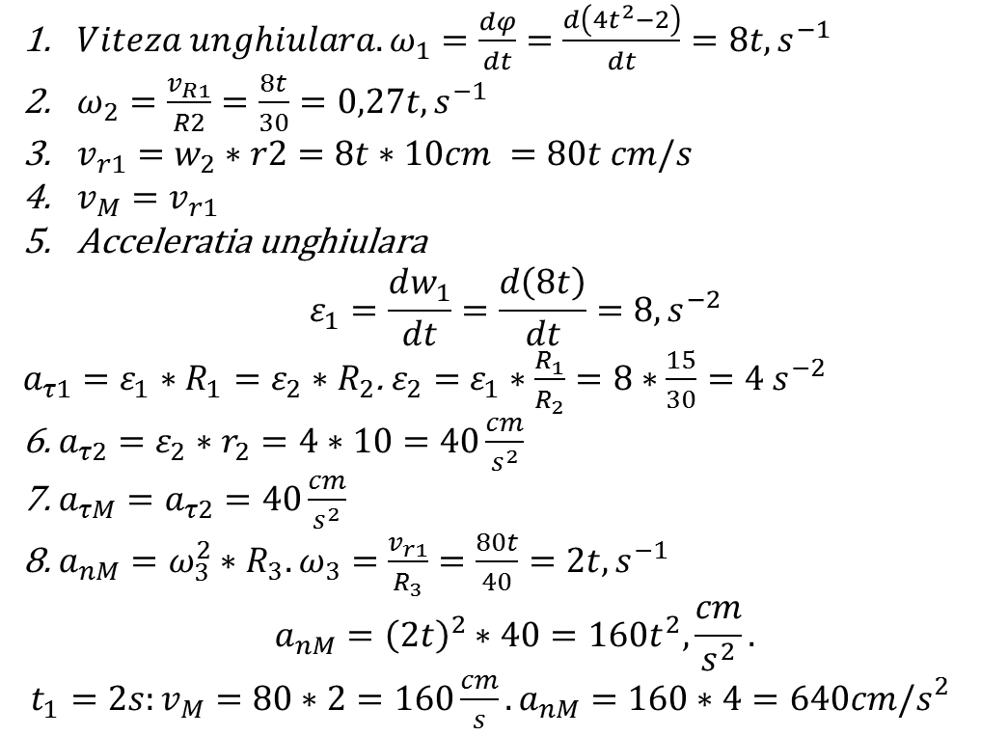
$$ω=\frac{v}{R}$$
$$ω =\frac{dφ}{dt}$$
$$ε_{2}$$
$${\vec{v}}_{M}$$
$$ε_{1}$$
$${\vec{a}}_{τM}$$
$$w_{2}$$
$$ε=\frac{dω}{dt}$$
$$w_{1}$$
$${\vec{v}}_{R1}$$
$$a_{τ}=ε∗R$$
$$a_{n}=w^{2}∗R$$
$$R_{2}$$
$$R_{3}$$
$${\vec{a}}_{τ1}$$
$Viteza unghiulara. ω_{1}=\frac{dφ}{dt}=\frac{d\left(4t^{2}−2\right)}{dt}=8t, s^{−1}$
$ω_{2}=\frac{v_{R1}}{R2}=\frac{8t}{30}=0,27t,s^{−1}$
$v_{r1}=w_{2}∗r2=8t∗10cm =80t cm/s$
$v_{M}=v_{r1}$
Acceleratia unghiulara
$$ε_{1}=\frac{dw_{1}}{dt}=\frac{d\left(8t\right)}{dt}=8, s^{−2}$$
$a_{τ1}=$ $ε_{1}∗R_{1}=ε_{2}∗R_{2}$. $ε_{2}=$ $ε_{1}∗\frac{R_{1}}{R_{2}}=8∗\frac{15}{30}=4 s^{−2}$
6. $a_{τ2}=$ $ε_{2}∗r_{2}=4∗10=40\frac{cm}{s^{2}}$
7. $a_{τM}=a_{τ2}=40\frac{cm}{s^{2}}$
8. $a_{nM}=ω_{3}^{2}∗R_{3}. ω_{3}=\frac{v_{r1}}{R_{3}}=\frac{80t}{40}=2t, s^{−1}$
$$a_{nM}={\left(2t\right)}^{2}∗40=160t^{2},\frac{cm}{s^{2}}.$$
${t_{1}=2s:v_{M}=80∗2=160\frac{cm}{s}. a_{nM}=160∗4=640cm/s_{}^{2}}_{}$
$$r_{2}$$
$${\vec{a}}_{τ2}$$
$${\vec{v}}_{r1}$$

Slide 2
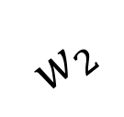
$${\vec{v}}_{R2}$$
$$w_{3}$$
$$w_{2}$$
$${\vec{v}}_{M}$$
$${\vec{v}}_{1}$$
$${\vec{v}}_{1}$$

Slide 3
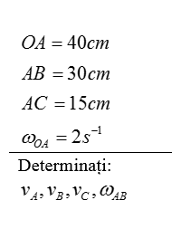
P
$$w_{AB}$$
$${\vec{v}}_{A}$$
30 cm
33,5 cm
$$v_{A}=ω_{OA}∗OA=2s^{−1}∗40cm=80cm/s$$
$$v_{A}\cos\left(α\right)=v_{B}\cos\left(β\right)$$
$${\vec{v}}_{C}$$
$$80∗\cos\left(0\right)=v_{B}∗\cos\left(45\right).;v_{B}=\frac{80}{0.71}=112,7cm/s$$
Teorema despre CIV
$$β$$
$$\frac{v_{A}}{AP}=\frac{v_{B}}{BP}=\frac{v_{C}}{CP}=ω_{AB}→$$
$${\vec{v}}_{B}$$
$ω_{AB}=\frac{v_{A}}{AP}=\frac{80}{30}=2,67 rad/sec$
2. ${v_{C}}_{}=ω_{AB}∗CP.CP=\sqrt{AP^{2}+AC^{2}}=\sqrt{900+225}=33,5cm$
3. $v_{C}=2,67∗33,5=89,45cm/s$
4. $v_{B}=ω_{AB}∗BP.BP= \sqrt{AP^{2}+AB^{2}}$= $\sqrt{900+900}$=42cm
$v_{B}=ω_{AB}∗BP$=2,67*42 = 112,14 cm/s

Slide 4
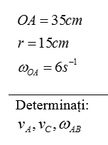
$${\vec{v}}_{C}$$
$${\vec{v}}_{A}$$
$$w_{AB}$$
$$v_{A}=ω_{OA}∗OA=6s^{−1}∗35cm=210cm/s$$
Teorema despre CIV
P
$$\frac{v_{A}}{AP}=\frac{v_{C}}{CP}=ω_{AB}→$$
$${1.v}_{C}=ω_{AB}∗CP;CP=\sqrt{r^{2}+r^{2}−2rrcos\left(135\right)}$$
$$CP=r\sqrt{1+1+2cos\left(45\right)}=15∗1,85=27,8cm$$
$${2. ω}_{AB}=\frac{v_{A}}{AP}=\frac{210}{15}=14s^{−1}\left(\frac{rad}{s}\right)$$
$$v_{C}=ω_{AB}∗CP=14∗27,8=389,2cm/s$$

Slide 5
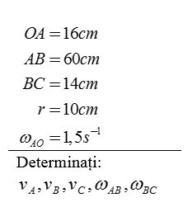
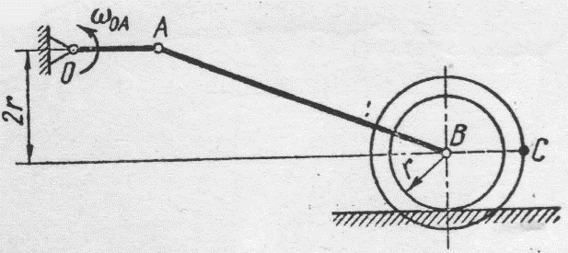

$${\vec{v}}_{A}$$
$$α$$
$$w_{AB}$$
P1
$${\vec{v}}_{C}$$
$$β$$
Teorema despre proiectii
$${\vec{v}}_{B}$$
$$v_{A}\cos\left(α\right)=v_{B}\cos\left(β\right)$$
Teorema despre CIV
P2
P1: $\frac{v_{A}}{AP1}=\frac{v_{B}}{BP1}=ω_{AB}$
P2: $\frac{v_{B}}{BP2}=\frac{v_{C}}{CP2}=ω_{BC}$
$$w_{BC}$$

Slide 6
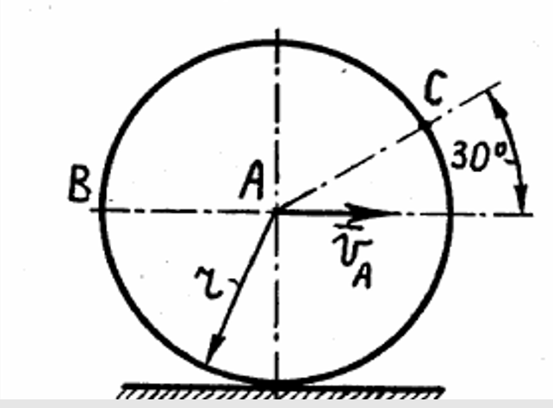
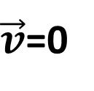
$${\vec{v}}_{B}$$
$$\frac{v_{A}}{AP}=\frac{v_{B}}{BP}=\frac{v_{C}}{CP}=ω$$
$${\vec{v}}_{C}$$
P
$\vec{v}$=0
$$ω$$

