Slide 1





Chapter 9:
The Client/Server Database Environment
Modern Database Management 6th Edition
Jeffrey A. Hoffer, Mary B. Prescott, Fred R.
McFadden
1
© Prentice Hall, 2002

Slide 2

Client/Server Systems
Networked computing model
Processes distributed between clients and servers
Client – Workstation (usually a PC) that requests and uses a service
Server – Computer (PC/mini/mainframe) that provides a service
For DBMS, server is a database server

Slide 3
Application Logic in C/S Systems
Presentation Logic
Input – keyboard/mouse
Output – monitor/printer
Processing Logic
I/O processing
Business rules
Data management
Storage Logic
Data storage/retrieval
GUI Interface
Procedures, functions, programs
DBMS activities

Slide 4

Client/Server Architectures
File Server Architecture
Client does extensive processing
Database Server Architecture
Three-tier Architecture
Client does little
processing

Slide 5


File Server Architecture
All processing is done at the PC that requested the
data
FAT CLIENT
Entire files are transferred from the server to the client for processing.
Problems:
Huge amount of data transfer on the network
Each client must contain full DBMS
  Heavy resource demand on clients
  Client DBMSs must recognize shared locks, integrity checks, etc.

Slide 6

Figure 9-2 – File Server Architecture
FAT CLIENT

Slide 7

Database Server Architectures
2-tiered approach Client is responsible for
I/O processing logic
Some business rules logic
Server performs all data storage and access processing
➔ DBMS is only on server
Advantages
Clients do not have to be as powerful
Greatly reduces data traffic on the network
Improved data integrity since it is all processed centrally
Stored procedures ➔ some business rules done on server

Slide 8


Advantages of Stored Procedures
Compiled SQL statements Reduced network traffic Improved security Improved data integrity Thinner clients

Slide 9
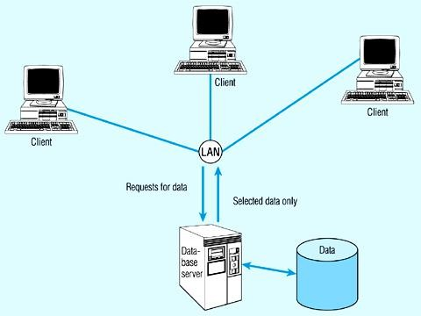




Figure 9-3 – Database server architecture
Thinner clients
DBMS only on server

Slide 10



Three-Tier Architectures
Three layers:
Client
Application server
Database server
GUI interface (I/O processing)
Browser
Web Server
Business rules
Data storage
DBMS
Thin Client
  PC just for user interface and a little application processing. Limited or no data storage (sometimes no hard drive)

Slide 11
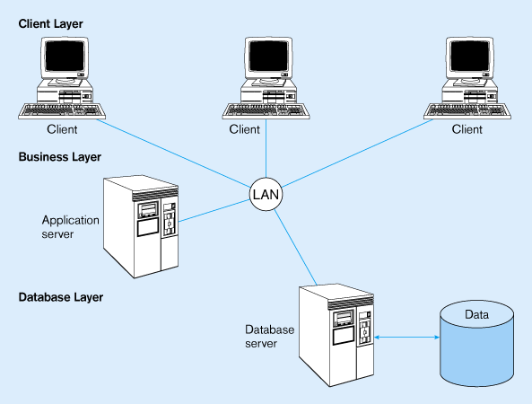






Figure 9-4 -- Three-tier architecture
Thinnest clients
Business rules on separate server
DBMS only on DB server

Slide 12




Advantages of Three-Tier Architectures
Scalability Technological flexibility Long-term cost reduction
Better match of systems to business needs Improved customer service
Competitive advantage Reduced risk

Slide 13



Challenges of Three-tier Architectures
High short-term costs Tools and training Experience Incompatible standards
Lack of compatible end-user tools

Slide 14

Application Partitioning
Placing portions of the application code in different locations (client vs. server) AFTER it is written
Advantages
Improve performance
Improve interoperability
Balanced workloads

Slide 15

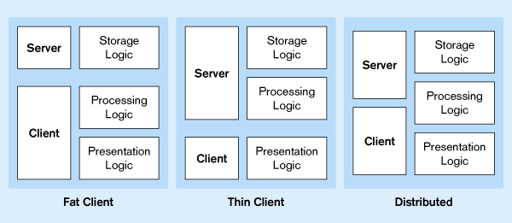
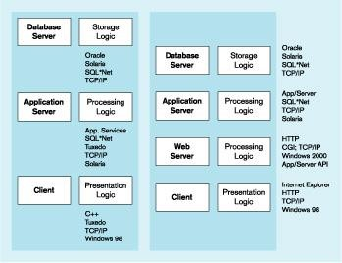
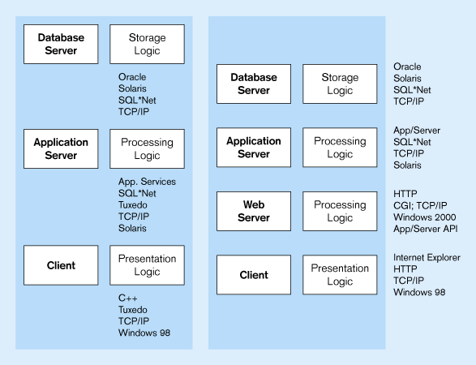
Processing Logic Distributions
2-tier distributions
Processing logic could be at client, server, or both
Processing logic will be at application server or Web server
n-tier distributions

Slide 16


Parallel Computer Architectures
Tightly Coupled
Symmetric Multiprocessing (SMP)
Multiple CPUs
Shared RAM
Loosely Coupled
Massively Parallel Processing (MPP)
Multiple CPUs
Each CPU has its own RAM space

Slide 17

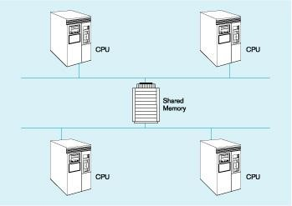
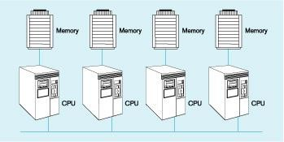
Parallel Computer Architectures
Figure 9-6 –
Tightly-coupled – CPUs share common memory space
Figure 9-7 –
Loosely-coupled – CPUs each have their own memory space

Slide 18


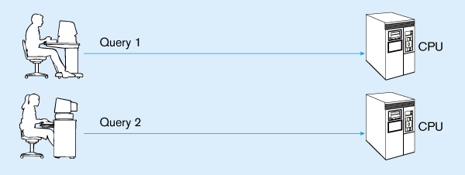
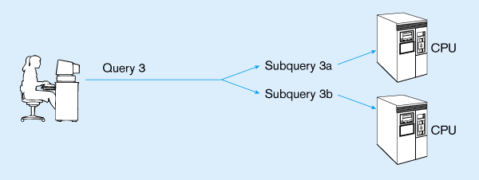
Query Processing with Parallel Processors
Figure 9-5(a) – Parallel transactions
Figure 9-5(b) –
Parallel query

Slide 19





Middleware
Software which allows an application to
interoperate with other software
No need for programmer/user to understand internal processing
Accomplished via Application Program Interface (API)
The “glue” that holds client/server applications together

Slide 20

Types of Middleware
RPC – Remote Procedure Calls (RPC)
client makes calls to procedures running on remote computers
synchronous and asynchronous
Message-Oriented Middleware (MOM)
asynchronous calls between the client via message queues
Publish/Subscribe
push technology → server sends information to client when available
Object Request Broker (ORB)
Object-oriented management of communications between clients and servers
SQL-oriented Data Access
Middleware between applications and database servers

Slide 21

Database Middleware
ODBC – Open Database Connectivity
Most DB vendors support this
OLE-DB
Microsoft enhancement of ODBC
JDBC – Java Database Connectivity
Special Java classes that allow Java applications/applets to connect to databases

Slide 22

Client/Server Security
Network environment ➔ complex security issues
Security levels:
System-level password security
  for allowing access to the system
Database-level password security
  for determining access privileges to tables; read/update/insert/delete privileges
Secure client/server communication
  via encryption

Slide 23



Query-by-Example (QBE)
Direct-manipulation database language Graphical approach
Available in MS Access
MS Access translates QBE to SQL and vice versa
Useful for end-user database programming Good for ad hoc processing and prototyping

Slide 24
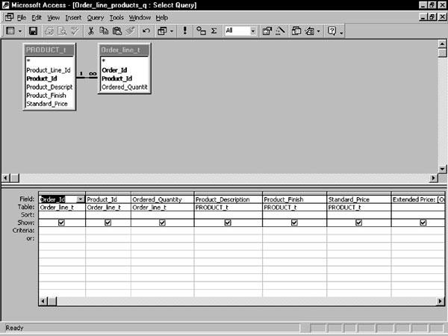
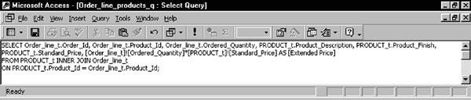
Figure 9-10: QBE view of a 2-table join query
Figure 9-12: Equivalent query in SQL

Slide 25
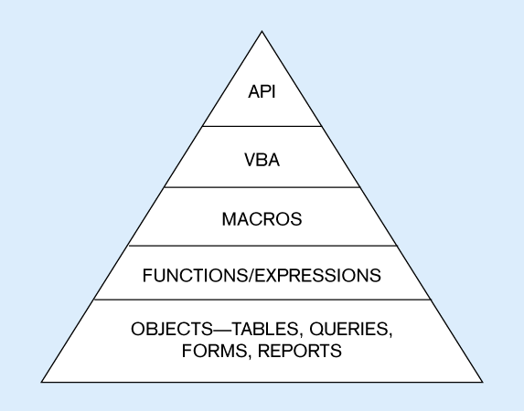
Figure 9-9: Access usability hierarchy
API to call functions in
DLLs external to MS Access
Visual Basic for
Applications…language for
customizing the application
Stored modules of pre- existing VBA code
Simple processes
Foundation of MS Access

Slide 26


Using ODBC to Link External Databases Stored on a Database Server
Open Database Connectivity (ODBC)
API that provides a common language for application programs to access and process SQL databases independent of the particular RDBMS that is accessed
Required parameters:
ODBC driver
Back-end server name
Database name
User id and password
Additional information:
Data source name (DSN)
Windows client computer name
Client application program’s executable name
Java Database Connectivity (JDBC) is similar to ODBC – built specifically for Java applications

Slide 27




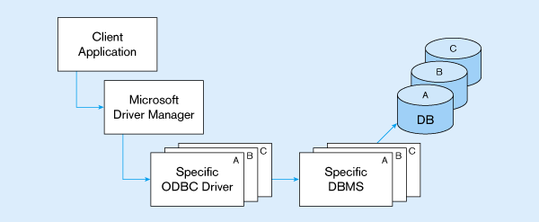
ODBC Architecture
(Figure 9-18)
Client does not need to know anything about the DBMS
Application Program Interface (API) provides common interface to all DBMSs
Each DBMS has its own ODBC-compliant driver

Slide 28

Visual Basic for Applications
VBA is the programming language that accompanies Access 2000
VBA provides these features:
Ability to perform complex functionality
Error handling
Faster execution than macros
Easier maintenance
OLE automation
Programmatic control
Ease of reading for programmers
Event-driven – nonprocedural programming that detects events and generates appropriate responses

