Slide 1
Chapter 8:
IP Addressing
Introduction to Networks
Notes:
Cisco Networking Academy program
Introduction to Networks
Chapter 8: IP Addressing

Slide 2
Chapter 8
8.0 Introduction
8.1 IPv4 Network Addresses
8.2 IPv6 Network Addresses
8.3 Connectivity Verification
8.4 Summary
Notes:
Chapter 8 Sections

Slide 3
Chapter 8: Objectives
Upon completion of this chapter, you will be able to:
Describe the structure of an IPv4 address.
Describe the purpose of the subnet mask.
Compare the characteristics and uses of the unicast, broadcast, and multicast IPv4 addresses.
Compare the use of public address space and private address space.
Explain the need for IPv6 addressing.
Describe the representation of an IPv6 address.
Describe types of IPv6 network addresses.
Configure global unicast addresses.
Describe multicast addresses.
Describe the role of ICMP in an IP network. (Include IPv4 and IPv6.)
Use ping and traceroute utilities to test network connectivity.
Notes:
Chapter 8 Objectives

Slide 4
8.1 IPv4 Network Addresses
Notes:
8.1 IPv4 Network Addresses

Slide 5
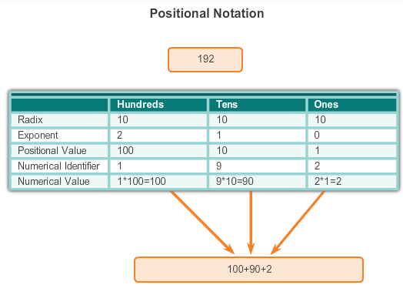
IPv4 Address Structure
Binary Notation
Binary notation refers to the fact that computers communicate in 1s and 0s
Positional notation - converting binary to decimal requires an understanding of the mathematical basis of a numbering system
Notes:
8.1.1.1 Binary Notation

Slide 6

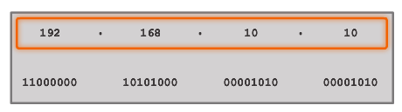


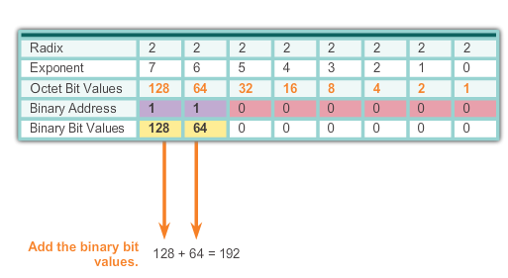
IPv4 Address Structure
Binary Number System
Notes:
8.1.1.2 Binary Number System

Slide 7


IPv4 Address Structure
Converting a Binary Address to Decimal
Practice
Notes:
8.1.1.3 Converting a Binary Address to Decimal

Slide 8
IPv4 Address Structure
Converting a Binary Address to Decimal
Practice
Answer = 176
Answer = 255
Notes:
8.1.1.3 Converting a Binary Address to Decimal

Slide 9
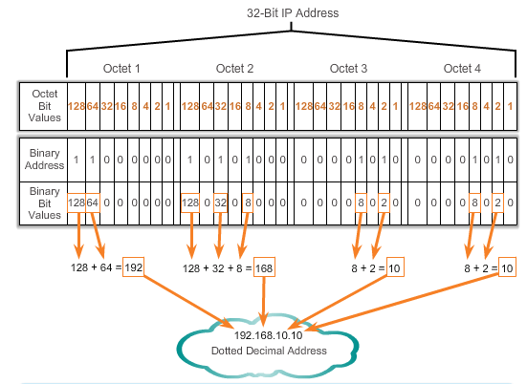
IPv4 Address Structure
Converting a Binary Address to Decimal
Notes:
Section 8.1.1.3 & 8.1.1.4 Converting a Binary Address to Decimal

Slide 10
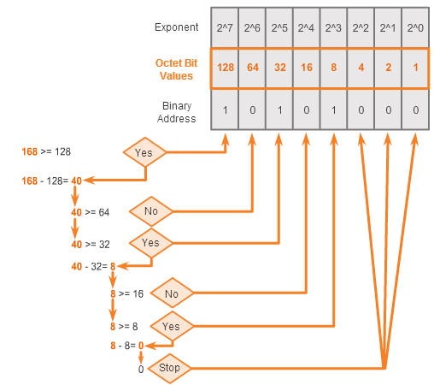
IPv4 Address Structure
Converting from Decimal to Binary
168 = ? binary
Notes:
8.1.1.5 Converting from Decimal to Binary

Slide 11
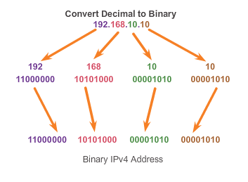
IPv4 Address Structure
Converting from Decimal to Binary (Cont.)
Notes:
8.1.1.6 Converting from Decimal to Binary (Cont.)

Slide 12
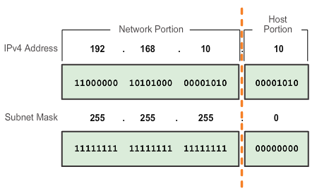
IPv4 Subnet Mask
Network Portion and Host Portion of an IPv4 Address
To define the network and host portions of an address, a devices use a separate 32-bit pattern called a subnet mask
The subnet mask does not actually contain the network or host portion of an IPv4 address, it just says where to look for these portions in a given IPv4 address
Notes:
8.1.2.1 Network Portion and Host Portion of an IPv4 Address

Slide 13
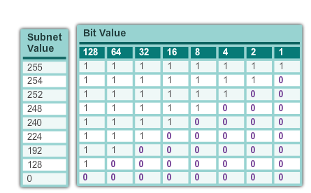
IPv4 Subnet Mask
Network Portion and Host Portion of an IPv4 Address (cont.)
Valid Subnet Masks
Notes:
8.1.2.1 Network Portion and Host Portion of an IPv4 Address (cont.)

Slide 14
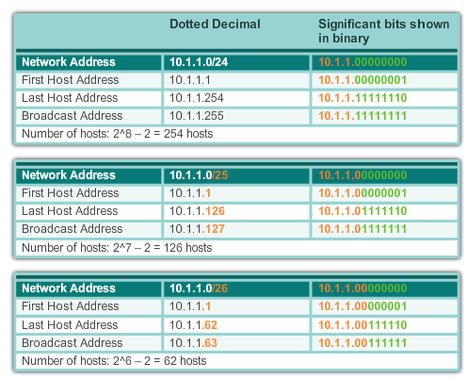
IPv4 Subnet Mask
Examining the Prefix Length
Notes:
8.1.2.2 Examining the Prefix Length

Slide 15
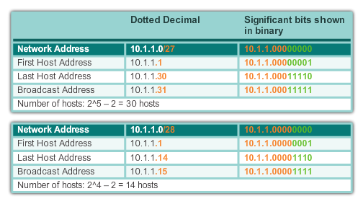
IPv4 Subnet Mask
Examining the Prefix Length (cont.)
Notes:
8.1.2.2 Examining the Prefix Length (cont.)

Slide 16
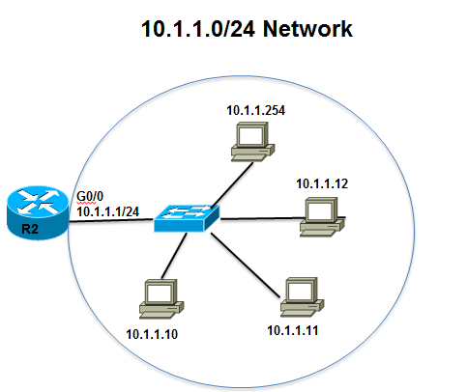
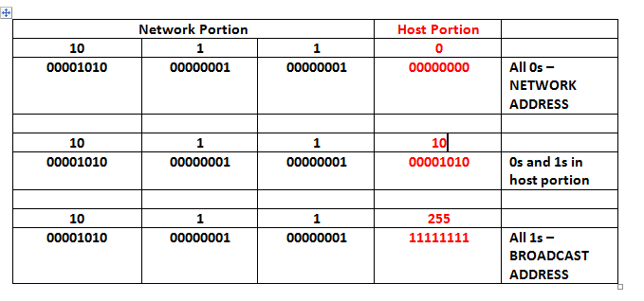
IPv4 Subnet Mask
IPv4 Network, Host, and Broadcast Address
10.1.1.0/24
Notes:
8.1.2.3 IPv4 Network, Host and Broadcast Address

Slide 17
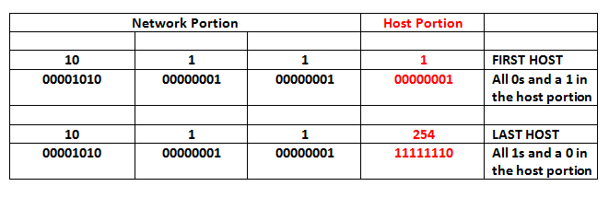
IPv4 Subnet Mask
First Host and Last Host Addresses
10.1.1.0/24
Notes:
8.1.2.4 First Host and Last Host Addresses

Slide 18
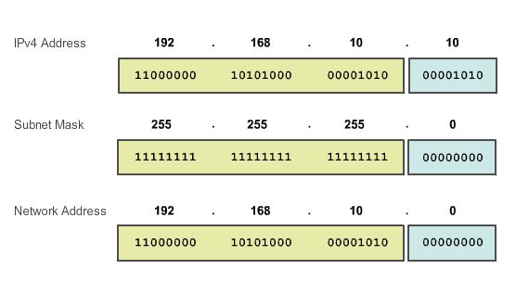
IPv4 Subnet Mask
Bitwise AND Operation
1 AND 1 = 1 1 AND 0 = 0 0 AND 1 = 0 0 AND 0 = 0
Notes:
8.1.2.5 and 8.1.2.6 Bitwise AND Operation/Importance of ANDing

Slide 19
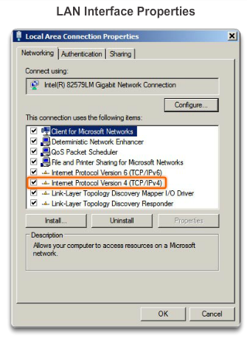
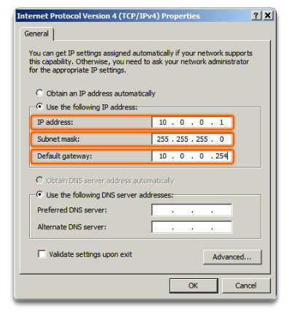
IPv4 Unicast, Broadcast, and Multicast
Assigning a Static IPv4 Address to a Host
LAN Interface Properties
Configuring a Static IPv4 Address
Notes:
8.1.3.1 Assigning a Static IPv4 Address to a Host

Slide 20
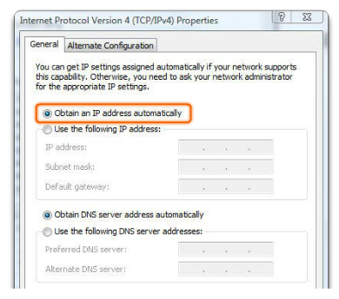
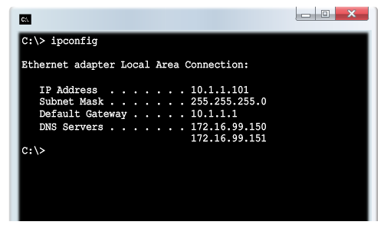
IPv4 Unicast, Broadcast, and Multicast
Assigning a Dynamic IPv4 Address to a Host
Verification
DHCP – The preferred method of assigning IPv4 addresses to hosts on large networks because it reduces the burden on network support staff and virtually eliminates entry errors.
Notes:
8.1.3.2 Assigning a Dynamic IPv4 Address to a Host

Slide 21
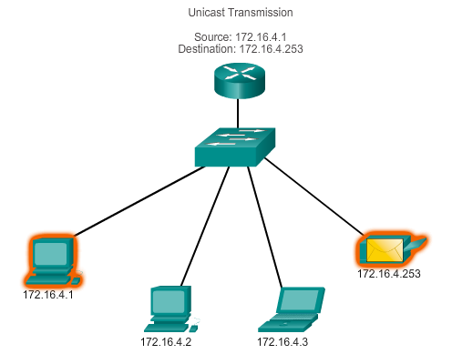
IPv4 Unicast, Broadcast, and Multicast
Unicast Transmission
In an IPv4 network, the hosts can communicate one of three different ways:
Unicast, Broadcast, and Multicast
#1 Unicast – the process of sending a packet from one host to an individual host.
Notes:
8.1.3.3 Unicast Transmission

Slide 22
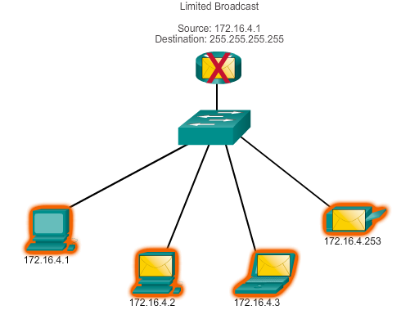
IPv4 Unicast, Broadcast, and Multicast
Broadcast Transmission
In an IPv4 network, the hosts can communicate one of three different ways: Unicast, Broadcast, and Multicast.
#2 Broadcast – the process of sending a packet from one host to all hosts in the network.
Directed broadcast
Destination 172.16.4.255
Hosts within the 172.16.4.0/24 network
NOTE: Routers do not forward a limited broadcast!
Directed broadcast
Destination 172.16.4.255
Hosts within the 172.16.4.0/24 network
Notes:
8.1.3.4 Broadcast Transmission

Slide 23
IPv4 Unicast, Broadcast, and Multicast
Multicast Transmission
In an IPv4 network, the hosts can communicate one of three different ways: Unicast, Broadcast, and Multicast.
#3 Multicast – The process of sending a packet from one host to a selected group of hosts, possibly in different networks.
Reduces traffic
Reserved for addressing multicast groups – 224.0.0.0 to 239.255.255.255.
Link local – 224.0.0.0 to 224.0.0.255 (Example: routing information exchanged by routing protocols)
Globally scoped addresses – 224.0.1.0 to 238.255.255.255 (Example: 224.0.1.1 has been reserved for Network Time Protocol)
Notes:
8.1.3.5 Multicast Transmission

Slide 24
Types of IPv4 Address
Public and Private IPv4 Addresses
Private address blocks are:
Hosts that do not require access to the Internet can use private addresses
  10.0.0.0 to 10.255.255.255 (10.0.0.0/8)
  172.16.0.0 to 172.31.255.255 (172.16.0.0/12)
  192.168.0.0 to 192.168.255.255 (192.168.0.0/16)
Shared address space addresses:
Not globally routable
Intended only for use in service provider networks
Address block is 100.64.0.0/10
Notes:
8.1.4.1 Public and Private IPv4 Addresses

Slide 25
Types of IPv4 Address
Special Use IPv4 Addresses
Network and Broadcast addresses – within each network the first and last addresses cannot be assigned to hosts
Loopback address – 127.0.0.1 a special address that hosts use to direct traffic to themselves (addresses 127.0.0.0 to 127.255.255.255 are reserved)
Link-Local address – 169.254.0.0 to 169.254.255.255 (169.254.0.0/16) addresses can be automatically assigned to the local host
TEST-NET addresses – 192.0.2.0 to 192.0.2.255 (192.0.2.0/24) set aside for teaching and learning purposes, used in documentation and network examples
Experimental addresses – 240.0.0.0 to 255.255.255.254 are listed as reserved
Notes:
8.1.4.3 Special Use IPv4 Addresses

Slide 26
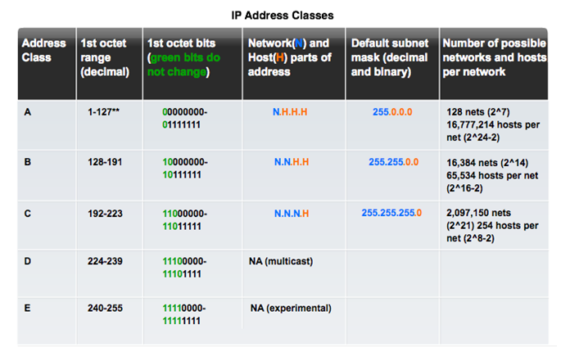
Types of IPv4 Address
Legacy Classful Addressing
See if updated graphic with top row in text case for consistency.
Notes:
8.1.4.4 Legacy Classful Addressing

Slide 27
Types of IPv4 Address
Legacy Classful Addressing (cont.)
Classless Addressing
Formal name is Classless Inter-Domain Routing (CIDR, pronounced “cider
Created a new set of standards that allowed service providers to allocate IPv4 addresses on any address bit boundary (prefix length) instead of only by a class A, B, or C address
Notes:
8.1.4.4 Legacy Classful Addressing (cont.)

Slide 28
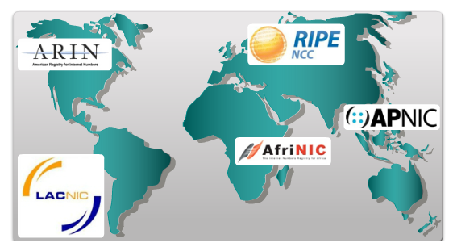
Types of IPv4 Address
Assignment of IP Addresses
Regional Internet Registries (RIRs)
Notes:
8.1.4.5 Assignment of IP Addresses

Slide 29
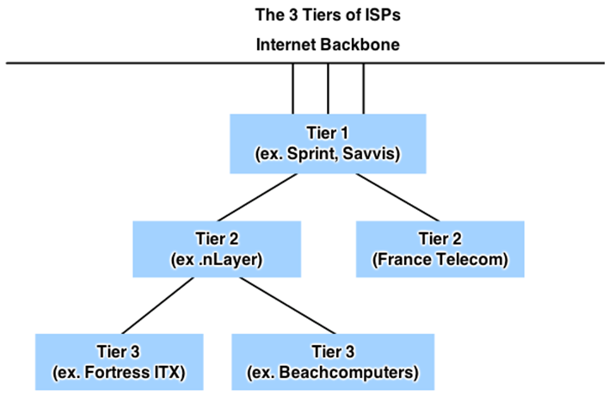
Types of IPv4 Address
Assignment of IP Addresses (Cont.)
ISPs are large national or international ISPs that are directly connected to the Internet backbone.
Tier 2 ISPs generally focus on business customers.
Tier 3 ISPs often bundle Internet connectivity as a part of network and computer service contracts for their customers.
Tier 3 ISPs purchase their Internet service from Tier 2 ISPs.
Notes:
8.1.4.6 Assignment of IP Addresses (Cont.)

Slide 30
8.2 IPv6 Network Addresses
Notes:
8.2 IPv6 Network Addresses

Slide 31
IPv4 Issues
The Need for IPv6
IPv6 is designed to be the successor to IPv4.
Depletion of IPv4 address space has been the motivating factor for moving to IPv6.
Projections show that all five RIRs will run out of IPv4 addresses between 2015 and 2020.
With an increasing Internet population, a limited IPv4 address space, issues with NAT and an Internet of things, the time has come to begin the transition to IPv6!
IPv4 has a theoretical maximum of 4.3 billion addresses, plus private addresses in combination with NAT.
IPv6 larger 128-bit address space provides for 340 undecillion addresses.
IPv6 fixes the limitations of IPv4 and includes additional enhancements, such as ICMPv6.
Notes:
8.2.1.1 The Need for IPv6

Slide 32
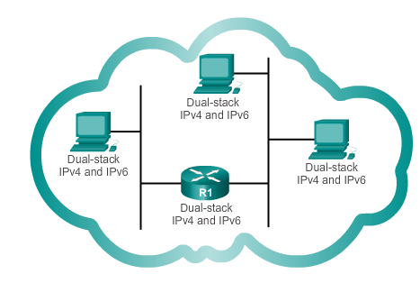
IPv4 Issues
IPv4 and IPv6 Coexistence
The migration techniques can be divided into three categories:
Dual-stack, Tunnelling, and Translation.
Dual-stack
Dual-stack: Allows IPv4 and IPv6 to coexist on the same network. Devices run both IPv4 and IPv6 protocol stacks simultaneously.
Notes:
8.2.1.2 IPv4 and IPv6 Coexistence

Slide 33
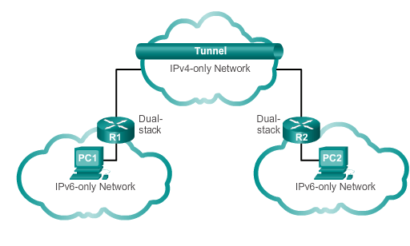
IPv4 Issues
IPv4 and IPv6 Coexistence (cont.)
Tunnelling
Tunnelling: A method of transporting an IPv6 packet over an IPv4 network. The IPv6 packet is encapsulated inside an IPv4 packet.
Notes:
8.2.1.2 IPv4 and IPv6 Coexistence

Slide 34
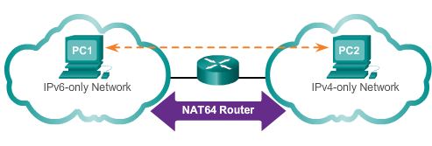
IPv4 Issues
IPv4 and IPv6 Coexistence (cont.)
Translation
Translation: The Network Address Translation 64 (NAT64) allows IPv6-enabled devices to communicate with IPv4-enabled devices using a translation technique similar to NAT for IPv4. An IPv6 packet is translated to an IPv4 packet, and vice versa.
Notes:
8.2.1.2 IPv4 and IPV6 Coexistence (cont.)

Slide 35
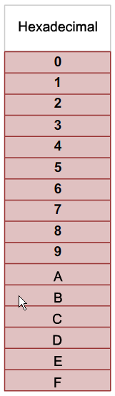
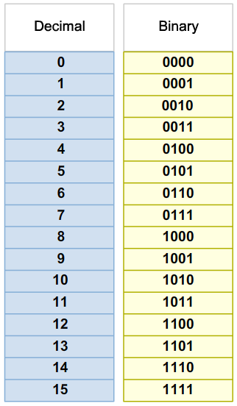
IPv6 Addressing
Hexadecimal Number System
Hexadecimal is a base sixteen system.
Base 16 numbering system uses the numbers 0 to 9 and the letters A to F.
Four bits (half of a byte) can be represented with a single hexadecimal value.
Notes:
8.2.2.1 Hexadecimal Number System

Slide 36
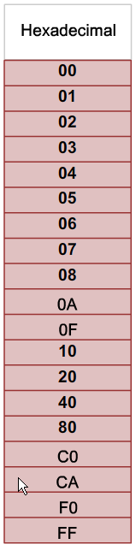
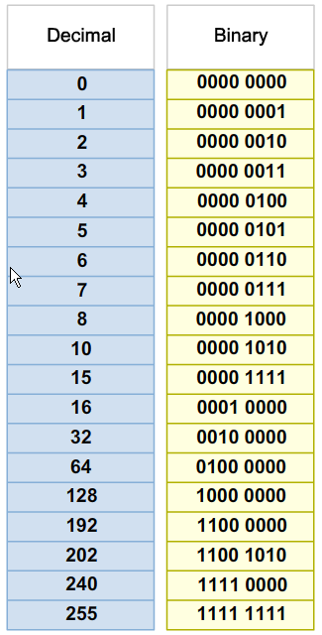
IPv6 Addressing
Hexadecimal Number System (cont.)
Look at the binary bit patterns that match the decimal and hexadecimal values
Notes:
8.2.2.1 Hexadecimal Number System (cont.)

Slide 37
IPv6 Addressing
IPv6 Address Representation
128 bits in length and written as a string of hexadecimal values
In IPv6, 4 bits represents a single hexadecimal digit, 32 hexadecimal value = IPv6 address
  2001:0DB8:0000:1111:0000:0000:0000:0200
  FE80:0000:0000:0000:0123:4567:89AB:CDEF
Hextet used to refer to a segment of 16 bits or four hexadecimals
Can be written in either lowercase or uppercase
Notes:
8.2.2.2 IPv6 Address Representation

Slide 38
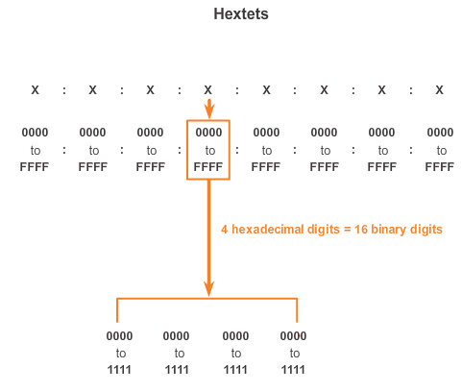
IPv6 Addressing
IPv6 Address Representation (cont.)
Notes:
8.2.2.2 IPv6 Address Representation (cont.)

Slide 39

IPv6 Addressing
Rule 1- Omitting Leading 0s
The first rule to help reduce the notation of IPv6 addresses is any leading 0s (zeros) in any 16-bit section or hextet can be omitted.
01AB can be represented as 1AB.
09F0 can be represented as 9F0.
0A00 can be represented as A00.
00AB can be represented as AB.
Notes:
8.2.2.3 Rule 1 – Omitting Leading 0s

Slide 40
IPv6 Addressing
Rule 2 - Omitting All 0 Segments
A double colon (::) can replace any single, contiguous string of one or more 16-bit segments (hextets) consisting of all 0’s.
Double colon (::) can only be used once within an address otherwise the address will be ambiguous.
Known as the compressed format.
Incorrect address - 2001:0DB8::ABCD::1234.
Notes:
8.2.2.4 Rule 2 – Omitting All 0 Segments

Slide 41
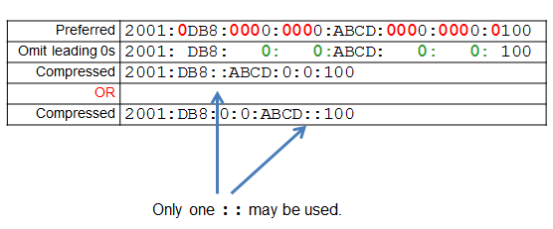
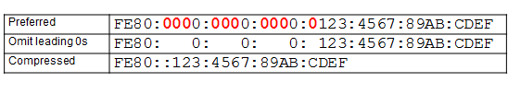
IPv6 Addressing
Rule 2 - Omitting All 0 Segments (cont.)
Example #1
Example #2
Notes:
8.2.2.4 Rule 2 – Omitting All 0 Segments (cont.)

Slide 42
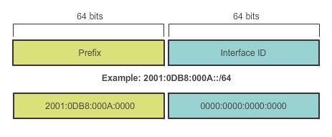
Types of IPv6 Addresses
IPv6 Prefix Length
IPv6 does not use the dotted-decimal subnet mask notation
Prefix length indicates the network portion of an IPv6 address using the following format:
  IPv6 address/prefix length
  Prefix length can range from 0 to 128
  Typical prefix length is /64
Notes:
8.2.3.2 IPv6 Prefix Length

Slide 43
Types of IPv6 Addresses
IPv6 Address Types
There are three types of IPv6 addresses:
Unicast
Multicast
Anycast.
Note: IPv6 does not have broadcast addresses.
Notes:
8.2.3.1 IPv6 Address Types

Slide 44
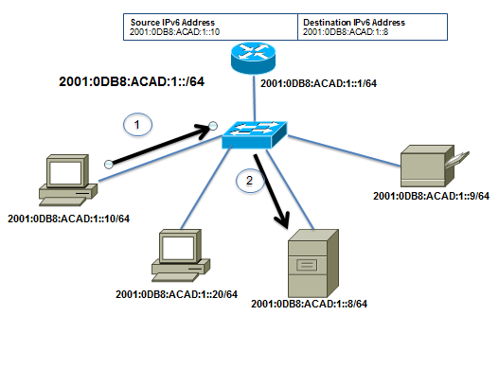
Types of IPv6 Addresses
IPv6 Unicast Addresses
Unicast
  Uniquely identifies an interface on an IPv6-enabled device.
  A packet sent to a unicast address is received by the interface that is assigned that address.
Notes:
8.2.3.1/8.2.3.3 IPv6 Unicast Addresses

Slide 45
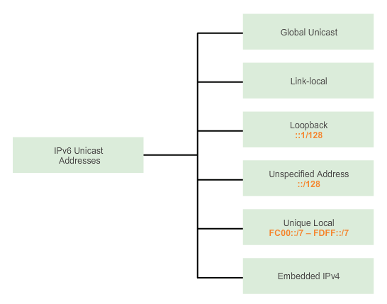
Types of IPv6 Addresses
IPv6 Unicast Addresses (cont.)
Notes:
8.2.3.3 IPv6 Unicast Addresses (cont.)

Slide 46
Types of IPv6 Addresses
IPv6 Unicast Addresses (cont.)
Global Unicast
  Similar to a public IPv4 address
  Globally unique
  Internet routable addresses
  Can be configured statically or assigned dynamically
Link-local
  Used to communicate with other devices on the same local link
  Confined to a single link; not routable beyond the link
Notes:
8.2.3.3 IPv6 Unicast Addresses (cont.)

Slide 47
Types of IPv6 Addresses
IPv6 Unicast Addresses (cont.)
Loopback
  Used by a host to send a packet to itself and cannot be assigned to a physical interface.
  Ping an IPv6 loopback address to test the configuration of TCP/IP on the local host.
  All-0s except for the last bit, represented as ::1/128 or just ::1.
Unspecified Address
  All-0’s address represented as ::/128 or just ::
  Cannot be assigned to an interface and is only used as a source address.
  An unspecified address is used as a source address when the device does not yet have a permanent IPv6 address or when the source of the packet is irrelevant to the destination.
Notes:
8.2.3.3 IPv6 Unicast Addresses (cont.)

Slide 48
Types of IPv6 Addresses
IPv6 Unicast Addresses (cont.)
Unique Local
  Similar to private addresses for IPv4.
  Used for local addressing within a site or between a limited number of sites.
  In the range of FC00::/7 to FDFF::/7.
IPv4 Embedded (not covered in this course)
  Used to help transition from IPv4 to IPv6.
Notes:
8.2.3.3 IPv6 Unicast Addresses (cont.)

Slide 49
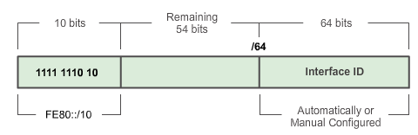
Types of IPv6 Addresses
IPv6 Link-Local Unicast Addresses
Add a header
Every IPv6-enabled network interface is REQUIRED to have a link-local address
Enables a device to communicate with other IPv6-enabled devices on the same link and only on that link (subnet)
FE80::/10 range, first 10 bits are 1111 1110 10xx xxxx
1111 1110 1000 0000 (FE80) - 1111 1110 1011 1111 (FEBF)
Notes:
8.2.3.4 IPv6 Link-Local Unicast Addresses

Slide 50
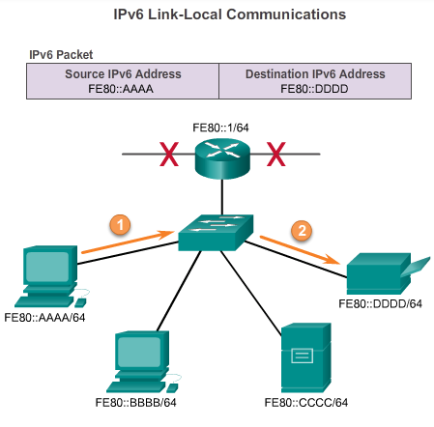
Types of IPv6 Addresses
IPv6 Link-Local Unicast Addresses (cont.)
Packets with a source or destination link-local address cannot be routed beyond the link from where the packet originated.
Notes:
8.2.3.4 IPv6 Link-Local Unicast Addresses

Slide 51
IPv6 Unicast Addresses
Structure of an IPv6 Global Unicast Address
IPv6 global unicast addresses are globally unique and routable on the IPv6 Internet
Equivalent to public IPv4 addresses
ICANN allocates IPv6 address blocks to the five RIRs
Notes:
8.2.4.1 Structure of an IPv6 Global Unicast Address

Slide 52
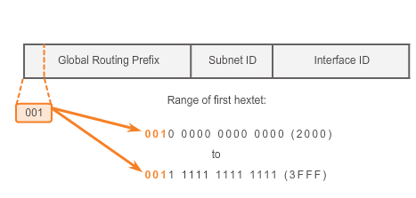
IPv6 Unicast Addresses
Structure of an IPv6 Global Unicast Address (cont.)
Currently, only global unicast addresses with the first three bits of 001 or 2000::/3 are being assigned
Notes:
8.2.4.1 Structure of an IPv6 Global Unicast Address (cont.)

Slide 53
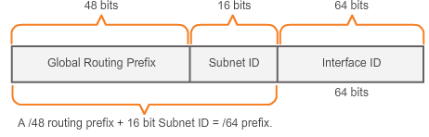
IPv6 Unicast Addresses
Structure of an IPv6 Global Unicast Address (cont.)
A global unicast address has three parts: Global Routing Prefix, Subnet ID, and Interface ID.
Global Routing Prefix is the prefix or network portion of the address assigned by the provider, such as an ISP, to a customer or site, currently, RIR’s assign a /48 global routing prefix to customers.
2001:0DB8:ACAD::/48 has a prefix that indicates that the first 48 bits (2001:0DB8:ACAD) is the prefix or network portion.
Notes:
8.2.4.1 Structure of an IPv6 Global Unicast Address (cont.)

Slide 54
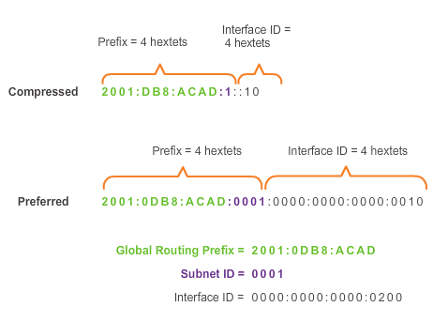
IPv6 Unicast Addresses
Structure of an IPv6 Global Unicast Address (cont.)
Subnet ID is used by an organization to identify subnets within its site
Interface ID
  Equivalent to the host portion of an IPv4 address.
  Used because a single host may have multiple interfaces, each having one or more IPv6 addresses.
Notes:
8.2.4.1 Structure of an IPv6 Global Unicast Address

Slide 55
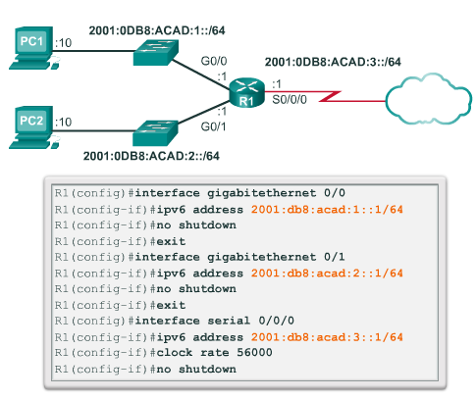
IPv6 Unicast Addresses
Static Configuration of a Global Unicast Address
Notes:
8.2.4.2 Static Configuration of a Global Unicast Address

Slide 56
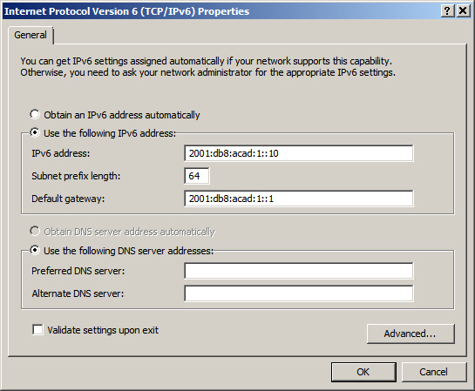
IPv6 Unicast Addresses
Static Configuration of an IPv6 Global Unicast Address (cont.)
Windows IPv6 Setup
Notes:
8.2.4.2 Static Configuration of an IPv6 Global Unicast Address (cont.)

Slide 57
IPv6 Unicast Addresses
Dynamic Configuration of a Global Unicast Address using SLAAC
Stateless Address Autoconfiguraton (SLAAC)
A method that allows a device to obtain its prefix, prefix length and default gateway from an IPv6 router
No DHCPv6 server needed
Rely on ICMPv6 Router Advertisement (RA) messages
IPv6 routers
Forwards IPv6 packets between networks
Can be configured with static routes or a dynamic IPv6 routing protocol
Sends ICMPv6 RA messages
Notes:
8.2.4.3 Dynamic Configuration of a Global Unicast Address using SLAAC

Slide 58
IPv6 Unicast Addresses
Dynamic Configuration of a Global Unicast Address using SLAAC (cont.)
The IPv6 unicast-routing command enables IPv6 routing.
RA message can contain one of the following three options:
  SLAAC Only – Uses the information contained in the RA message.
  SLAAC and DHCPv6 – Uses the information contained in the RA message and get other information from the DHCPv6 server, stateless DHCPv6 (for example, DNS).
  DHCPv6 only – The device should not use the information in the RA, stateful DHCPv6.
Routers send ICMPv6 RA messages using the link-local address as the source IPv6 address
Notes:
8.2.4.3 Dynamic Configuration of a Global Unicast Address using SLAAC (cont.)

Slide 59
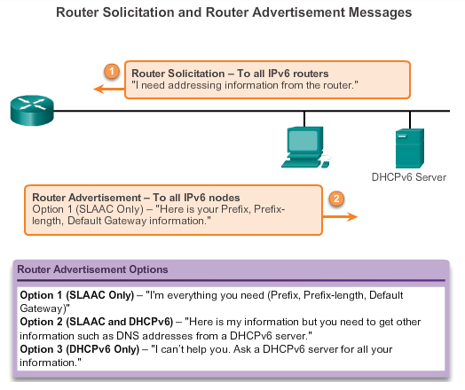
IPv6 Unicast Addresses
Dynamic Configuration of a Global Unicast Address using SLAAC (cont.)
Notes:
8.2.4.3 Dynamic Configuration of a Global Unicast Address using SLAAC (cont.)

Slide 60
IPv6 Unicast Addresses
Dynamic Configuration of a Global Unicast Address using DHCPv6 (cont.)
Dynamic Host Configuration Protocol for IPv6 (DHCPv6)
Similar to IPv4
Automatically receives addressing information, including a global unicast address, prefix length, default gateway address and the addresses of DNS servers using the services of a DHCPv6 server.
Device may receive all or some of its IPv6 addressing information from a DHCPv6 server depending upon whether option 2 (SLAAC and DHCPv6) or option 3 (DHCPv6 only) is specified in the ICMPv6 RA message.
Host may choose to ignore whatever is in the router’s RA message and obtain its IPv6 address and other information directly from a DHCPv6 server.
Notes:
8.2.4.4 Dynamic Configuration of a Global Unicast Address using DHCPv6 (cont.)

Slide 61
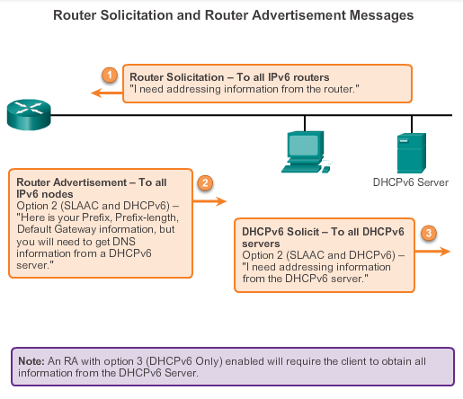
IPv6 Unicast Addresses
Dynamic Configuration of a Global Unicast Address using DHCPv6 (cont.)
Notes:
8.2.4.4 Dynamic Configuration of a Global Unicast Address using DHCPv6 (cont.)

Slide 62
IPv6 Unicast Addresses
EUI-64 Process or Randomly Generated
EUI-64 Process
Uses a client’s 48-bit Ethernet MAC address and inserts another 16 bits in the middle of the 46-bit MAC address to create a 64-bit Interface ID.
Advantage is that the Ethernet MAC address can be used to determine the interface; is easily tracked.
EUI-64 Interface ID is represented in binary and comprises three parts:
24-bit OUI from the client MAC address, but the 7th bit (the Universally/Locally bit) is reversed (0 becomes a 1).
Inserted as a 16-bit value FFFE.
24-bit device identifier from the client MAC address.
Notes:
8.2.4.5 EUI-64 Process or Randomly Generated

Slide 63
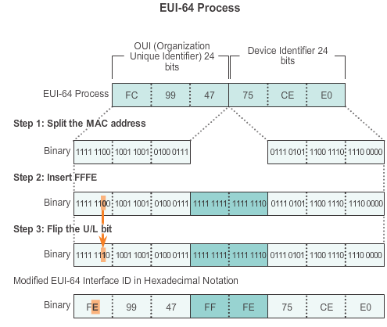
IPv6 Unicast Addresses
EUI-64 Process or Randomly Generated (cont.)
Notes:
8.2.4.5 EUI-64 Process or Randomly Generated

Slide 64
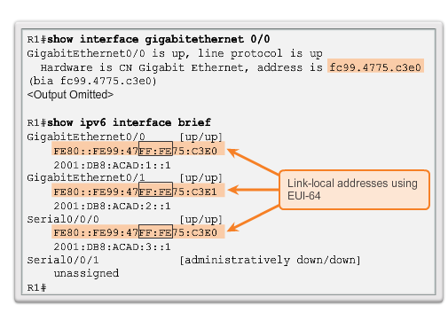
IPv6 Unicast Addresses
EUI-64 Process or Randomly Generated (cont.)
Notes:
8.2.4.5 EUI-64 Process or Randomly Generated (cont.)

Slide 65
IPv6 Unicast Addresses
EUI-64 Process or Randomly Generated (cont.)
Randomly Generated Interface IDs
Depending upon the operating system, a device can use a randomly generated Interface ID instead of using the MAC address and the EUI-64 process.
Beginning with Windows Vista, Windows uses a randomly generated Interface ID instead of one created with EUI-64.
Windows XP (and previous Windows operating systems) used EUI-64.
Notes:
8.2.4.5 EUI-64 Process or Randomly Generated (cont.)

Slide 66
IPv6 Unicast Addresses
Dynamic Link-local Addresses
Link-Local Address
After a global unicast address is assigned to an interface, an IPv6-enabled device automatically generates its link-local address.
Must have a link-local address that enables a device to communicate with other IPv6-enabled devices on the same subnet.
Uses the link-local address of the local router for its default gateway IPv6 address.
Routers exchange dynamic routing protocol messages using link-local addresses.
Routers’ routing tables use the link-local address to identify the next-hop router when forwarding IPv6 packets.
Notes:
8.2.4.6 Dynamic Link-local Addresses

Slide 67
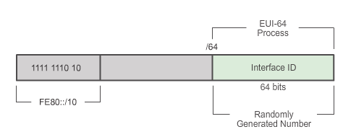
IPv6 Unicast Addresses
Dynamic Link-local Addresses (cont.)
Dynamically Assigned
The link-local address is dynamically created using the FE80::/10 prefix and the Interface ID.
Notes:
8.2.4.6 Dynamic Link-local Addresses (cont.)

Slide 68
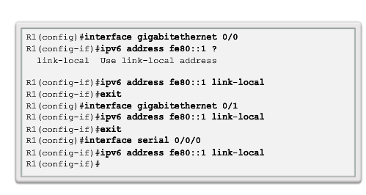
IPv6 Unicast Addresses
Static Link-local Addresses
Configuring Link-local
Notes:
8.2.4.7 Static Link-local Addresses

Slide 69
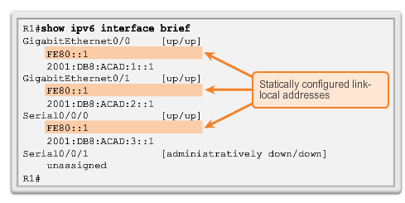
IPv6 Unicast Addresses
Static Link-local Addresses (cont.)
Configuring Link-local
Notes:
8.2.4.7 Static Link-local Addresses (cont.)

Slide 70

IPv6 Global Unicast Addresses
Verifying IPv6 Address Configuration
Each interface has two IPv6 addresses -
global unicast address that was configured
one that begins with FE80 is automatically added as a link-local unicast address
Notes:
8.2.4.8 Verifying IPv6 Address Configuration

Slide 71

IPv6 Global Unicast Addresses
Verifying IPv6 Address Configuration (cont.)
Notes:
8.2.4.8 Verifying IPv6 Address Configuration (cont.)

Slide 72
IPv6 Multicast Addresses
Assigned IPv6 Multicast Addresses
IPv6 multicast addresses have the prefix FF00::/8
There are two types of IPv6 multicast addresses:
  Assigned multicast
  Solicited node multicast
Notes:
8.2.5.1 Assigned IPv6 Multicast Addresses

Slide 73
IPv6 Multicast Addresses
Assigned IPv6 Multicast Addresses (cont.)
Two common IPv6 assigned multicast groups include:
  FF02::1 All-nodes multicast group –
    All IPv6-enabled devices join
    Same effect as an IPv4 broadcast address
  FF02::2 All-routers multicast group
    All IPv6 routers join
    A router becomes a member of this group when it is enabled as an IPv6 router with the ipv6 unicast-routing global configuration mode command.
    A packet sent to this group is received and processed by all IPv6 routers on the link or network.
Notes:
8.2.5.1 Assigned IPv6 Multicast Addresses (cont.)

Slide 74

IPv6 Multicast Addresses
Assigned IPv6 Multicast Addresses (cont.)
Notes:
8.2.5.1 Assigned IPv6 Multicast Addresses (cont.)

Slide 75

IPv6 Multicast Addresses
Solicited Node IPv6 Multicast Addresses
Similar to the all-nodes multicast address, matches only the last 24 bits of the IPv6 global unicast address of a device
Automatically created when the global unicast or link-local unicast addresses are assigned
Created by combining a special FF02:0:0:0:0:0:FF00::/104 prefix with the right-most 24 bits of its unicast address
Notes:
8.2.5.2 Solicited Node IPv6 Multicast Addresses

Slide 76
IPv6 Multicast Addresses
Solicited Node IPv6 Multicast Addresses (cont.)
The solicited node multicast address consists of two parts:
FF02:0:0:0:0:0:FF00::/104 multicast prefix – First 104 bits of the all solicited node multicast address
Least significant 24-bits – Copied from the right-most 24 bits of the global unicast or link-local unicast address of the device
Notes:
8.2.5.2 Solicited Node IPv6 Multicast Addresses (cont.)

Slide 77
8.3 Connectivity Verification
Notes:
8.3 Connectivity Verification

Slide 78
ICMP
ICMPv4 and ICMPv6 Messages
ICMP messages common to both ICMPv4 and ICMPv6 include:
  Host confirmation
  Destination or Service Unreachable
  Time exceeded
  Route redirection
Although IP is not a reliable protocol, the TCP/IP suite does provide for messages to be sent in the event of certain errors, sent using the services of ICMP.
Notes:
8.3.1.1 ICMPv4 and ICMPv6 Messages

Slide 79
ICMP
ICMPv6 Router Solicitation and Router Advertisement Messages
ICMPv6 includes four new protocols as part of the Neighbor Discovery Protocol (ND or NDP):
  Router Solicitation message
  Router Advertisement message
  Neighbor Solicitation message
  Neighbor Advertisement message
Router Solicitation and Router Advertisement Message – Sent between hosts and routers.
Router Solicitation (RS) message – RS messages are sent as an IPv6 all-routers multicast message.
Router Advertisement (RA) message – RA messages are sent by routers to provide addressing information.
Notes:
8.3.1.2 ICMPv6 Router Solicitation and Router Advertisement Messages

Slide 80

ICMP
ICMPv6 Router Solicitation and Router Advertisement Messages (cont.)
Notes:
8.3.1.2 ICMPv6 Router Solicitation and Router Advertisement Messages (cont.)

Slide 81
ICMP
ICMPv6 Neighbor Solicitation and Neighbor Advertisement Messages
  Two additional message types:
    Neighbor Solicitation (NS)
    Neighbor Advertisement (NA) messages
  Used for address resolution is used when a device on the LAN knows the IPv6 unicast address of a destination, but does not know its Ethernet MAC address.
  Also used for Duplicate Address Detection (DAD)
      Performed on the address to ensure that it is unique.
      The device sends an NS message with its own IPv6 address as the targeted IPv6 address.
Notes:
8.3.1.3 ICMPv6 Neighbor Solicitation and Neighbor Advertisement Messages

Slide 82

ICMP
ICMPv6 Neighbor Solicitation and Neighbor Advertisement Messages (cont.)
Notes:
8.3.1.3 ICMPv6 Neighbor Solicitation and Neighbor Advertisement Messages (cont.)

Slide 83

Testing and Verification
Ping – Testing the Local Stack
Notes:
8.3.2.1 Ping – Testing the Local Stack

Slide 84

Testing and Verification
Ping – Testing Connectivity to the Local LAN
Notes:
8.3.2.2 Ping – Testing Connectivity to the Local LAN

Slide 85

Testing and Verification
Ping – Testing Connectivity to Remote
Notes:
8.3.2.3 Ping – Testing Connectivity to Remote

Slide 86
Testing and Verification
Traceroute – Testing the Path
  Traceroute
  Generates a list of hops that were successfully reached along the path.
  Provides important verification and troubleshooting information.
  If the data reaches the destination, then the trace lists the interface of every router in the path between the hosts.
  If the data fails at some hop along the way, the address of the last router that responded to the trace can provide an indication of where the problem or security restrictions are found.
  Provides round-trip time for each hop along the path and indicates if a hop fails to respond.
Notes:
8.3.2.4 Traceroute – Testing the Path

Slide 87
IP Addressing
Summary
IP addresses are hierarchical with network, subnetwork, and host portions.
An IP address can represent a complete network, a specific host, or the broadcast address of the network.
The subnet mask or prefix is used to determine the network portion of an IP address. Once implemented, an IP network needs to be tested to verify its connectivity and operational performance.
DHCP enables the automatic assignment of addressing information such as IP address, subnet mask, default gateway, and other configuration information.
Notes:
Summary

Slide 88
IP Addressing
Summary (cont.)
IPv4 hosts can communicate one of three different ways: unicast, broadcast, and multicast.
The private IPv4 address blocks are: 10.0.0.0/8, 172.16.0.0/12, and 192.168.0.0/16.
The depletion of IPv4 address space is the motivating factor for moving to IPv6.
Each IPv6 address has 128 bits verses the 32 bits in an IPv4 address.
The prefix length is used to indicate the network portion of an IPv6 address using the following format: IPv6 address/prefix length.
Notes:
Summary

Slide 89
IP Addressing
Summary (cont.)
There are three types of IPv6 addresses: unicast, multicast, and anycast.
An IPv6 link-local address enables a device to communicate with other IPv6-enabled devices on the same link and only on that link (subnet).
Packets with a source or destination link-local address cannot be routed beyond the link from where the packet originated.
IPv6 link-local addresses are in the FE80::/10 range.
ICMP is available for both IPv4 and IPv6.
Notes:
Summary

Slide 90


