Slide 1
Chapter 4:
Network Access
Introduction to Networks
Notes:
Cisco Networking Academy program
Introduction to Networks
Chapter 4: Network Access

Slide 2
Chapter 4: Objectives
Upon completion of this chapter, you will be able to:
Identify device connectivity options.
Describe the purpose and functions of the physical layer in the network.
Describe basic principles of the physical layer standards.
Identify the basic characteristics of copper cabling.
Build a UTP cable used in Ethernet networks.
Describe fiber-optic cabling and its main advantages over other media.
Describe wireless media.
Select the appropriate media for a given requirement and connect devices.
Notes:
2
Chapter 4 Objectives

Slide 3
Chapter 4: Objectives (cont.)
Upon completion of this chapter, you will be able to:
Describe the purpose and function of the data link layer in preparing communication for transmission on specific media.
Describe the Layer 2 frame structure and identify generic fields.
Identify several sources for the protocols and standards used by the data link layer.
Compare the functions of logical topologies and physical topologies.
Describe the basic characteristics of media control methods on WAN topologies.
Describe the basic characteristics of media control methods on LAN topologies.
Describe the characteristics and functions of the data link frame.
Notes:
3
Chapter 4 Objectives (cont.)

Slide 4
4.4 Media Access Control
Notes:
Cisco Networking Academy program
Introduction to Networks
Chapter 4: Network Access

Slide 5
Chapter 4
  4.1 Physical Layer Protocols
  4.2 Network Media
  4.3 Data Link Layer Protocols
  4.4 Media Access Control
  4.5 Summary
Notes:
Chapter 4 Sections

Slide 6
4.1 Physical Layer Protocols
Notes:
Cisco Networking Academy program
Introduction to Networks
Chapter 4: Network Access

Slide 7
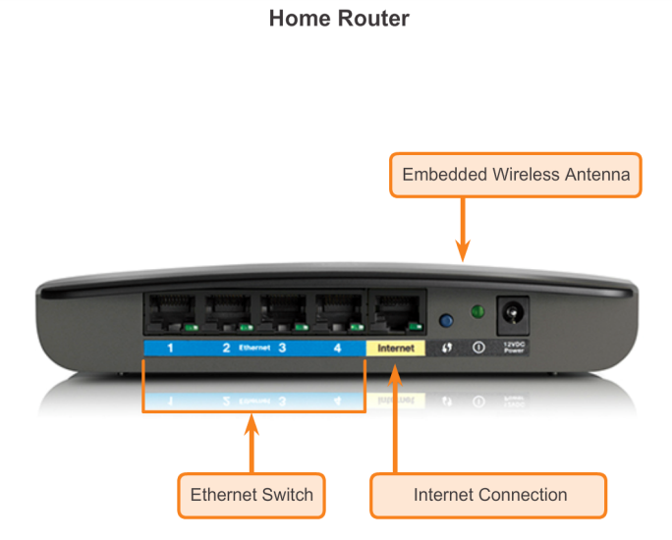
Getting it Connected
Connecting to the Network
Notes:
4.1.1.1 Connecting to the Network

Slide 8
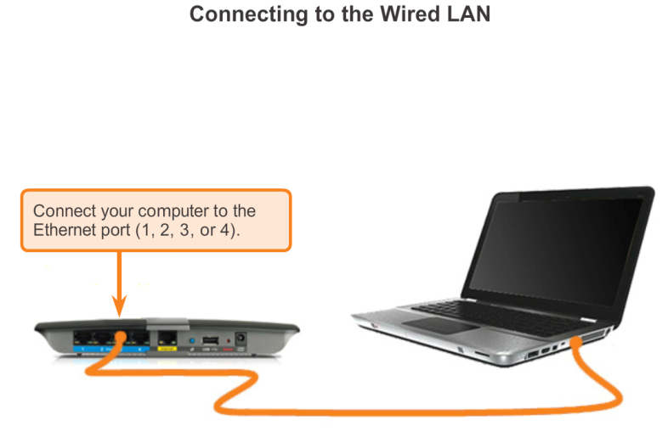
Getting it Connected
Connecting to the Network (cont.)
Notes:
4.1.1.1 Connecting to the Network (cont.)

Slide 9
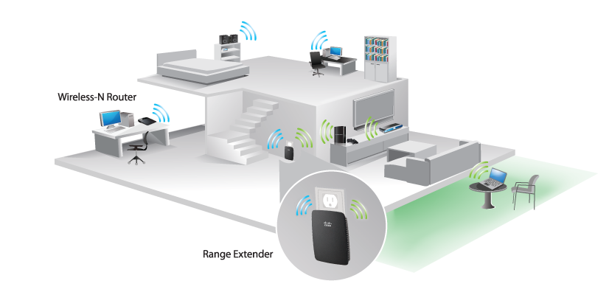
Getting it Connected
Network Interface Cards
Connecting to the Wireless LAN with a Range Extender
Notes:
4.1.1.2 Network Interface Cards

Slide 10
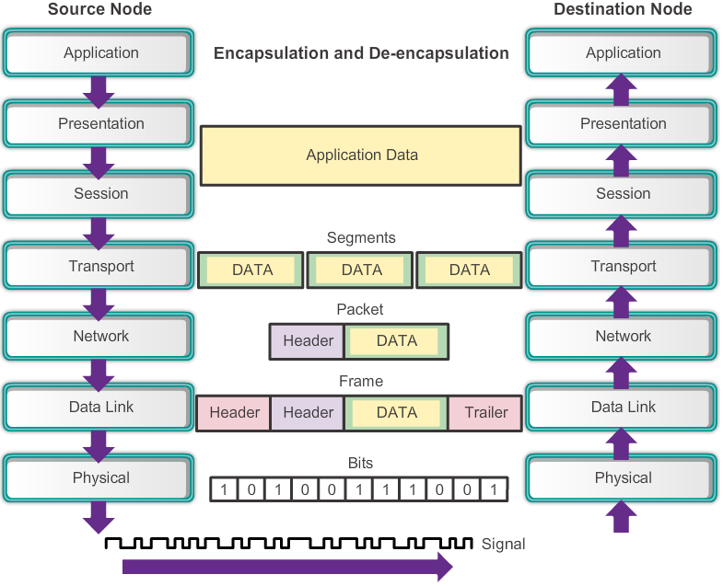
Purpose of the Physical Layer
The Physical Layer
Notes:
4.1.2.1 The Physical Layer

Slide 11
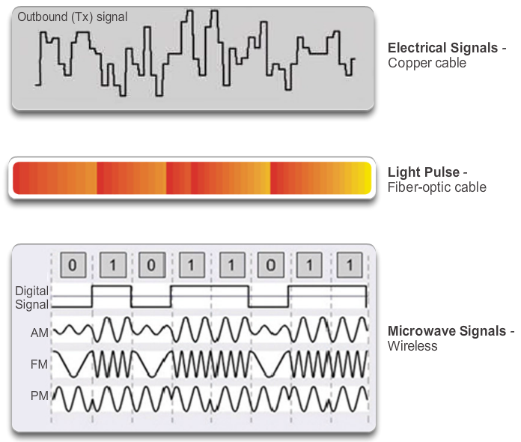
Purpose of the Physical Layer
Physical Layer Media
Notes:
4.1.2.2 Physical Layer Media

Slide 12
Purpose of the Physical Layer
Physical Layer Standards
Standard Organization | Networking Standards
ISO | ISO 8877: Officially adopted the RJ connectors (e.g., RJ-11, RJ-45) ISO 11801: Network cabling standard similar to EIA/TIA 568.
EIA/TIA | TIA-568-C: Telecommunications cabling standards, used by nearly all voice, video and data networks. TIA-569-B: Commercial Building Standards for Telecommunications Pathways and Spaces TIA-598-C: Fiber optic color coding TIA-942: Telecommunications Infrastructure Standard for Data Centers
ANSI | 568-C: RJ-45 pinouts. Co-developed with EIA/TIA
ITU-T | G.992: ADSL
IEEE | 802.3: Ethernet 802.11: Wireless LAN (WLAN) & Mesh (Wi-Fi certification) 802.15: Bluetooth
Notes:
4.1.2.3 Physical Layer Standards

Slide 13
Fundamental Principles of Layer 1
Physical Layer Fundamental Principles
Media | Physical Components | Frame Encoding Technique | Signalling Method
Copper Cable | UTP Coaxial Connectors NICs Ports Interfaces | Manchester Encoding Non-Return to Zero (NRZ) techniques 4B/5B codes are used with Multi-Level Transition Level 3 (MLT-3) signaling 8B/10B PAM5 | Changes in the electromagnetic field Intensity of the electromagnetic field Phase of the electromagnetic wave
Fiber Optic Cable | Single-mode Fiber Multimode Fiber Connectors NICs Interfaces Lasers and LEDs Photoreceptors | Pulses of light Wavelength multiplexing using different colors | A pulse equals 1. No pulse is 0.
Wireless Media | Access Points NICs Radio Antennae | DSSS (direct-sequence spread-spectrum) OFDM (orthogonal frequency division multiplexing) | Radio waves
Notes:
4.1.3.1 Physical Layer Fundamental Principles

Slide 14
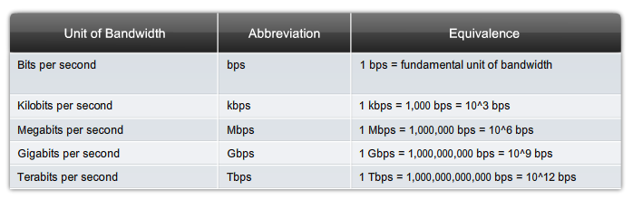
Fundamental Principles of Layer 1
Bandwidth
Notes:
4.1.3.2 Bandwidth

Slide 15
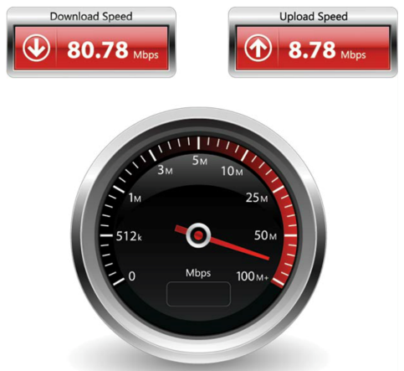
Fundamental Principles of Layer 1
Throughput
Notes:
4.1.3.3 Throughput

Slide 16
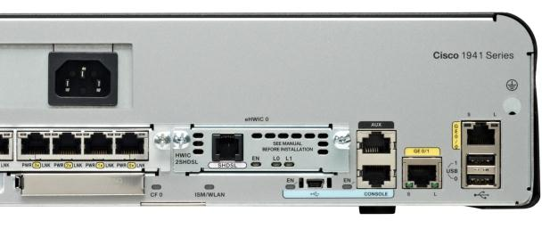
Fundamental Principles of Layer 1
Types of Physical Media
SHDSL
Interface
Management
Ports
Gigabit Ethernet
Interfaces
USB Type A
Connector
FastEthernet
Switch Ports
USB Mini-B
Connector
Notes:
4.1.3.4 Types of Physical Media

Slide 17
4.2 Network Media
Notes:
Cisco Networking Academy program
Introduction to Networks
Chapter 4: Network Access

Slide 18
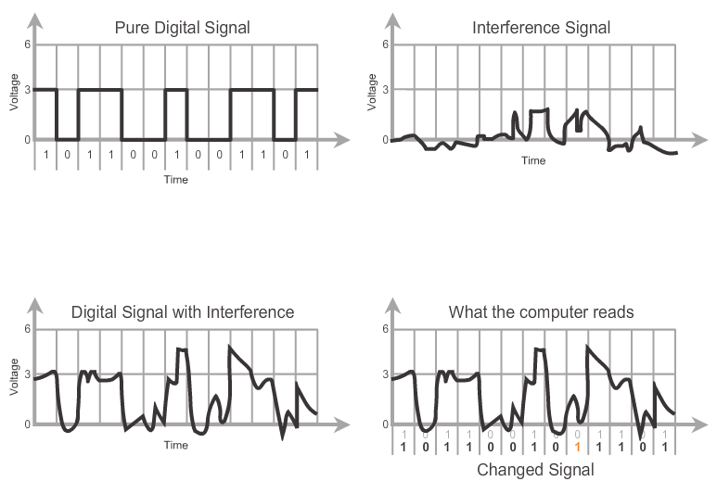
Copper Cabling
Characteristics of Copper Media
Notes:
4.2.1.1 Characteristics of Copper Media

Slide 19
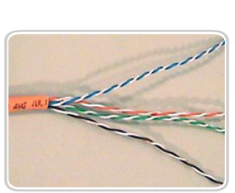
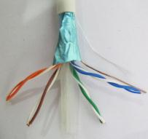

Copper Cabling
Copper Media
Unshielded Twisted Pair (UTP) Cable
Shielded Twisted Pair (STP) Cable
Coaxial Cable
Notes:
4.2.1.2 Copper Media

Slide 20
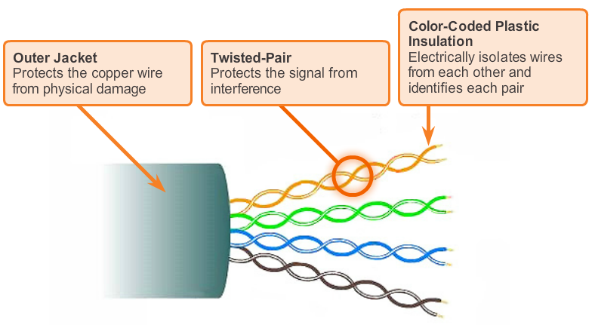
Copper Cabling
UTP Cable
Notes:
4.2.1.3 Unshielded Twisted-Pair Cable

Slide 21
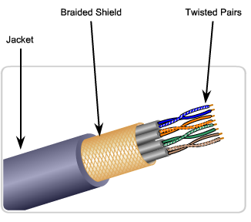
Copper Cabling
STP Cable
Braided or Foil Shield
Foil Shields
Notes:
4.2.1.4 Shielded Twisted-Pair (STP) Cable

Slide 22
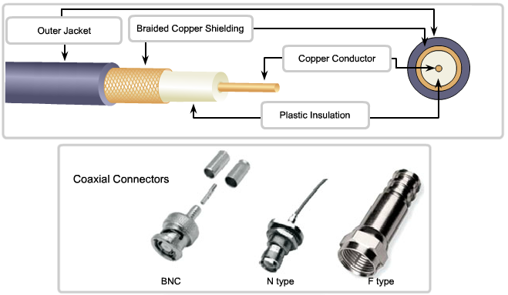
Copper Cabling
Coaxial Cable
Notes:
4.2.1.5 Coaxial Cable

Slide 23
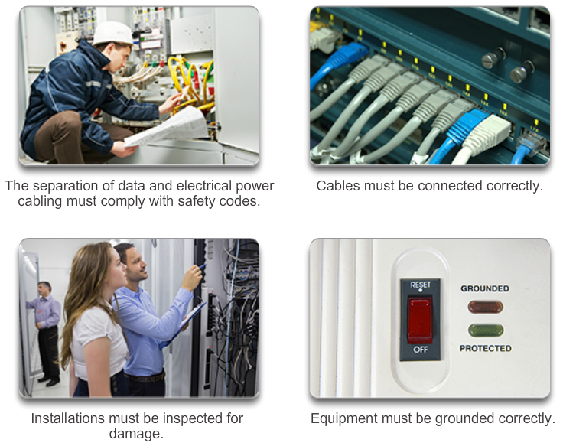
Copper Cabling
Cooper Media Safety
Notes:
4.2.1.6 Copper Media Safety

Slide 24
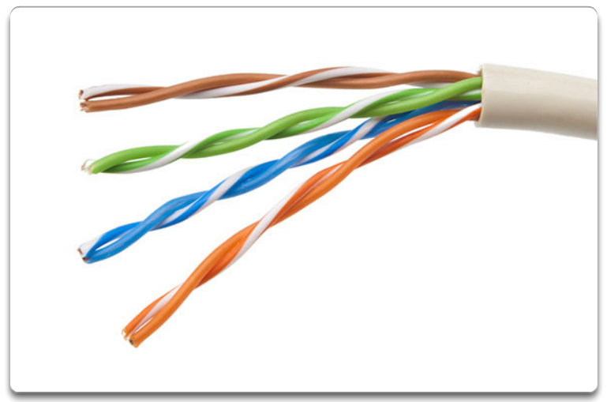
UTP Cabling
Properties of UTP Cabling
UTP cable does not use shielding to counter the effects of EMI and RFI. Instead, cable designers have discovered that they can limit the negative effect of crosstalk by:
Cancellation
Varying the number of twists per wire pair
Notes:
4.2.2.1 Properties of UTP Cabling

Slide 25
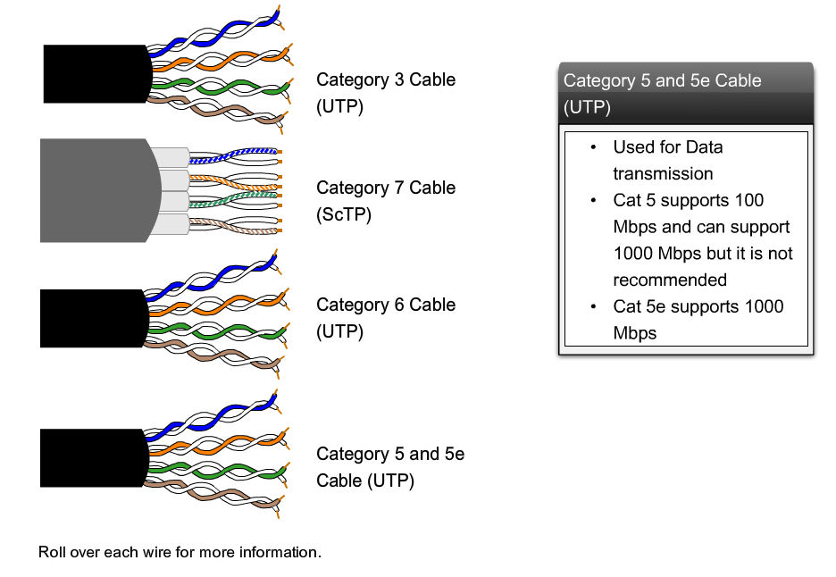
UTP Cabling
UTP Cabling Standards
Notes:
4.2.2.2 UTP Cabling Standards

Slide 26
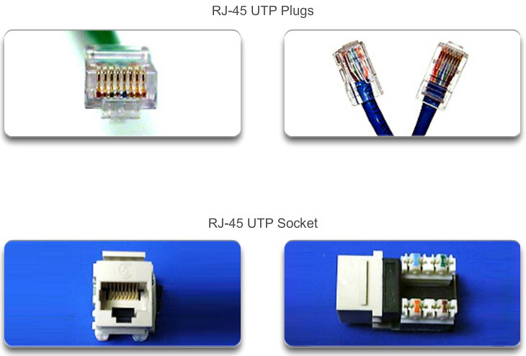
UTP Cabling
UTP Connectors
Notes:
4.2.2.3 UTP Connectors

Slide 27
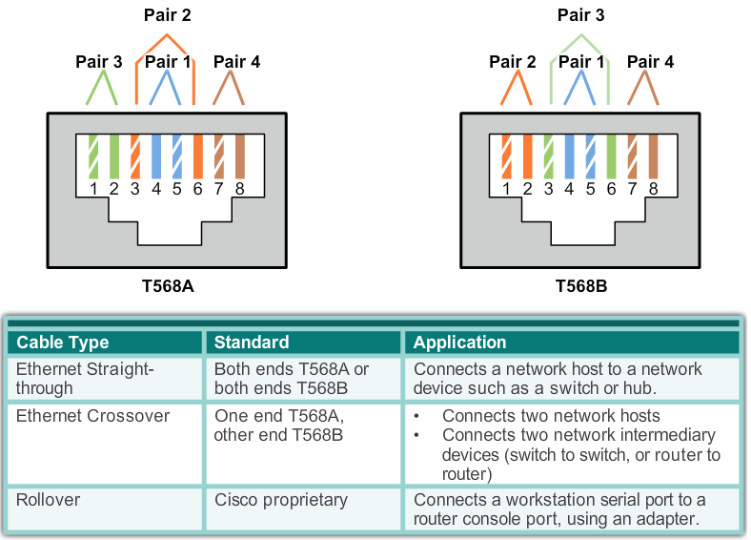
UTP Cabling
Types of UTP Cable
Notes:
4.2.2.4 Types of UTP Cable

Slide 28
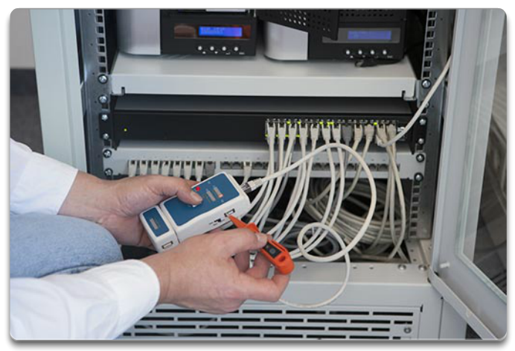
UTP Cabling
Testing UTP Cables
After installation, a UTP cable tester should be used to test for the following parameters:
Wire map
Cable length
Signal loss due to attenuation
Crosstalk
Notes:
4.2.2.5 Testing UTP Cables

Slide 29
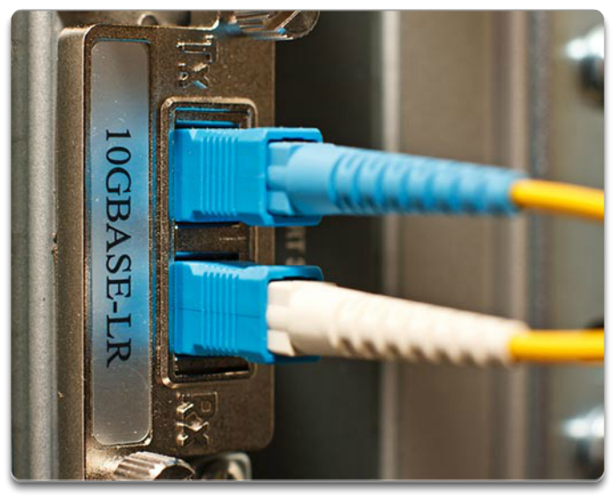
Fiber Optic Cabling
Properties of Fiber Optic Cabling
Fiber-optic cabling is now being used in four types of industry:
Enterprise Networks
Fiber-to-the-home (FTTH) and Access Networks
Long-Haul Networks
Submarine Networks
Notes:
4.2.3.1 Properties of Fiber Optic Cabling

Slide 30
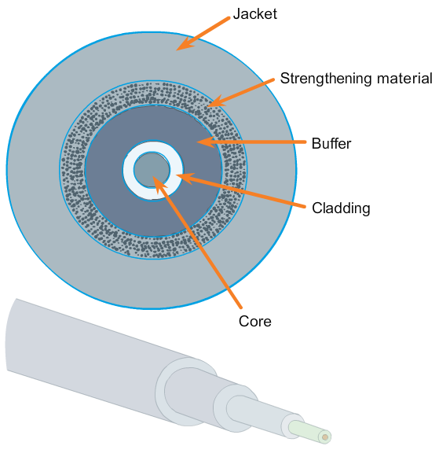
Fiber Optic Cabling
Fiber Media Cable Design
Notes:
4.2.3.2 Fiber Media Cable Design

Slide 31
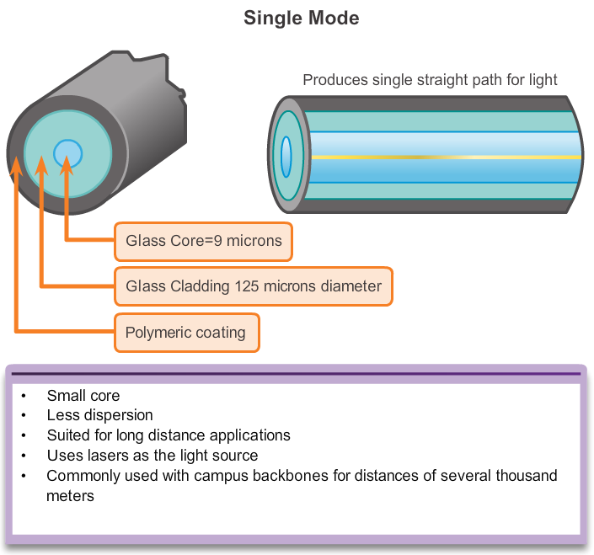
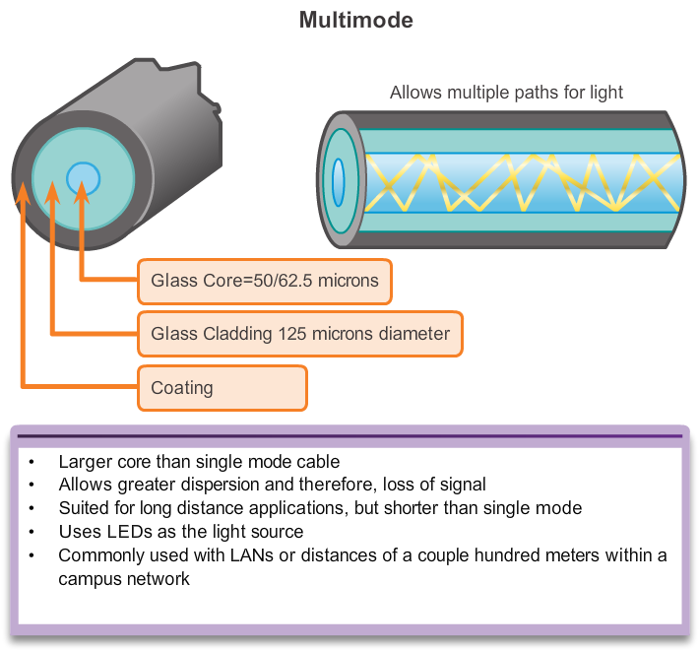
Fiber Optic Cabling
Types of Fiber Media
Notes:
4.2.3.3 Types of Fiber Media

Slide 32
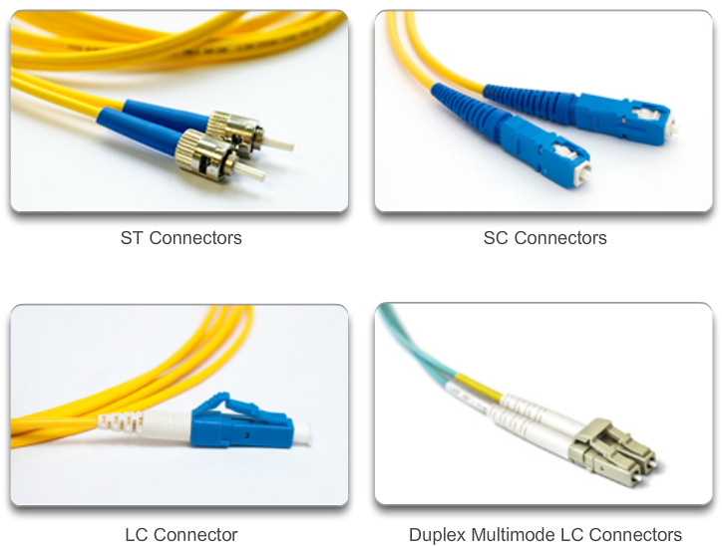
Fiber Optic Cabling
Network Fiber Connectors
Notes:
4.2.3.4 Network Fiber Connectors

Slide 33
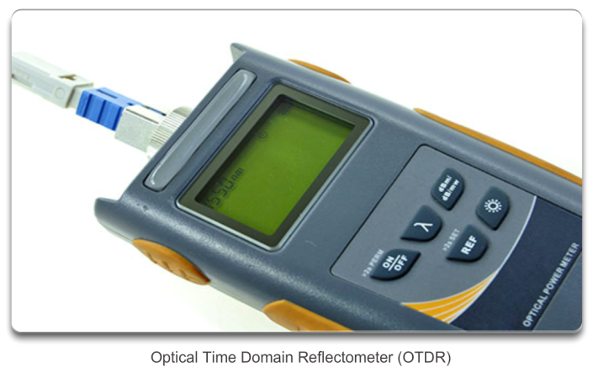
Fiber Optic Cabling
Testing Fiber Cables
Notes:
4.2.3.5 Testing Fiber Cables

Slide 34
Fiber Optic Cabling
Fiber versus Copper
Implementation Issues | Copper Media | Fibre Optic
Bandwidth Supported | 10 Mbps – 10 Gbps | 10 Mbps – 100 Gbps
Distance | Relatively short (1 – 100 meters) | Relatively High (1 – 100,000 meters)
Immunity To EMI And RFI | Low | High (Completely immune)
Immunity To Electrical Hazards | Low | High (Completely immune)
Media And Connector Costs | Lowest | Highest
Installation Skills Required | Lowest | Highest
Safety Precautions | Lowest | Highest
Notes:
4.2.3.6 Fiber versus Copper

Slide 35
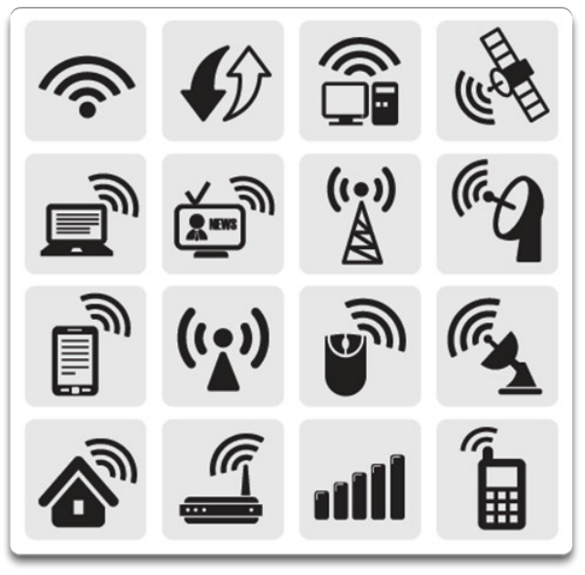
Wireless Media
Properties of Wireless Media
Wireless does have some areas of concern including:
Coverage area
Interference
Security
Notes:
4.2.4.1 Properties of Wireless Media

Slide 36
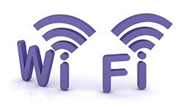


Wireless Media
Types of Wireless Media
 | IEEE 802.11 standards Commonly referred to as Wi-Fi. Uses CSMA/CA Variations include: 802.11a: 54 Mbps, 5 GHz 802.11b: 11 Mbps, 2.4 GHz 802.11g: 54 Mbps, 2.4 GHz 802.11n: 600 Mbps, 2.4 and 5 GHz 802.11ac: 1 Gbps, 5 GHz 802.11ad: 7 Gbps, 2.4 GHz, 5 GHz, and 60 GHz
 | IEEE 802.15 standard Supports speeds up to 3 Mb/s Provides device pairing over distances from 1 to 100 meters.
 | IEEE 802.16 standard Provides speeds up to 1 Gbps Uses a point-to-multipoint topology to provide wireless broadband access.
Notes:
4.2.4.2 Types of Wireless Media

Slide 37
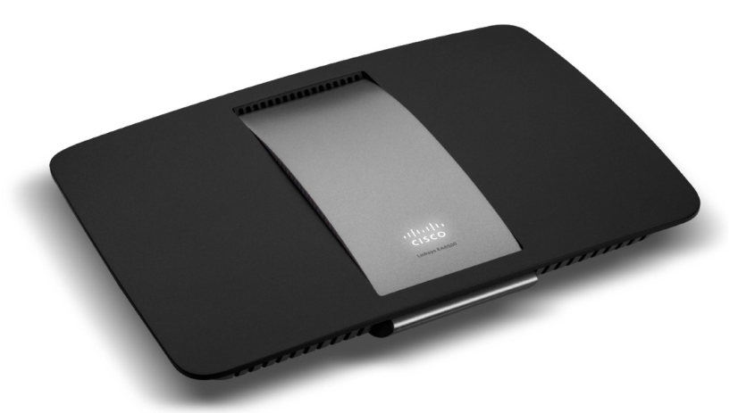
Wireless Media
Wireless LAN
Cisco Linksys EA6500 802.11ac Wireless Router
Notes:
4.2.4.3 Wireless LAN

Slide 38
Wireless Media
802.11 Wi-Fi Standards
Standard | Maximum Speed | Frequency | Backwards Compatible
802.11a | 54 Mbps | 5 GHz | No
802.11b | 11 Mbps | 2.4 GHz | No
802.11g | 54 Mbps | 2.4 GHz | 802.11b
802.11n | 600 Mbps | 2.4 GHz or 5 GHz | 802.11b/g
802.11ac | 1.3 Gbps (1300 Mbps) | 2.4 GHz and 5.5 GHz | 802.11b/g/n
802.11ad | 7 Gbps (7000 Mbps) | 2.4 GHz, 5 GHz and 60 GHz | 802.11b/g/n/ac
Notes:
4.2.4.4 802.11 Wi-Fi Standards

Slide 39
4.3 Data Link Layer Protocols
Notes:
Cisco Networking Academy program
Introduction to Networks
Chapter 4: Network Access

Slide 40
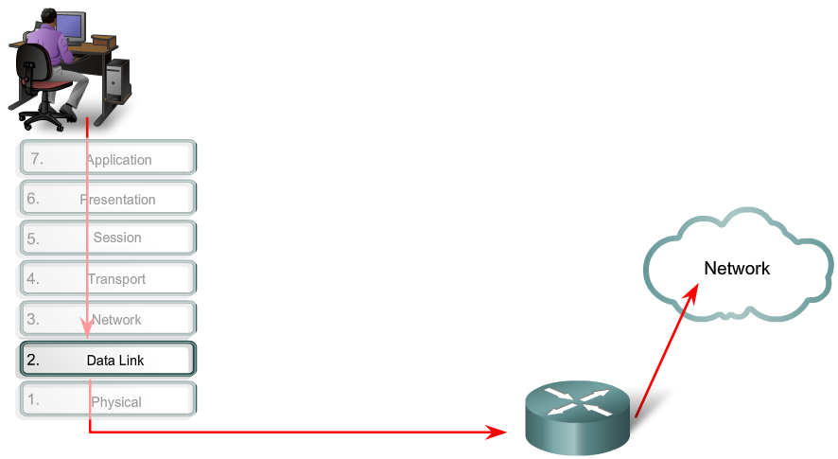
Purpose of the Data Link Layer
The Data Link Layer
Notes:
4.3.1.1 The Data Link Layer

Slide 41
Purpose of the Data Link Layer
Data Link Sublayers
Network
Data Link | LLC Sublayer
 | MAC Sublayer
Physical
802.3
Ethernet
802.11
Wi-Fi
802.15
Bluetooth
Notes:
4.3.1.2 Data Link Sublayers

Slide 42
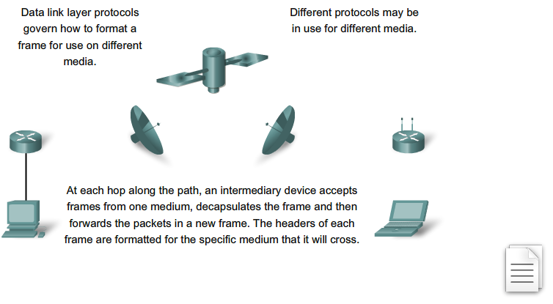
Purpose of the Data Link Layer
Media Access Control
The Data Link Layer
Notes:
4.3.1.3 Media Access Control

Slide 43
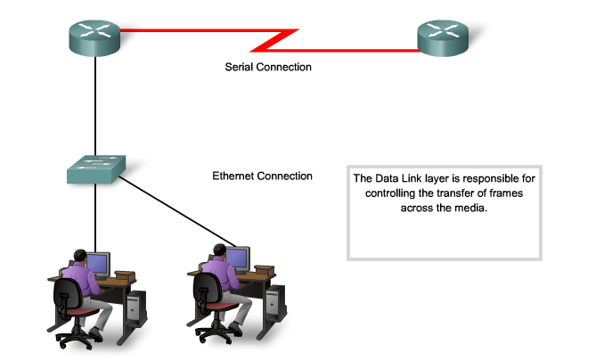
Purpose of the Data Link Layer
Providing Access to Media
Notes:
4.3.1.4 Providing Access to Media

Slide 44
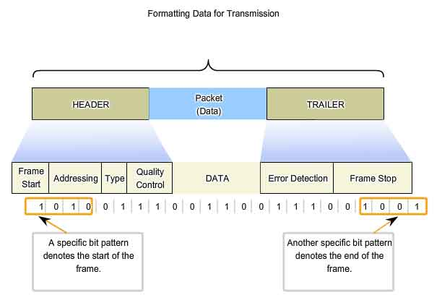
Data Link Layer
Formatting Data for Transmission
Notes:
4.3.2.1 Formatting Data for Transmission

Slide 45
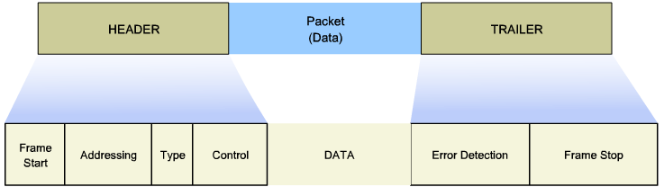
Layer 2 Frame Structure
Creating a Frame
Notes:
4.3.2.2 Creating a Frame

Slide 46
Layer 2 Standards
Data Link Layer Standards
Standard organization | Networking Standards
IEEE | 802.2: Logical Link Control (LLC) 802.3: Ethernet 802.4: Token bus 802.5: Token passing 802.11: Wireless LAN (WLAN) & Mesh (Wi-Fi certification) 802.15: Bluetooth 802.16: WiMax
ITU-T | G.992: ADSL G.8100 - G.8199: MPLS over Transport aspects Q.921: ISDN Q.922: Frame Relay
ISO | HDLC (High Level Data Link Control) ISO 9314: FDDI Media Access Control (MAC)
ANSI | X3T9.5 and X3T12: Fiber Distributed Data Interface (FDDI)
Notes:
4.3.3.1 Data Link Layer Standards

Slide 47
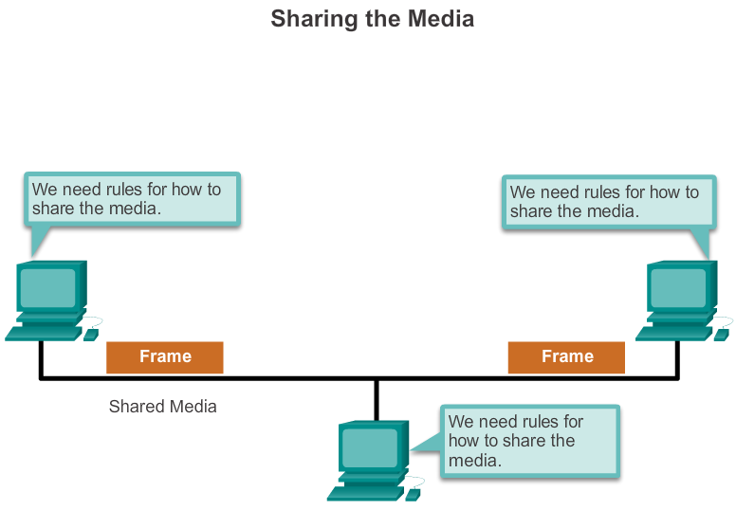
Topologies
Controlling Access to the Media
Notes:
4.4.1.1 Controlling Access to the Media

Slide 48
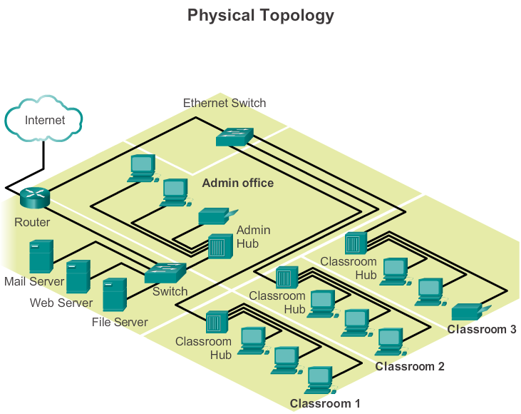
Topologies
Physical and Logical Topologies
Notes:
4.4.1.2 Physical and Logical Topologies

Slide 49
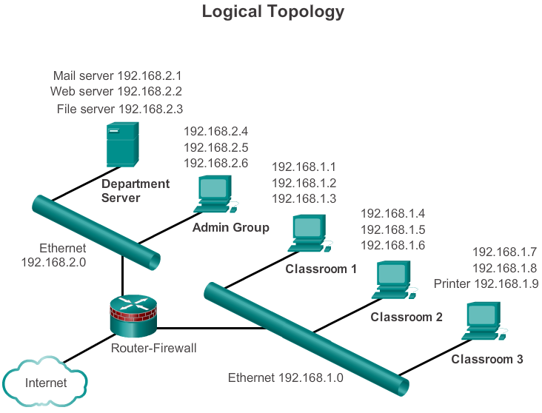
Topologies
Physical and Logical Topologies (cont.)
Notes:
4.4.1.2 Physical and Logical Topologies (cont.)

Slide 50
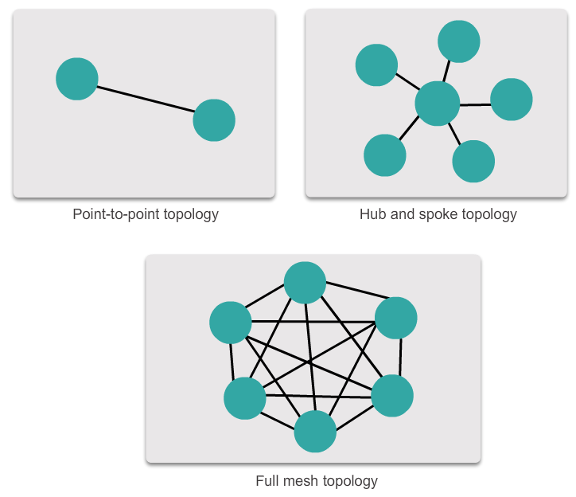
WAN Topologies
Common Physical WAN Topologies
Notes:
4.4.2.1 Common Physical WAN Topologies

Slide 51
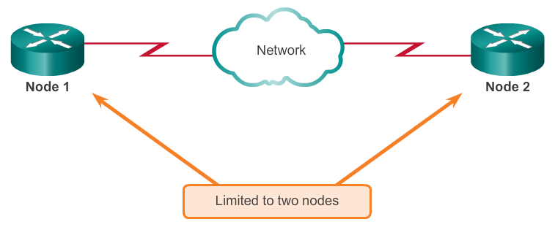
WAN Topologies
Physical Point-to-Point Topology
Notes:
4.4.2.2 Physical Point-to-Point Topology

Slide 52
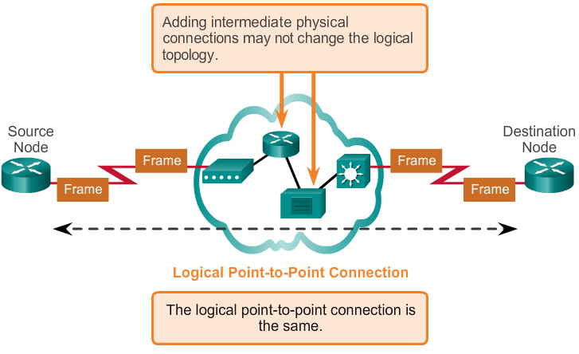
WAN Topologies
Logical Point-to-Point Topology
Notes:
4.4.2.3 Logical Point-to-Point Topology

Slide 53
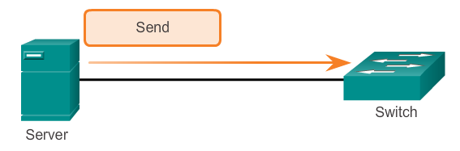
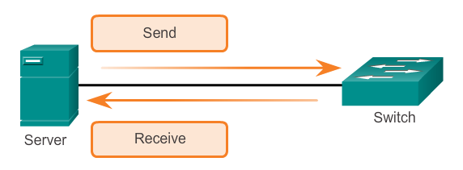
WAN Topologies
Half- and Full-Duplex
Half-Duplex
Full-Duplex
Notes:
4.4.2.4 Half and Full Duplex

Slide 54
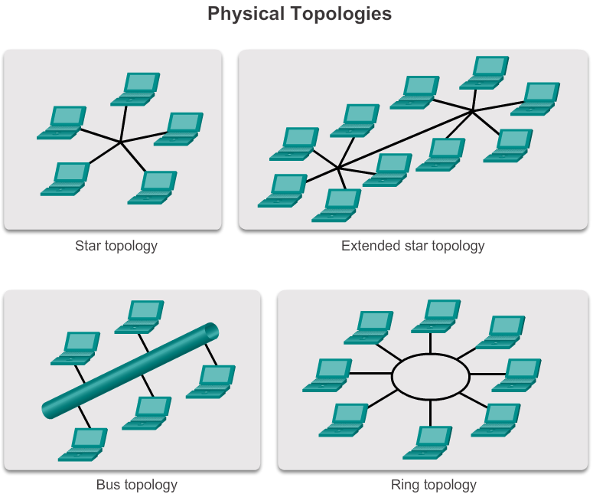
LAN Topologies
Physical LAN Topologies
Notes:
4.4.3.1 Physical LAN Topologies

Slide 55
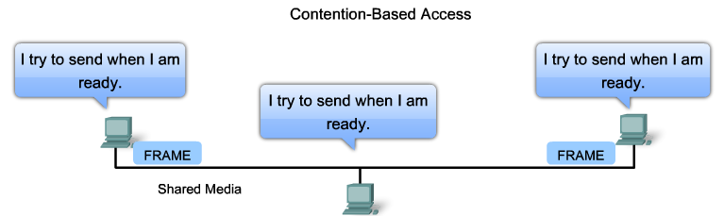
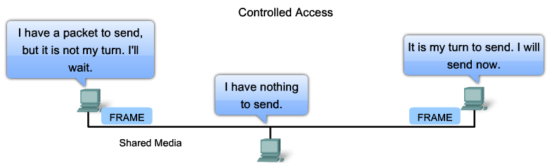
LAN Topologies
Logical Topology for Shared Media
Notes:
4.4.3.2 Logical Topology for Shared Media

Slide 56
LAN Topologies
Contention-Based Access
Characteristics | Contention-Based Technologies
Stations can transmit at any time Collision exist There are mechanisms to resolve contention for the media | CSMA/CD for 802.3 Ethernet networks CSMA/CA for 802.11 wireless networks
Notes:
4.4.3.3 Contention-Based Access

Slide 57
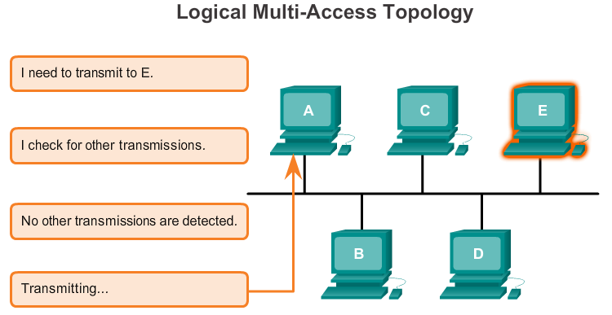
LAN Topologies
Multi-Access Topology
Notes:
4.4.3.4 Multi-Access Topology

Slide 58
LAN Topologies
Controlled Access
Characteristics | Controlled Access Technologies
Only one station can transmit at a time Devices wanting to transmit must wait their turn No collisions May use a token passing method | Token Ring (IEEE 802.5) FDDI
Notes:
4.4.3.5 Controlled Access

Slide 59
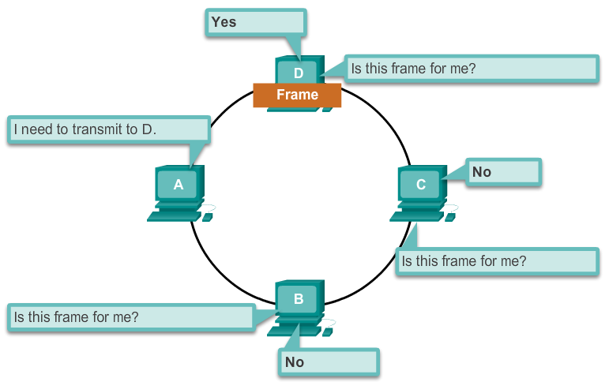
LAN Topologies
Ring Topology
Notes:
4.4.3.6 Ring Topology

Slide 60
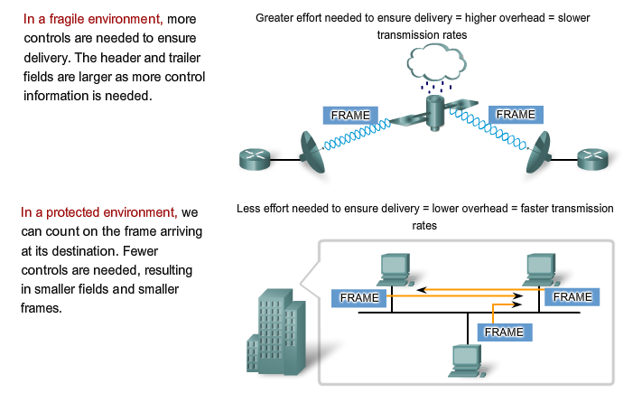
Data Link Frame
The Frame
Notes:
4.4.4.1 The Frame

Slide 61
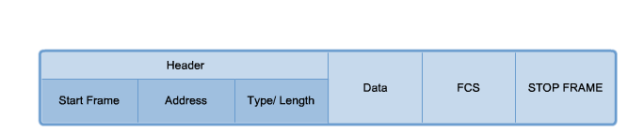
Data Link Frame
The Header
Notes:
4.4.4.2 The Header

Slide 62
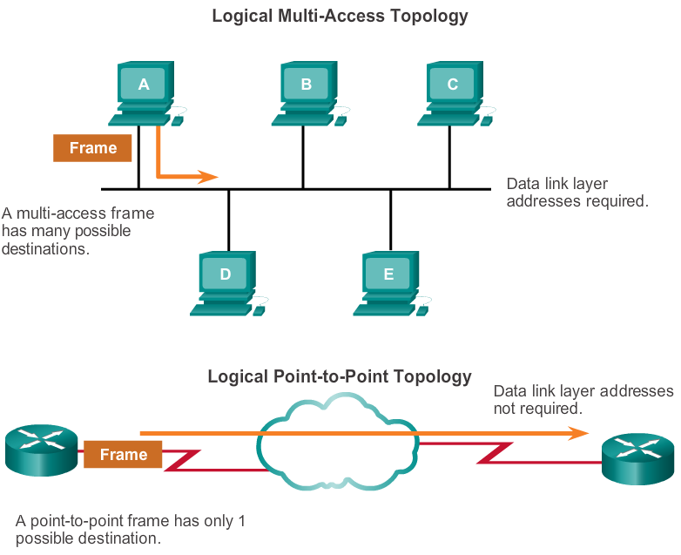
Data Link Frame
Layer 2 Address
Notes:
4.4.4.3 Layer 2 Address

Slide 63



Data Link Frame
The Trailer
Notes:
4.4.4.4 The Trailer

Slide 64

Data Link Frame
LAN and WAN Frames
Notes:
4.4.4.5 LAN and WAN Frames

Slide 65

Data Link Frame
Ethernet Frame
Notes:
4.4.4.6 Ethernet Frame

Slide 66

Data Link Frame
Point-to-Point Protocol Frame
Notes:
4.4.4.7 PPP Frame

Slide 67

Data Link Frame
802.11 Wireless Frame
Notes:
4.4.4.8 802.11 Wireless Frame

Slide 68
Network Access
Summary
The TCP/IP network access layer is the equivalent of the OSI data link layer (Layer 2) and the physical layer (Layer 1).
The OSI physical layer provides the means to transport the bits that make up a data link layer frame across the network media.
The physical layer standards address three functional areas: physical components, frame encoding technique, and signaling method.
Using the proper media is an important part of network communications. Without the proper physical connection, either wired or wireless, communications between any two devices will not occur.
Wired communication consists of copper media and fiber cable.
There are three main types of copper media used in networking: unshielded-twisted pair (UTP), shielded-twisted pair (STP), and coaxial cable. UTP cabling is the most common copper networking media.
Notes:
Chapter 4 Summary

Slide 69
Network Access
Summary (cont.)
Optical fiber cable has become very popular for interconnecting infrastructure network devices. It permits the transmission of data over longer distances and at higher bandwidths (data rates) than any other networking media.
Wireless media carry electromagnetic signals that represent the binary digits of data communications using radio or microwave frequencies.
The data link layer is responsible for the exchange of frames between nodes over a physical network media. It allows the upper layers to access the media and controls how data is placed and received on the media.
Among the different implementations of the data link layer protocols, there are different methods of controlling access to the media. These media access control techniques define if and how the nodes share the media.
The actual media access control method used depends on the topology and media sharing. LAN and WAN topologies can be physical or logical.
Notes:
Chapter 4 Summary (cont.)

Slide 70
Network Access
Summary (cont.)
WANs are commonly interconnected using the point-to-point, hub and spoke, or mesh physical topologies.
In shared media LANs, end devices can be interconnected using the star, bus, ring, or extended star (hybrid) physical topologies.
All data link layer protocols encapsulate the Layer 3 PDU within the data field of the frame. However, the structure of the frame and the fields contained in the header and trailer vary according to the protocol.
Notes:
Chapter 4 Summary (cont.)

Slide 71


