Slide 1
Chapter 2:
Configuring a Network Operating System
Introduction to Networks
Notes:
Cisco Networking Academy program
Introduction to Network
Chapter 2: Configuring a Network Operating System

Slide 2
Chapter 2 - Objectives
Upon completion of this chapter you will be able to:
Explain the purpose of the Cisco IOS.
Explain how to access and navigate Cisco IOS to configure network devices.
Describe the command structure of the Cisco IOS software.
Configure hostnames on a Cisco IOS device using the CLI.
Use Cisco IOS commands to limit access to device configurations.
Use Cisco IOS commands to save the running configuration.
Explain how devices communicate across network media.
Configure a host device with an IP address.
Verify connectivity between two end devices.
Notes:
Chapter 2 Objectives

Slide 3
Chapter 2
2.0 Introduction
2.1 IOS Bootcamp
2.2 Getting Basic
2.3 Addressing Schemes
2.4 Summary
Notes:
Chapter 2 Objectives

Slide 4
2.1 IOS Bootcamp
Notes:
2.1 IOS Bootcamp

Slide 5
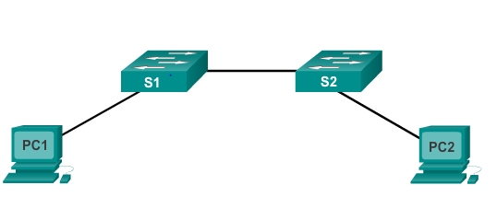
Cisco IOS
Operating Systems
All networking equipment dependent on operating systems
The operating system on home routers is usually called firmware
Cisco IOS – Collection of network operating systems used on Cisco devices
Notes:
2.1.1.1 Operating Systems

Slide 6
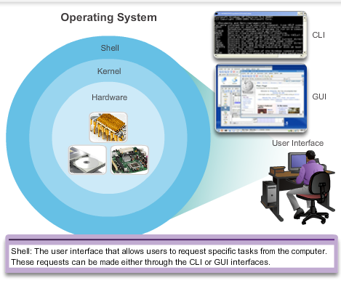

Cisco IOS
Operating Systems (cont.)
Notes:
2.1.1.1 Operating Systems

Slide 7
Cisco IOS
Purpose of OS
PC operating systems (Windows 8 and OS X) perform technical functions that enable:
  Use of a mouse
  View output
  Enter text
Switch or router IOS provides options to:
  Configure interfaces
  Enable routing and switching functions
All networking devices come with a default IOS
Possible to upgrade the IOS version or feature set
In this course, primary focus is Cisco IOS Release 15.x
Notes:
2.1.1.2 Purpose of OS

Slide 8
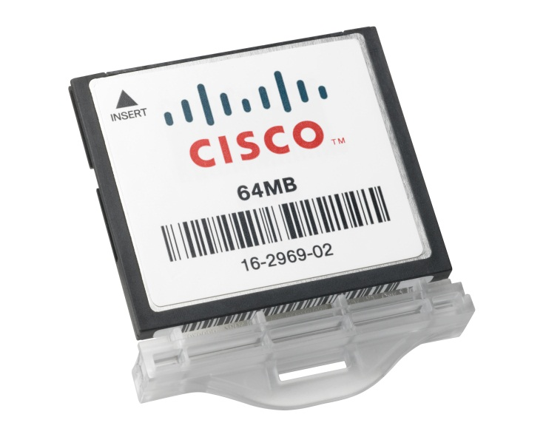
Cisco IOS
Location of the Cisco IOS
Cisco IOS stored in Flash
Non-volatile storage, not lost when power is lost
Can be changed or overwritten as needed
Can be used to store multiple versions of IOS
IOS copied from flash to volatile RAM
Quantity of flash and RAM memory determines IOS that can be used
Notes:
2.1.1.3 Location of the Cisco IOS

Slide 9
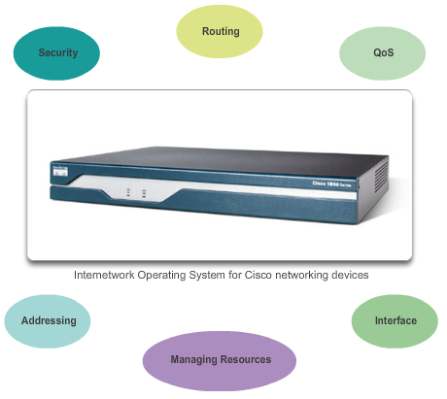
Cisco IOS
IOS Functions
These are the major functions performed or enabled by Cisco routers and switches.
Notes:
2.1.1.4 IOS Functions

Slide 10
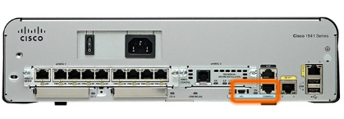
Accessing a Cisco IOS Device
Console Access Method
Most common methods to access the CLI:
Console
Telnet or SSH
AUX port
Notes:
2.1.2.1 Console Access Method

Slide 11
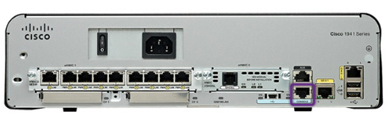
Accessing a Cisco IOS Device
Console Access Method
Console Port
Device is accessible even if no networking services have been configured (out-of-band)
Need a special console cable
Allows configuration commands to be entered
Should be configured with passwords to prevent unauthorized access
Device should be located in a secure room so console port cannot be easily accessed
Notes:
2.1.2.1 Console Access Method
Out-of-band access refers to access via a dedicated management channel that is used for device maintenance purposes only.
In the event that a password is lost, there is a special set of procedures for bypassing the password and accessing the device.

Slide 12
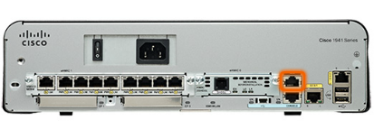

Accessing a Cisco IOS Device
Telnet, SSH, and AUX Access Methods
Telnet
Method for remotely accessing the CLI over a network
Require active networking services and one active interface that is configured
Secure Shell (SSH)
Remote login similar to Telnet, but utilizes more security
Stronger password authentication
Uses encryption when transporting data
Aux Port
Out-of-band connection
Uses telephone line
Can be used like console port
Notes:
2.1.2.2 Telnet, SSH, and AUX Access Methods

Slide 13
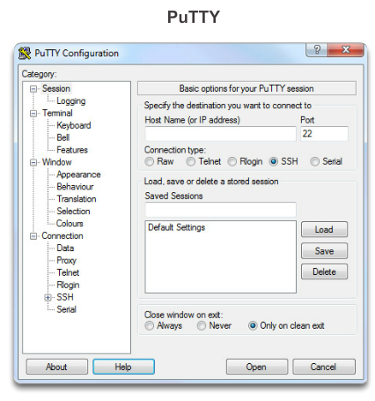
Accessing a Cisco IOS Device
Terminal Emulation Programs
Software available for connecting to a networking device:
PuTTY
Tera Term
SecureCRT
HyperTerminal
OS X Terminal
Notes:
2.1.2.3 Terminal Emulation Programs
There are a number of excellent terminal emulation programs available for connecting to a networking device either by a serial connection over a console port or by an SSH connection. Some of these include:
PuTTY
Tera Term
SecureCRT
HyperTerminal
OS X Terminal
There are a number of excellent terminal emulation programs available for connecting to a networking device either by a serial connection over a console port or by an SSH connection.
Each network technician tends to have a favorite terminal emulation program that they use exclusively. These programs allow you to enhance your productivity by adjusting window sizes, changing font sizes, and changing color schemes

Slide 14
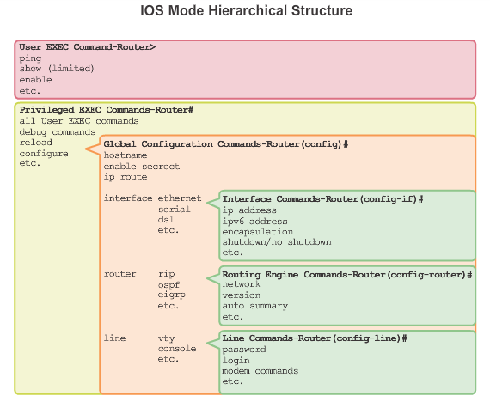
Navigating the IOS
Cisco IOS Modes of Operation
Notes:
2.1.3.1 Cisco IOS Modes of Operations
In hierarchical order from most basic to most specialized, the major modes are:
User executive (User EXEC) mode
Privileged executive (Privileged EXEC) mode
Global configuration mode
Other specific configuration modes, such as Interface configuration mode.
Each mode has a distinctive prompt

Slide 15
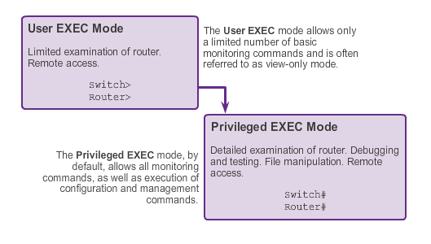
Navigating the IOS
Primary Modes
Notes:
2.1.3.2 Primary Modes
The two primary modes of operation are user EXEC mode and privileged EXEC mode. Tthe privileged EXEC mode has a higher level of authority in what it allows the user to do with the device.
User EXEC Mode
The user EXEC mode has limited capabilities but is useful for some basic operations. This mode is the first mode encountered upon entrance into the CLI of an IOS device.
This is often referred to as view-only mode. The user EXEC level does not allow the execution of any commands that might change the configuration of the device.
By default, there is no authentication required to access the user EXEC mode from the console. However, it is a good practice to ensure that authentication is configured during the initial configuration.
The user EXEC mode is identified by the CLI prompt that ends with the > symbol. This is an example that shows the > symbol in the prompt: Switch>
Privileged EXEC Mode
The execution of configuration and management commands requires that the network administrator use the privileged EXEC mode, or a more specific mode in the hierarchy.
The privileged EXEC mode can be identified by the prompt ending with the #symbol. Switch#
By default, privileged EXEC mode does not require authentication.
Global configuration mode and all other more specific configuration modes can only be reached from the privileged EXEC mode.

Slide 16
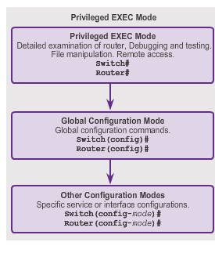
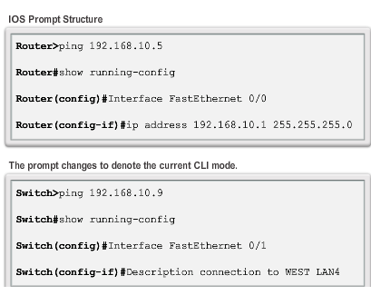
Navigating the IOS
Global Configuration Mode and Submodes
Notes:
2.1.3.3 Global Configuration Mode and Submodes
Global configuration mode and interface configuration modes can only be reached from the privileged EXEC mode.
From global config, CLI configuration changes are made that affect the operation of the device as a whole.
Switch# configure terminal
Switch(config)#
From the global config mode, the user can enter different subconfiguration modes. Each of these modes allows the configuration of a particular part or function of the IOS device.
Interface mode - to configure one of the network interfaces (Fa0/0, S0/0/0)
Line mode - to configure one of the physical or virtual lines (console, AUX, VTY)
To exit a specific configuration mode and return to global configuration mode, enter exit at a prompt. To leave configuration mode completely and return to privileged EXEC mode, enter end or use the key sequence Ctrl-Z.
As commands are used and modes are changed, the prompt changes to reflect the current context.

Slide 17
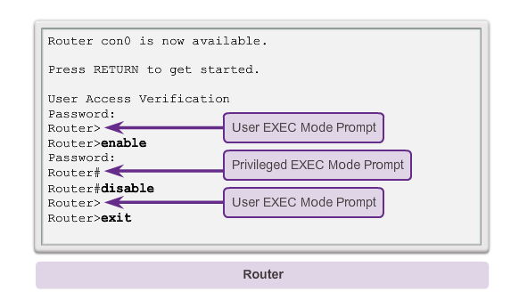
Navigating the IOS
Navigating Between IOS Modes
Notes:
2.1.3.4 Navigating between IOS Modes
The enable and disable commands are used to change the CLI between the user EXEC mode and the privileged EXEC mode, respectively.

Slide 18
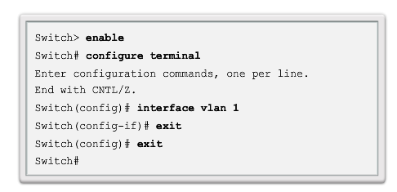
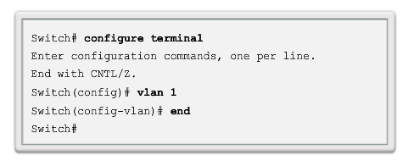
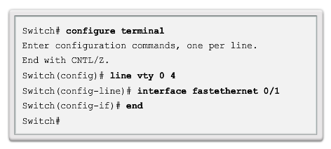
Navigating the IOS
Navigating Between IOS Modes (cont.)
Notes:
2.1.3.5 Navigating between IOS Modes (cont.)
To move from the global configuration mode to the privileged EXEC mode, you enter the command exit.
To move from any submode of the global configuration mode to the mode one step above it in the hierarchy of modes, enter the exit command.
To move from any submode of the privileged EXEC mode to the privileged EXEC mode, enter the end command or enter the key combination Ctrl+Z.
To move from any submode of the global configuration mode to another “immediate” submode of the global configuration mode, simply enter the corresponding command that is normally entered from global configuration mode

Slide 19
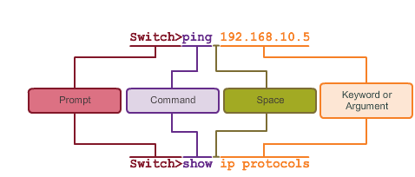
The Command Structure
IOS Command Structure
Notes:
2.1.4.1 IOS Command Structure
Each IOS command has a specific format or syntax and can only be executed at the appropriate mode.
The commands are not case-sensitive. Following the command are one or more keywords and arguments.
Unlike a keyword, an argument is generally not a predefined word. An argument is a value or variable defined by the user
Switch> ping IP address
Switch> ping 10.10.10.5
The command is ping and the user defined argument is the 10.10.10.5.
Similarly, the syntax for entering thetraceroute command is:
Switch> traceroute IP address
Switch> traceroute 192.168.254.254
The command is traceroute and the user defined argument is the 192.168.254.254.

Slide 20
The Command Structure
Cisco IOS Command Reference
To navigate to Cisco’s IOS Command Reference to find a command:
Go to http://www.cisco.com.
Click Support.
Click Networking Software (IOS & NX-OS).
Click 15.2M&T (for example).
Click Reference Guides.
Click Command References.
Click the particular technology that encompasses the command you reference.
Click the link on the left that alphabetically matches the command you referencing.
Click the link for the command.
Notes:
2.1.4.2 Cisco IOS Command Reference
The Command Reference is a fundamental resource that network engineers use to check various characteristics of a given IOS command.

Slide 21
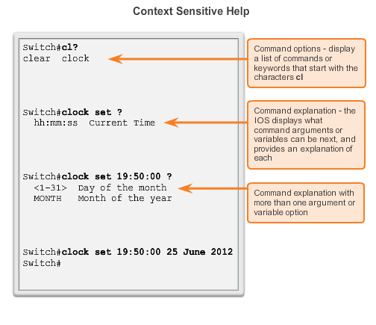
The Command Structure
Context-Sensitive Help
Notes:
2.1.4.3 Context Sensitive Help
The IOS has several forms of help available:
Context-sensitive help
Command Syntax Check
Hot Keys and Shortcuts

Slide 22
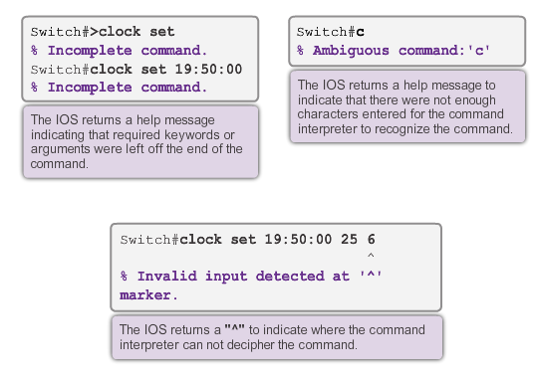
The Command Structure
Command Syntax Check
Notes:
2.1.4.4 Command Syntax Check
There are three different types of error messages:
Ambiguous command
Incomplete command
Incorrect command

Slide 23
The Command Structure
Hot Keys and Shortcuts
Tab – Completes the remainder of a partially typed command or keyword.
Ctrl-R – Redisplays a line.
Ctrl-A – Moves to the beginning of the line.
Ctrl-Z – Exits the configuration mode and returns to user EXEC.
Down Arrow – Allows the user to scroll forward through former commands.
Up Arrow – Allows the user to scroll backward through former commands.
Ctrl-shift-6 – Allows the user to interrupt an IOS process such as ping or traceroute.
Ctrl-C – Exits the current configuration or aborts the current command.
Notes:
2.1.4.5 Hot Keys and Shortcuts
Tab - This is a good technique to use when you are learning because it allows you to see the full word used for the command or keyword.
Ctrl-Z - Because the IOS has a hierarchical mode structure, you may find yourself several levels down. Rather than exit each mode individually, use Ctrl-Z to return directly to the privileged EXEC prompt at the top level.
Ctrl-Shift-6 - Using the escape sequence. When an IOS process is initiated from the CLI, such as a ping or traceroute, the command runs until it is complete or is interrupted. While the process is running, the CLI is unresponsive. To interrupt the output and interact with the CLI, press Ctrl-Shift-6.
Commands and keywords can be abbreviated to the minimum number of characters that -identify a unique selection.

Slide 24
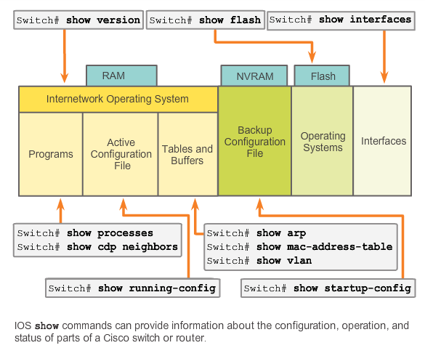
The Command Structure
IOS Examination Commands
Notes:
2.1.4.6 IOS Examination Commands
Use the show ? command to get a list of available commands in a given context, or mode.
A typical show command can provide information about the configuration, operation, and status of parts of a Cisco device.
A very commonly used show command is show interfaces. This command displays statistics for all interfaces on the device. To view the statistics for a specific interface, enter the show interfaces command followed by the specific interface type and slot/port number.
Some other show commands frequently used by network technicians include:
show startup-config - Displays the saved configuration located in NVRAM.
show running-config - Displays the contents of the currently running configuration file.

Slide 25
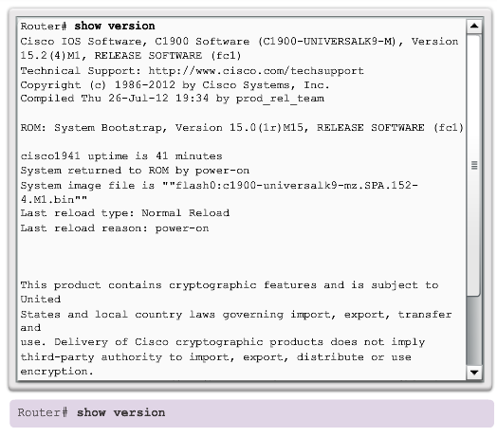
The Command Structure
The show version Command
Notes:
2.1.4.7 The show version Command
This command displays information about the currently loaded IOS version, along with hardware and device information.
Software Version - IOS software version (stored in flash)
Bootstrap Version - Bootstrap version (stored in Boot ROM)
System up-time - Time since last reboot
System restart info - Method of restart (e.g., power cycle, crash)
Software image name - IOS filename stored in flash
Router Type and Processor type - Model number and processor type
Memory type and allocation (Shared/Main) - Main Processor RAM and Shared Packet I/O buffering
Software Features - Supported protocols / feature sets
Hardware Interfaces - Interfaces available on the device
Configuration Register - Sets bootup specifications, console speed setting, and related parameters

Slide 26
2.2 Getting Basic
Notes:
2.2 Getting Basic

Slide 27
Hostnames
Why the Switch
Let’s focus on:
Creating a two PC network connected via a switch
Setting a name for the switch
Limiting access to the device configuration
Configuring banner messages
Saving the configuration
Notes:
2.2.1.1 Why the Switch

Slide 28
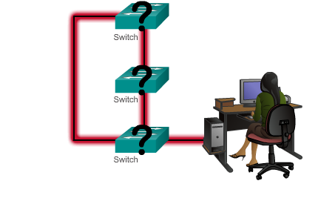
Hostnames
Device Names
Some guidelines for naming conventions:
Start with a letter
Contains no spaces
Ends with a letter or digit
Uses only letters, digits, and dashes
Be less than 64 characters in length
Without names, network devices are difficult to identify for configuration purposes.
Notes:
2.2.1.2 Device Names

Slide 29
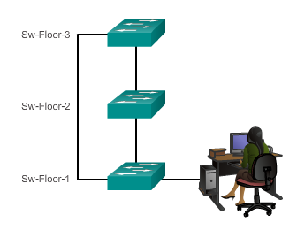
Hostnames
Configuring Device Names
Hostnames allow devices to be identified by network administrators over a network or the Internet.
Notes:
2.2.1.3 Hostnames

Slide 30
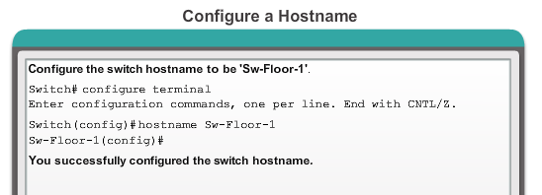
Hostnames
Configuring Hostnames
Notes:
2.2.1.4 Configuring Hostnames

Slide 31
Limiting Access to Device Configurations
Securing Device Access
These are device access passwords:
enable password – Limits access to the privileged EXEC mode
enable secret – Encrypted, limits access to the privileged EXEC mode
console password – Limits device access using the console connection
VTY password – Limits device access over Telnet
Note: In most of the labs in this course, we will be using simple passwords such as cisco or class.
Notes:
2.2.2.1 Securing Device Access
Consider these key points when choosing passwords:
Use passwords that are more than eight characters in length.
Use a combination of upper and lowercase letters, numbers, special characters, and/or numeric sequences in passwords.
Avoid using the same password for all devices.
Avoid using common words such as password or administrator, because these are easily guessed

Slide 32
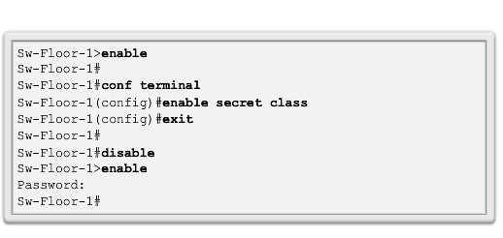
Limiting Access to Device Configurations
Securing Privileged EXEC Access Mode
Use the enable secret command, not the older enable password command.
The enable secret command provides greater security because the password is encrypted.
Notes:
2.2.2.2 Securing Privileged EXEC Access

Slide 33
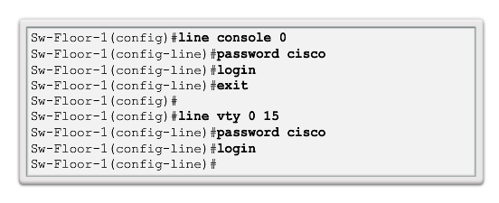
Limiting Access to Device Configurations
Securing User EXEC Access
Console port must be secured; it reduces the chance of unauthorized personnel physically plugging a cable into the device and gaining device access.
VTY lines allow access to a Cisco device via Telnet. The number of VTY lines supported varies with the type of device and the IOS version.
Notes:
2.2.2.3 Securing User EXEC Access

Slide 34
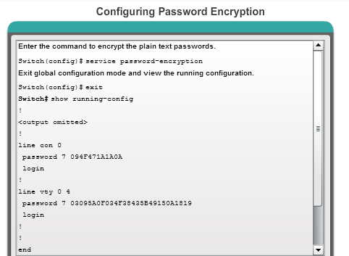
Limiting Access to Device Configurations
Encrypting Password Display
service password-encryption
Prevents passwords from showing up as plain text when viewing the configuration
Keeps unauthorized individuals from viewing passwords in the configuration file
Once applied, removing the encryption service does not reverse the encryption
Notes:
2.2.2.4 Encrypting Password Display

Slide 35
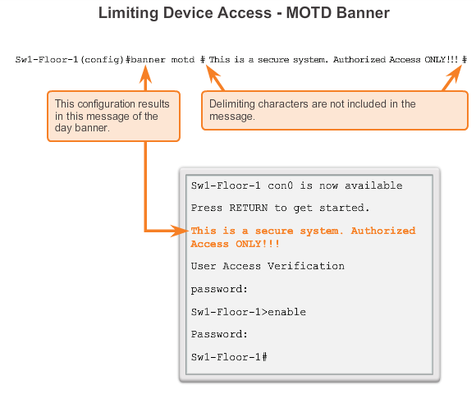
Limiting Access to Device Configurations
Banner Messages
Important part of the legal process in the event that someone is prosecuted for breaking into a device
Wording that implies that a login is "welcome" or "invited" is not appropriate
Often used for legal notification because it is displayed to all connected terminals
Notes:
2.2.2.5 Banner Messages

Slide 36
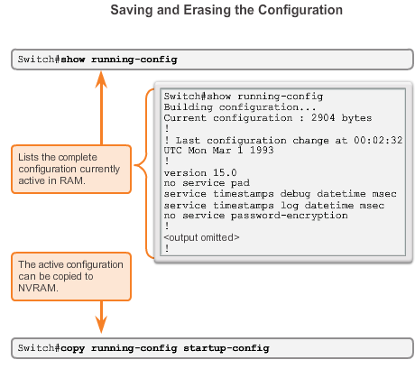
Saving Configurations
Configuration Files
Switch# reload
  System configuration has been modified. Save? [yes/no]: n
  Proceed with reload? [confirm]
Startup configuration is removed by using the erase startup-config
  Switch# erase startup-config
On a switch, you must also issue the delete vlan.dat
  Switch# delete vlan.dat
  Delete filename [vlan.dat]?
  Delete flash:vlan.dat? [confirm]
Notes:
2.2.3.1 Configuration Files
Switch# erase startup-config
After the command is issued, the switch will prompt you for confirmation:
Erasing the nvram filesystem will remove all configuration files! Continue? [confirm]
Confirm is the default response. To confirm and erase the startup configuration file, press . Pressing any other key will abort the process.

Slide 37
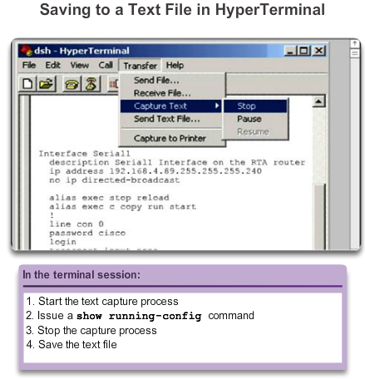
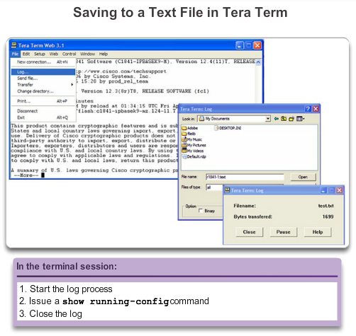
Saving Configurations
Capturing Text
Notes:
2.2.3.2 Capturing Text
Restoring Text Configurations
A configuration file can be copied from storage to a device. When copied into the terminal, the IOS executes each line of the configuration text as a command. This means that the file will require editing to ensure that encrypted passwords are in plain text and that non-command text such as "--More--" and IOS messages are removed. This process is discussed in the lab.
Further, at the CLI, the device must be set at the global configuration mode to receive the commands from the text file being copied.
When using HyperTerminal, the steps are:
Locate the file to be copied into the device and open the text document.
Copy all of the text.
On the Edit menu, click paste to host.
When using TeraTerm, the steps are:
On the File menu, click Send file.
Locate the file to be copied into the device and click Open.
TeraTerm will paste the file into the device.

Slide 38
2.3 Addressing Schemes
Notes:
2.3 Addressing Schemes

Slide 39
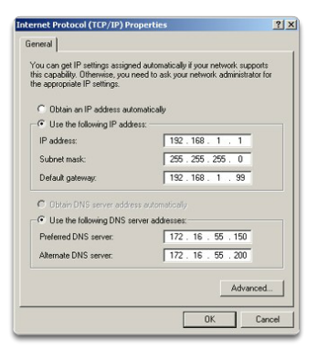
Ports and Addresses
IP Addressing of Devices
Each end device on a network must be configured with an IP address.
Structure of an IPv4 address is called dotted decimal.
IP address displayed in decimal notation, with four decimal numbers between 0 and 255.
With the IP address, a subnet mask is also necessary.
IP addresses can be assigned to both physical ports and virtual interfaces.
Notes:
2.3.1.1 IP Addressing of Devices

Slide 40
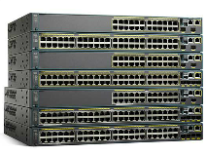
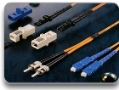
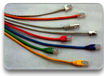
Ports and Addresses
Interfaces and Ports
Network communications depend on end user device interfaces, networking device interfaces, and the cables that connect them.
Types of network media include twisted-pair copper cables, fiber-optic cables, coaxial cables, or wireless.
Different types of network media have different features and benefits.
Ethernet is the most common local area network (LAN) technology.
Ethernet ports are found on end user devices, switch devices, and other networking devices.
Cisco IOS switches have physical ports for devices to connect to, but also have one or more switch virtual interfaces (SVIs; no physical hardware on the device associated with it; created in software).
SVI provides a means to remotely manage a switch over a network.
Notes:
2.3.1.2 Interfaces and Ports
Some of the differences between various types of media include:
The distance the media can successfully carry a signal.
The environment in which the media is to be installed.
The amount of data and the speed at which it must be transmitted.
The cost of the media and installation

Slide 41
Addressing Devices
Configuring a Switch Virtual Interface
IP address – Together with subnet mask, uniquely identifies end device on internetwork.
Subnet mask – Determines which part of a larger network is used by an IP address.
interface VLAN 1 – Available in interface configuration mode,
ip address 192.168.10.2 255.255.255.0 – Configures the IP address and subnet mask for the switch.
no shutdown – Administratively enables the interface.
Switch still needs to have physical ports configured and VTY lines to enable remote management.
Notes:
2.3.2.1 Configuring a Switch Virtual Interface

Slide 42
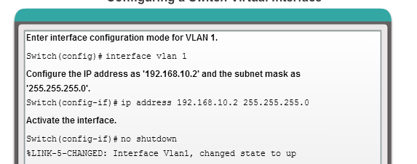
Addressing Devices
Configuring a Switch Virtual Interface
Notes:
2.3.2.1 Configuring a Switch Virtual Interface

Slide 43
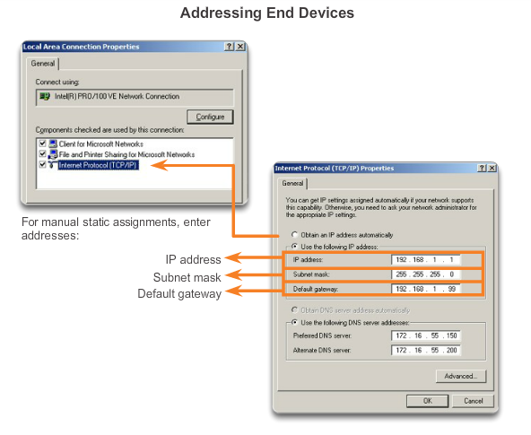
Addressing Devices
Manual IP Address Configuration for End Devices
Notes:
2.3.2.2 Manual IP Address Configuration for End Devices

Slide 44
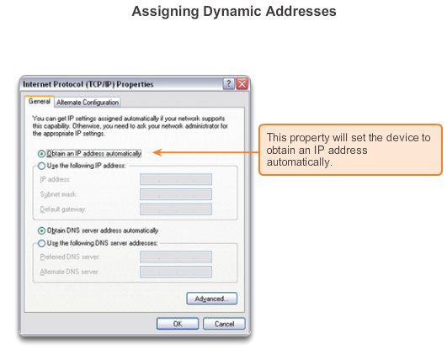
Addressing Devices
Automatic IP Address Configuration for End Devices
Notes:
2.3.2.3 Automatic IP Address Configuration for End Devices

Slide 45
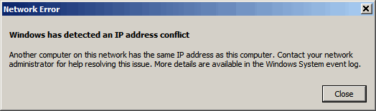
Addressing Devices
IP Address Conflicts
Notes:
2.3.2.4 IP Address Conflicts

Slide 46
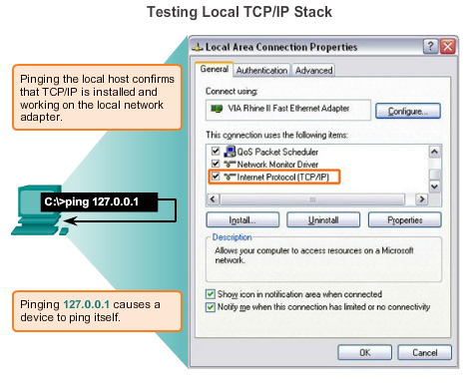
Verifying Connectivity
Test the Loopback Address on an End Device
Notes:
2.3.3.1 Test the Loopback Address on an End Device

Slide 47
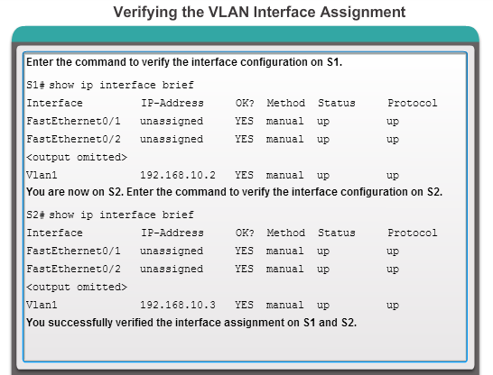
Verifying Connectivity
Testing the Interface Assignment
Notes:
2.3.3.2 Testing the Interface Assignment

Slide 48
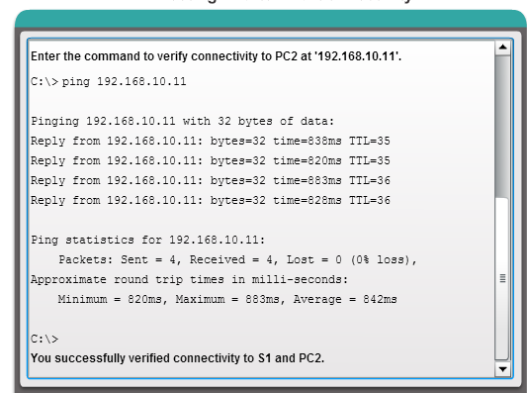
Verifying Connectivity
Testing End-to-End Connectivity
Notes:
2.3.3.3 Testing End-to-End Connectivity

Slide 49
Configuring a Network Operating System
Chapter 2 Summary
Cisco IOS:
The technician can enter commands to configure, or program, the device to perform various networking functions.
Services are generally accessed using a command-line interface (CLI), which is accessed by either the console port, the AUX port, or through telnet or SSH.
Once connected to the CLI, network technicians can make configuration changes to Cisco IOS devices.
Cisco IOS is designed as a modal operating system, which means a network technician must navigate through various hierarchical modes of the IOS.
Cisco IOS routers and switches support a similar modal operating system, support similar command structures, and support many of the same commands. In addition, both devices have identical initial configuration steps when implementing them in a network.
Notes:
2.4.1.3 Summary

Slide 50

Configuring a Network Operating System
Chapter 2 Summary (cont.)
Notes:
2.4.1.3 Summary

Slide 51
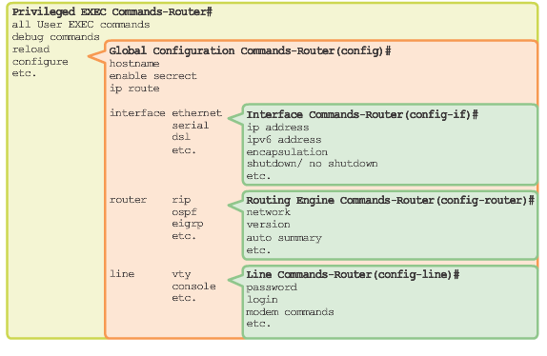
Configuring a Network Operating System
Chapter 2 Summary (cont.)
Notes:
2.4.1.3 Summary

Slide 52


