Slide 1
Chapter 11: It’s a Network
Introduction to Networking
Notes:
Cisco Networking Academy program
Introduction to Networking
Chapter 11: It’s a Network

Slide 2
Chapter 11
11.0 Introduction
11.1 Create and Grow
11.2 Keeping the Network Safe
11.3 Basic Network Performance
11.4 Managing IOS Configuration Files
11.5 Integrated Routing Services
11.6 Summary
Notes:
Chapter 11

Slide 3
Chapter 11: Objectives
Upon completion of this chapter, you will be able to:
Identify the devices and protocols used in a small network.
Explain how a small network serves as the basis of larger networks.
Describe the need for basic security measures on network devices.
Identify security vulnerabilities and general mitigation techniques.
Configure network devices with device hardening features to mitigate security threats.
Use the output of ping and tracert commands to establish relative network performance.
Use basic show commands to verify the configuration and status of a device interface.

Slide 4
Chapter 11: Objectives (Cont.)
Use the basic host and IOS commands to acquire information about the devices in a network.
Explain the file systems on Routers and Switches.
Apply the commands to back up and restore an IOS configuration file.

Slide 5
11.1 Create and Grow
Notes:
11.1 Create and Grow

Slide 6
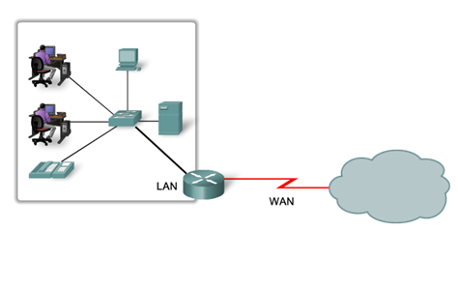
Devices in a Small Network
Small Network Topologies
Typical Small Network Topology
Notes:
11.1.1.1 Small Network Topologies

Slide 7
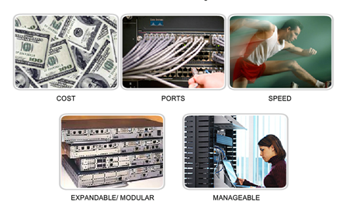
Devices in a Small Network
Device Selection for a Small Network
Factors to be considered when selecting intermediate devices.
Notes:
11.1.1.2 Device Selection for a Small Network

Slide 8
Devices in a Small Network
IP Addressing for a Small Network
IP addressing scheme should be planned, documented and maintained based on the type of devices receiving the address.
Examples of devices that will be part of the IP design:
  End devices for users
  Servers and peripherals
  Hosts that are accessible from the Internet
  Intermediary devices
Planned IP schemes help the administrator:
  Track devices and troubleshoot
  Control access to resources
Notes:
11.1.1.3 IP Addressing for a Small Network

Slide 9
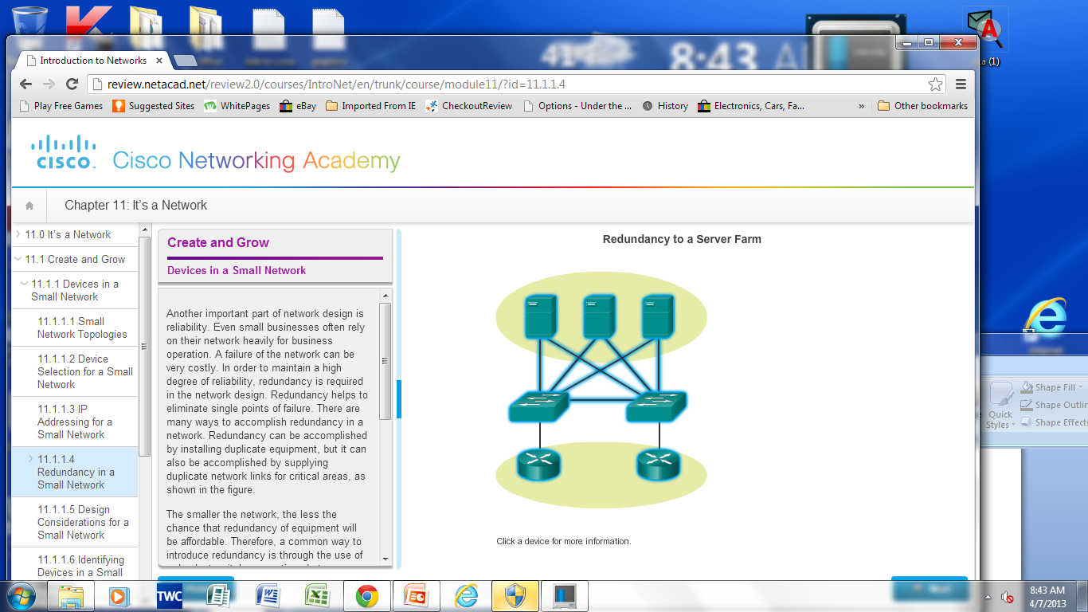
Devices in a Small Network
Redundancy in a Small Network
Redundancy helps to eliminate single points of failure.
Improves the reliability of the network.
Notes:
11.1.1.4 Redundancy in a Small Network

Slide 10
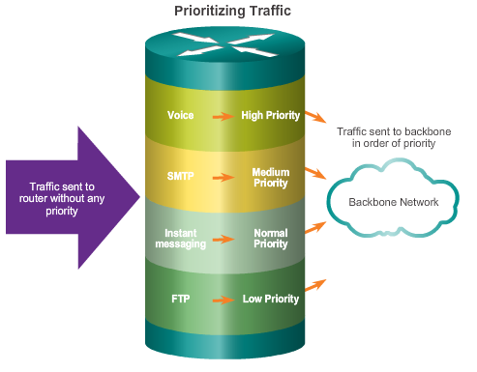
Devices in a Small Network
Design Considerations for a Small Network
The following should be included in the network design:
  Secure file and mail servers in a centralized location.
  Protect the location by physical and logical security measures.
  Create redundancy in the server farm.
  Configure redundant paths to the servers.
Notes:
11.1.1.5 Design Considerations for a Small Network

Slide 11
Protocols in a Small Network
Common Applications in a Small Network
Network-Aware Applications – Software programs that are used to communicate over the network.
Application Layer Services – Programs that interface with the network and prepare the data for transfer.
Notes:
11.1.2.1 Common Applications in a Small Network

Slide 12
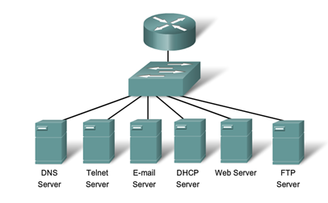
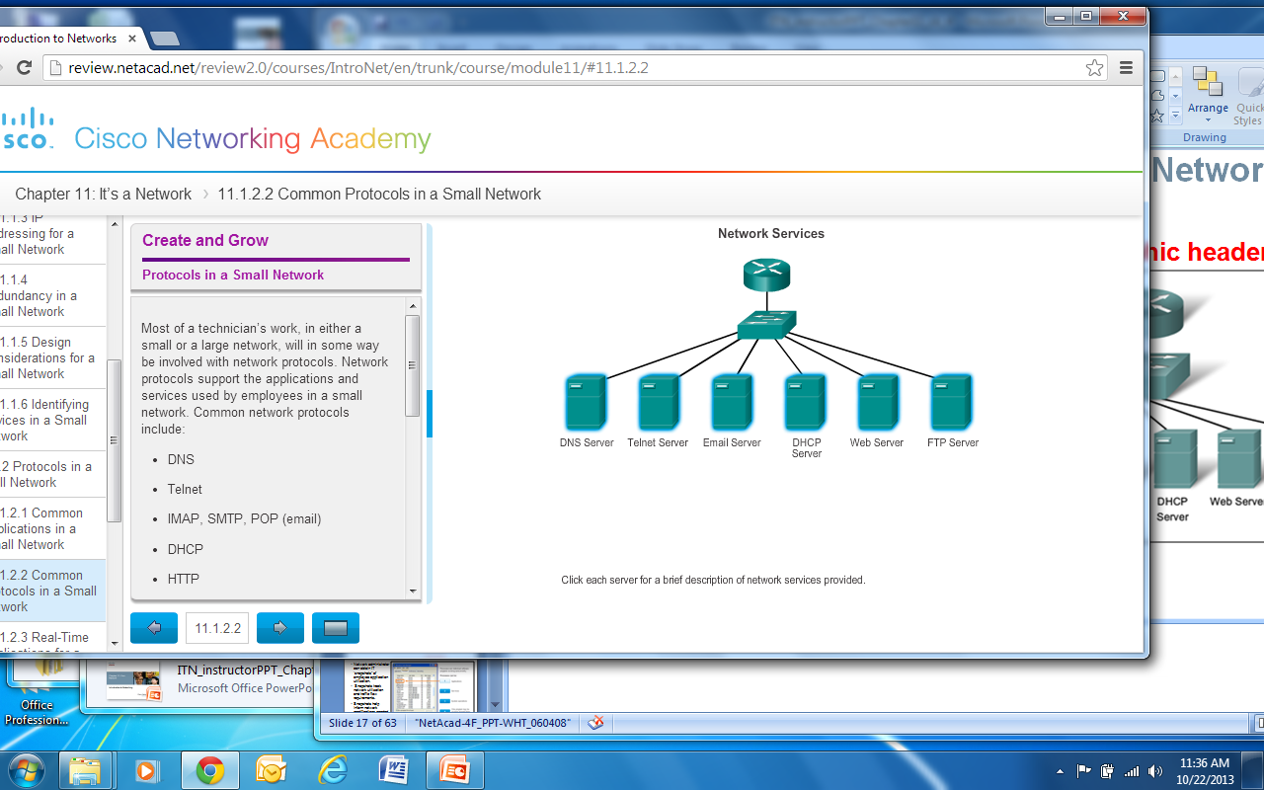
Protocols in a Small Network
Common Protocols in a Small Network
Network Protocols Define:
  Processes on either end of a communication session.
  Types of messages.
  Syntax of the messages.
  Meaning of informational fields.
  How messages are sent and the expected response.
  Interaction with the next lower layer.
Notes:
11.1.2.2 Common Protocols in a Small Network

Slide 13
Protocols in a Small Network
Real-Time Applications for a Small Network
Real-time applications require planning and dedicated services to ensure priority delivery of voice and video traffic.
Infrastructure – Needs to be evaluated to ensure it will support proposed real time applications.
VoIP – Is implemented in organizations that still use traditional telephones.
IP telephony – The IP phone itself performs voice-to-IP conversion.
Real-time Video Protocols – Use Time Transport Protocol (RTP) and Real-Time Transport Control Protocol (RTCP).
Notes:
11.1.2.3 Real-Time Applications for a Small Network

Slide 14
Growing to Larger Networks
Scaling a Small Network
Important considerations when growing to a larger network:
Documentation –Physical and logical topology.
Device inventory – List of devices that use or comprise the network.
Budget – Itemized IT expense items, including the amount of money allocated to equipment purchase for that fiscal year.
Traffic Analysis – Protocols, applications, and services and their respective traffic requirements should be documented.
Notes:
11.1.3.1 Scaling a Small Network

Slide 15
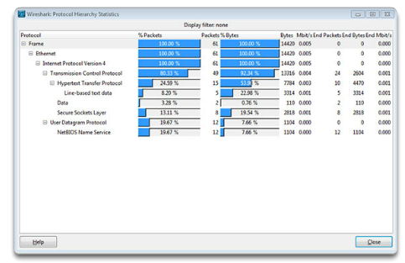
Growing to Larger Networks
Protocol Analysis of a Small Network
Information gathered by protocol analysis can be used to make decisions on how to manage traffic more efficiently.
Notes:
11.1.3.2 Protocol Analysis of a Small Network

Slide 16
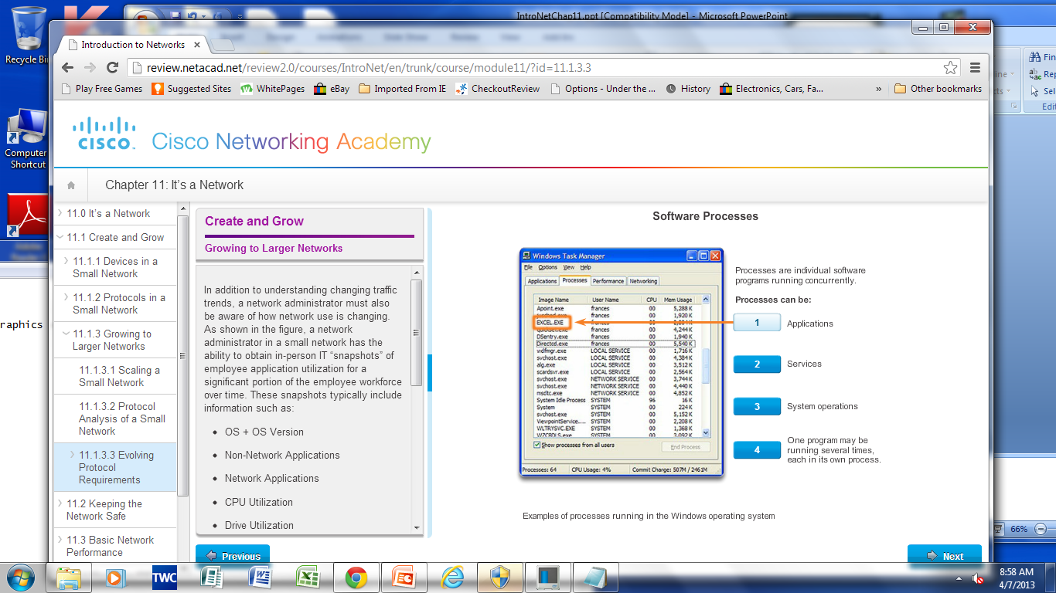
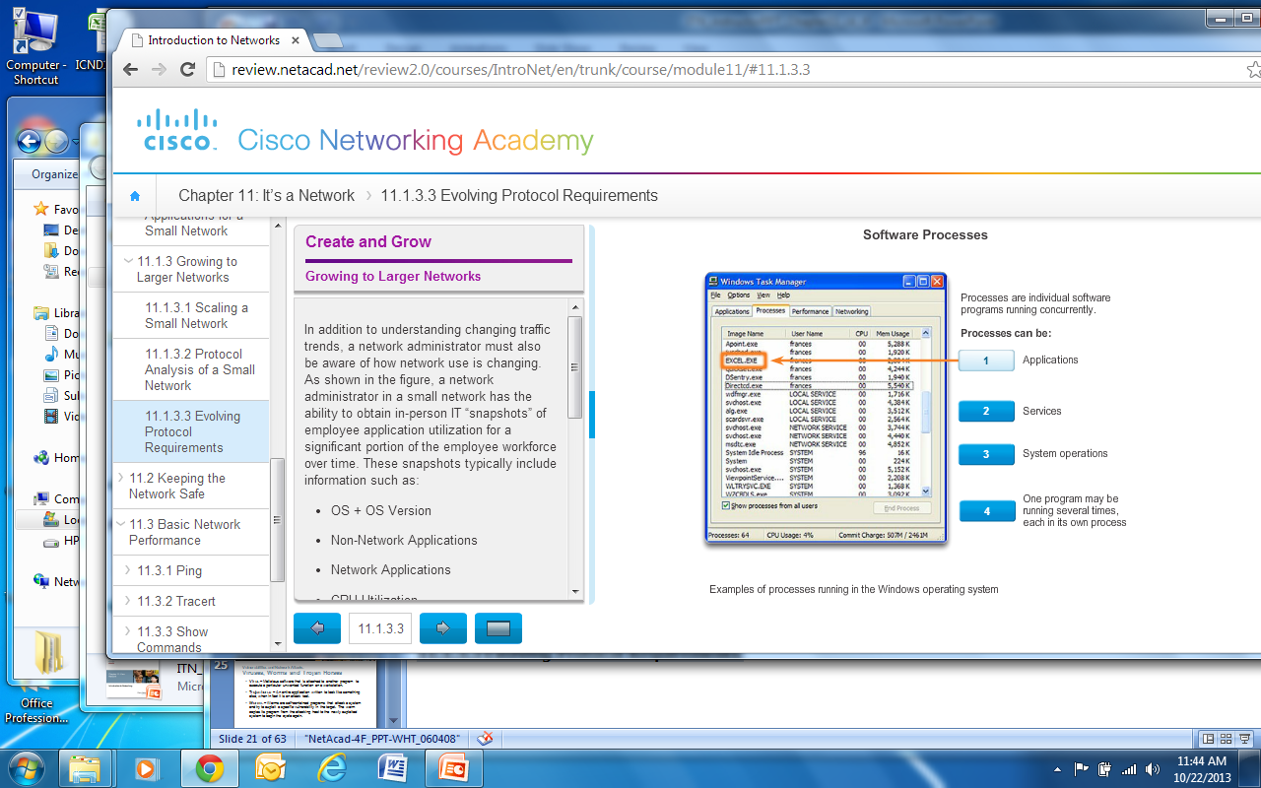
Growing to Larger Networks
Evolving Protocol Requirements
Network administrator can obtain IT “snapshots” of employee application utilization.
Snapshots track network utilization and traffic flow requirements.
Snapshots help inform network modifications needed.
Notes:
11.1.3.3 Evolving Protocol Requirements

Slide 17
11.2 Keeping the Network Safe
Notes:
11.2 Keeping the Network Safe

Slide 18
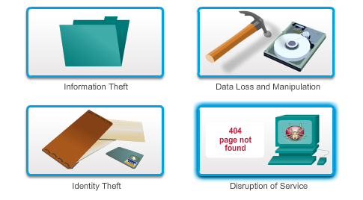
Network Device Security Measures
Threats to Network Security
Categories of Threats to Network Security
Notes:
11.2.1.1 Categories of Threats to Network Security

Slide 19
Network Device Security Measures
Physical Security
Four classes of physical threats are:
Hardware threats – Physical damage to servers, routers, switches, cabling plant, and workstations
Environmental threats – Temperature extremes (too hot or too cold) or humidity extremes (too wet or too dry)
Electrical threats – Voltage spikes, insufficient supply voltage (brownouts), unconditioned power (noise), and total power loss
Maintenance threats – Poor handling of key electrical components (electrostatic discharge), lack of critical spare parts, poor cabling, and poor labeling
Notes:
11.2.1.2 Physical Security

Slide 20
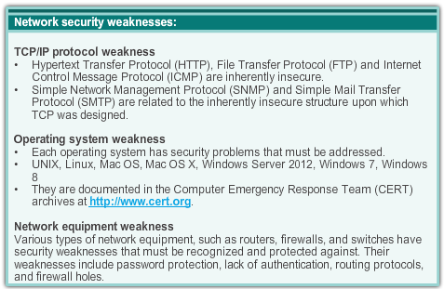
Network Device Security Measures
Types of Security Vulnerabilities
Vulnerabilities - Technology
Types of Security Weaknesses:
Technological
Configuration
Security policy
Notes:
11.2.1.3 Types of Security Vulnerabilities

Slide 21
Vulnerabilities and Network Attacks
Viruses, Worms and Trojan Horses
Virus – Malicious software that is attached to another program to execute a particular unwanted function on a workstation.
Trojan horse – An entire application written to look like something else, when in fact it is an attack tool.
Worms – Worms are self-contained programs that attack a system and try to exploit a specific vulnerability in the target. The worm copies its program from the attacking host to the newly exploited system to begin the cycle again.
Notes:
11.2.2.1 Viruses, Worms and Trojan Horses

Slide 22
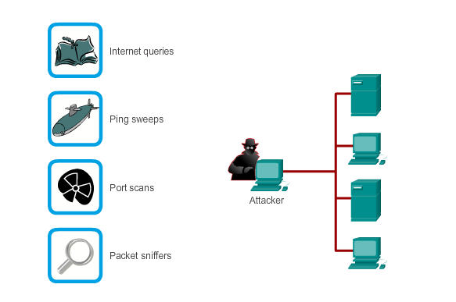
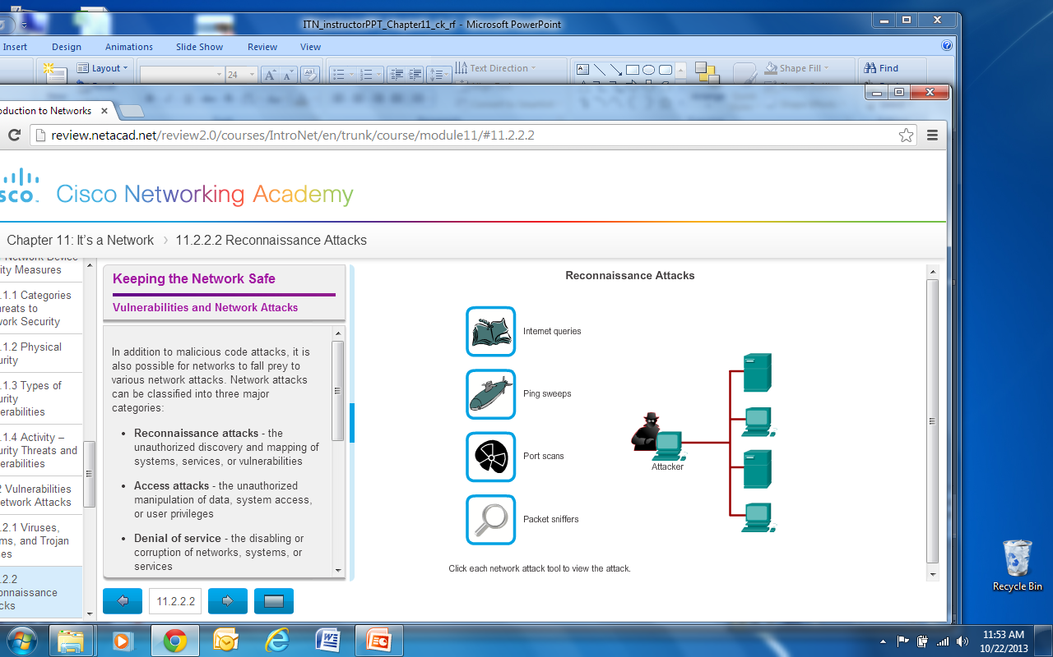
Vulnerabilities and Network Attacks
Reconnaissance Attacks
Notes:
11.2.2.2 Reconnaissance, Access and DoS Attacks

Slide 23
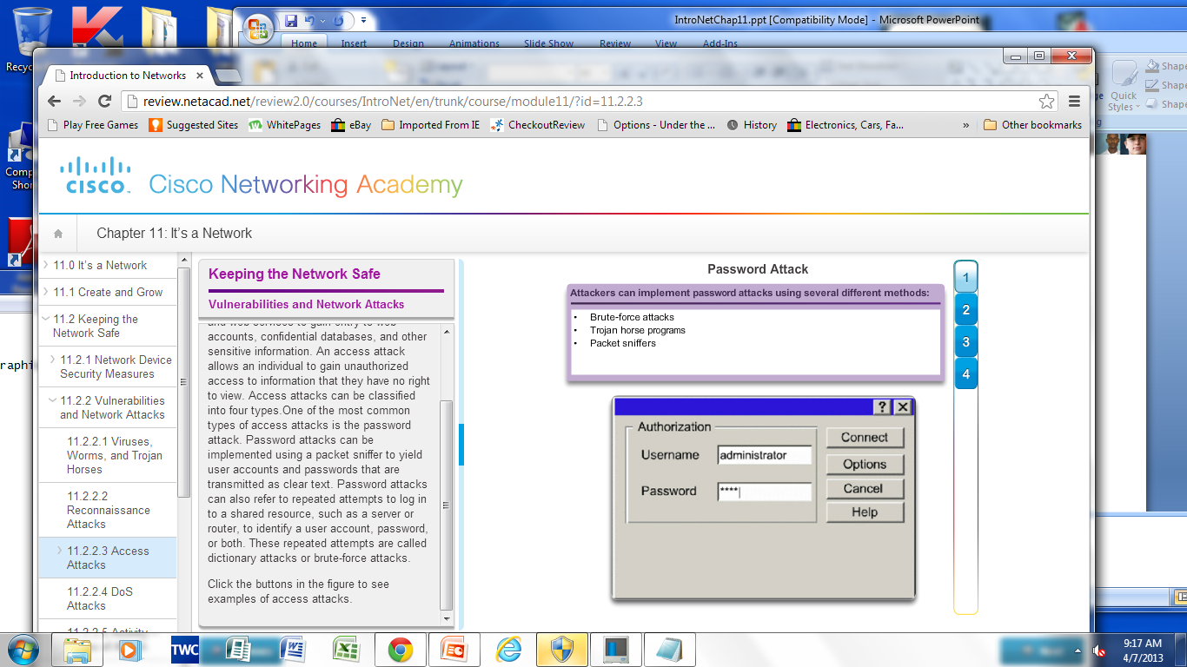
Vulnerabilities and Network Attacks
Access Attacks
Notes:
11.2.2.3 Access Attacks

Slide 24
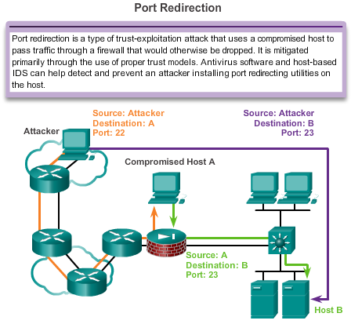
Vulnerabilities and Network Attacks
Access Attacks (Cont.)
Notes:
11.2.2.3 Access Attacks

Slide 25
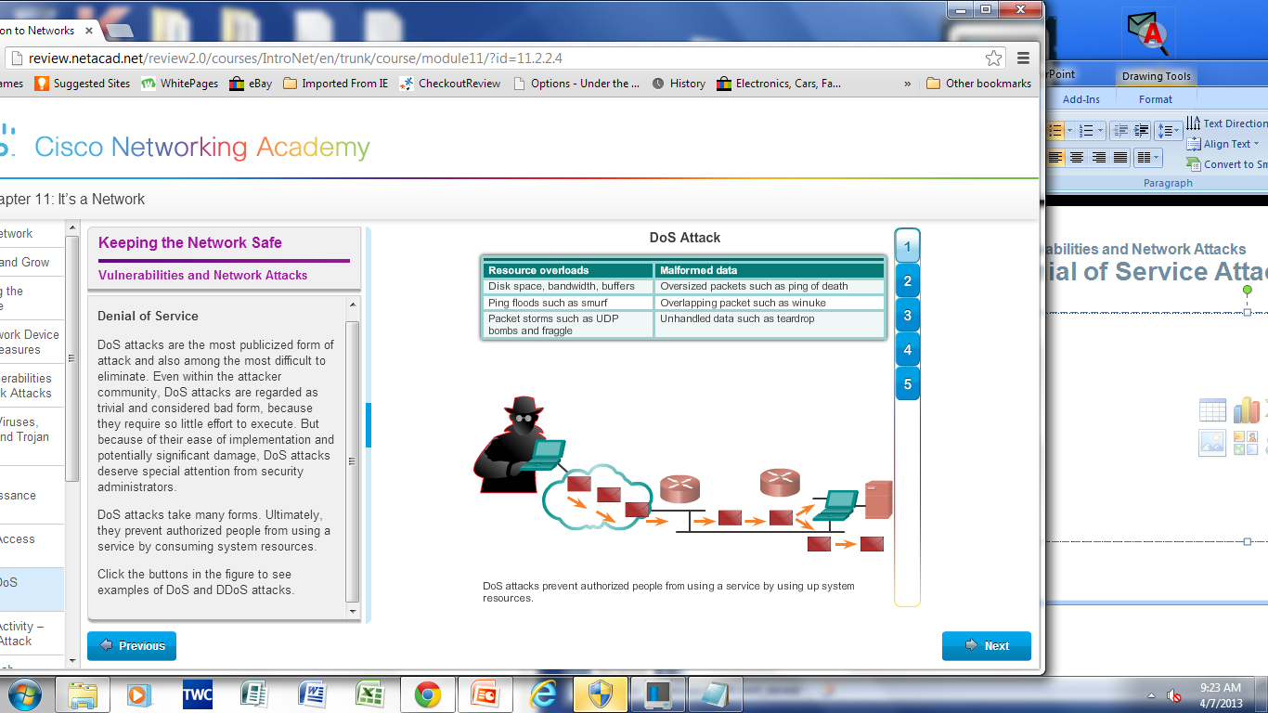
Vulnerabilities and Network Attacks
Denial of Service Attacks (DoS)
Notes:
11.2.2.4 DoS Attacks

Slide 26
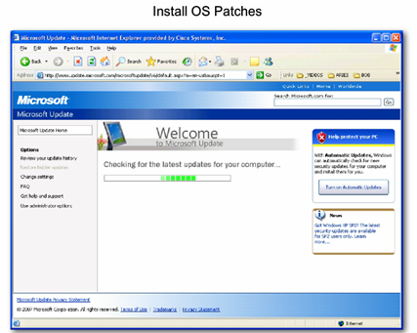
Mitigating Network Attacks
Backup, Upgrade, Update, and Patch
Antivirus software can detect most viruses and many Trojan horse applications and prevent them from spreading in the network.
Keep current with the latest versions of antivirus software.
Install updated security patches.
Notes:
11.2.3.1 Backup, Upgrade, Update, and Patch

Slide 27
Mitigating Network Attacks
Authentication, Authorization, and Accounting
Authentication, Authorization, and Accounting (AAA, or “triple A”)
Authentication – Users and administrators must prove their identity. Authentication can be established using username and password combinations, challenge and response questions, token cards, and other methods.
Authorization – Determines which resources the user can access and the operations that the user is allowed to perform.
Accounting – Records what the user accessed, the amount of time the resource is accessed, and any changes made.
Notes:
11.2.3.2 Authentication, Authorization, and Accounting

Slide 28
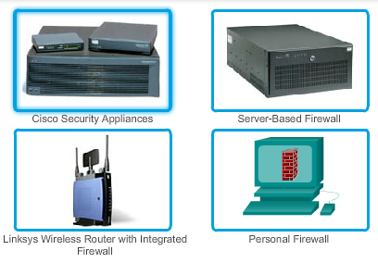
Mitigating Network Attacks
Firewalls
A Firewall resides between two or more networks. It controls traffic and helps prevent unauthorized access.
Methods used are:
Packet Filtering
Application Filtering
URL Filtering
Stateful Packet Inspection (SPI) – Incoming packets must be legitimate responses to requests from internal hosts.
Firewalls
Notes:
11.2.3.3 Firewalls

Slide 29

Mitigating Network Attacks
Endpoint Security
Common endpoints are laptops, desktops, servers, smart phones, and tablets.
Employees must follow the companies documented security policies to secure their devices.
Policies often include the use of anti-virus software and host intrusion prevention.
Common Endpoint Devices
Notes:
11.2.3.4 Endpoint Security

Slide 30
Securing Devices
Introduction to Securing Devices
Part of network security is securing devices, including end devices and intermediate devices.
Default usernames and passwords should be changed immediately.
Access to system resources should be restricted to only the individuals that are authorized to use those resources.
Any unnecessary services and applications should be turned off and uninstalled, when possible.
Update with security patches as they become available.
Notes:
11.2.4.1 Introduction to Securing Devices

Slide 31
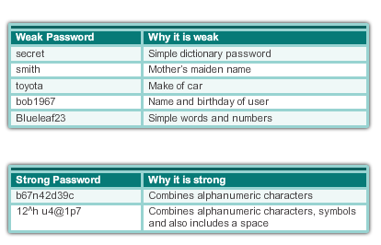
Securing Devices
Passwords
Weak and Strong Passwords
Notes:
11.2.4.2 Passwords

Slide 32
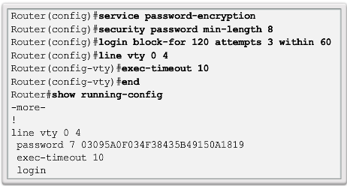
Securing Devices
Basic Security Practices
Securing Devices
Encrypt passwords.
Require minimum length passwords.
Block brute force attacks.
Use Banner Message.
Set EXEC timeout.
Notes:
11.2.4.3 Basic Security Practices

Slide 33
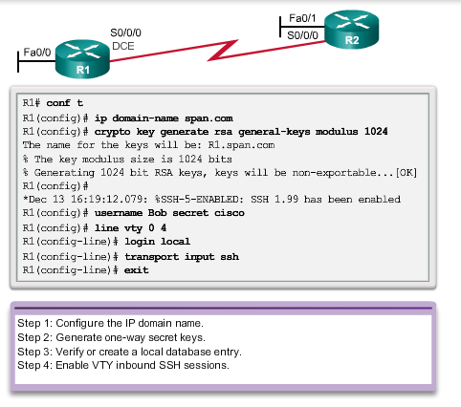
Securing Devices
Enable SSH
Notes:
11.2.4.4 Enable SSH

Slide 34
11.3 Basic Network Performance
Notes:
11.3 Basic Network Performance

Slide 35
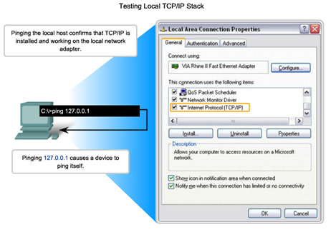
Ping
Interpreting ICMP Messages
! – indicates receipt of an ICMP echo reply message
. – indicates a time expired while waiting for an ICMP echo reply message
U – an ICMP unreachable message was received
Notes:
11.3.1.1 Interpreting ICMP Messages

Slide 36
Ping
Leveraging Extended Ping
The Cisco IOS offers an "extended" mode of the ping command:
  R2# ping
  Protocol [ip]:
  Target IP address: 192.168.10.1
  Repeat count [5]:
  Datagram size [100]:
  Timeout in seconds [2]:
  Extended commands [n]: y
  Source address or interface: 10.1.1.1
  Type of service [0]:
Notes:
11.3.1.2 Leveraging Extended Ping

Slide 37
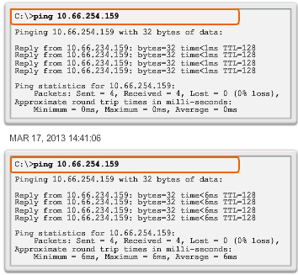
Ping
Network Baseline
Baseline with ping
Notes:
11.3.1.3 Network Baseline

Slide 38
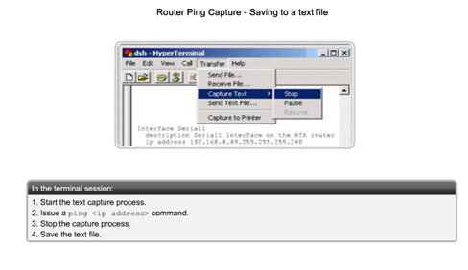
Ping
Network Baseline (Cont.)
Notes:
11.3.1. 3 Network Baseline (Cont.)

Slide 39
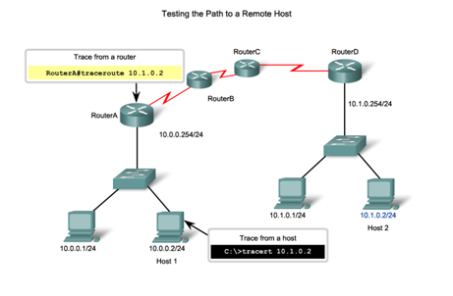
Tracert
Interpreting Tracert Messages
Notes:
11.3.2.1 Interpreting Tracert Messages

Slide 40
Show Commands
Common Show Commands Revisited
The status of nearly every process or function of the router can be displayed using a show command.
Frequently used show commands:
  show running-config
  show interfaces
  show arp
  show ip route
  show protocols
  show version
Notes:
11.3.3.1 Common Show Commands Revisited

Slide 41
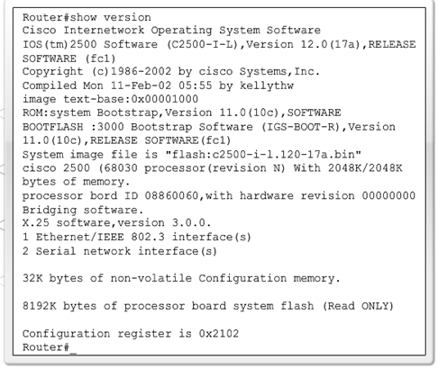
Show Commands
Viewing Router Settings With Show Version
Cisco IOS Version
System Bootstrap
Cisco IOS Image
CPU and RAM
Number and Type of Physical Interfaces
Amount of NVRAM
Amount of Flash
Configuration Register
Notes:
11.3.3.2 Viewing Router Settings with the Show Version Command

Slide 42
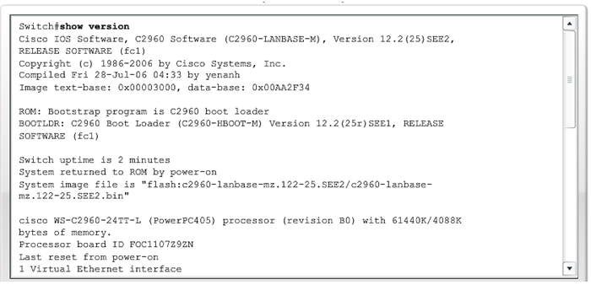
Show Commands
Viewing Switch Settings With Show Version
show version Command
Notes:
11.3.3.3 Viewing Switch Settings with Show Version

Slide 43
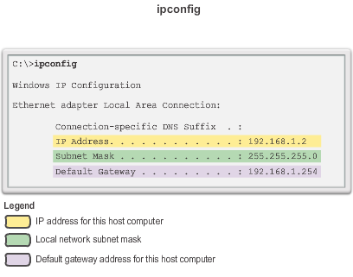
Host and IOS Commands ipconfig Command Options
ipconfig – Displays ip address, subnet mask, default gateway.
ipconfig /all – Also displays MAC address.
ipconfig /displaydns – Displays all cached dns entries in a Windows system.
Notes:
11.3.4.1 ipconfig Command Options

Slide 44
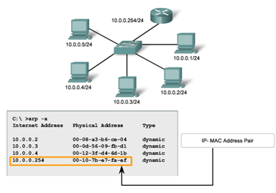
Host and IOS Commands arp Command Options
arp Command Options
Notes:
11.3.4.2 arp Command Options

Slide 45
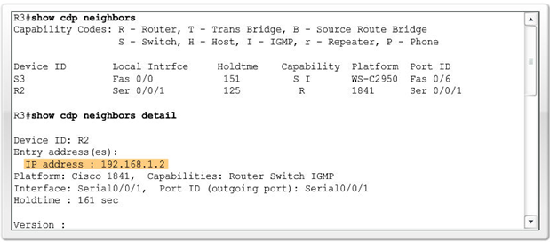
Host and IOS Commands show cdp neighbors Command Options
show cdp neighbors command provides information about each directly connected CDP neighbor device.
Notes:
11.3.4.3 Show cdp neighbors Command Options

Slide 46
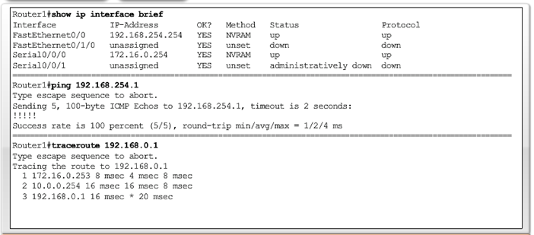
Host and IOS Commands
Using show ip interface brief Command
show ip interface brief command-used to verify the status of all network interfaces on a router or a switch.
Notes:
11.3.4.4 Using the show ip interface brief Command

Slide 47
11.4 Managing IOS Configuration Files
Notes:
11.4 Managing IOS Configuration Files

Slide 48
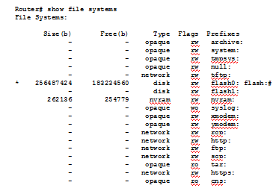
Router and Switch File Systems
Router File Systems
show file systems command – Lists all of the available file systems on a Cisco 1941 route.
The asterisk (*) indicates this is the current default file system.
Notes:
11.4.1.1 Router File Systems

Slide 49
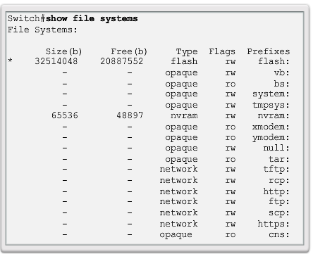
Router and Switch File Systems
Switch File Systems
show file systems command – Lists all of the available file systems on a Catalyst 2960 switch.
Notes:
11.4.1.2 Switch File Systems

Slide 50
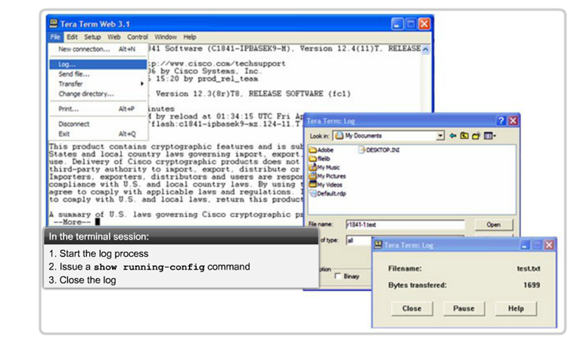
Backup and Restore Configuration Files
Backup and Restore Using Text Files
Saving to a Text File in Tera Term
Notes:
11.4.2.1 Backing up and Restore using Text Files

Slide 51
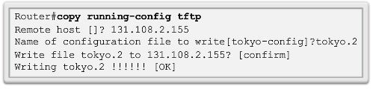
Backup and Restore Configuration Files
Backup and Restore Using TFTP
Configuration files can be stored on a Trivial File Transfer Protocol (TFTP) server.
copy running-config tftp – Save running configuration to a tftp server.
copy startup-config tftp – Save startup configuration to a tftp server.
Notes:
11.4.2.2 Backing up and Restore using TFTP

Slide 52
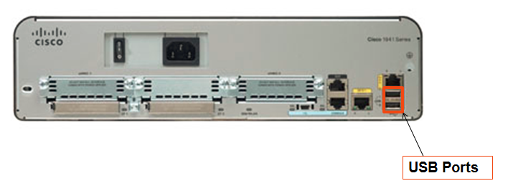
Backup and Restore Configuration Files
Using USB Interfaces on a Cisco Router
USB flash drive must be formatted in a FAT16 format.
Can hold multiple copies of the Cisco IOS and multiple router configurations.
Allows administrator to easily move configurations from router to router.
Notes:
11.4.2.3 Using USB Interfaces on a Cisco Router

Slide 53
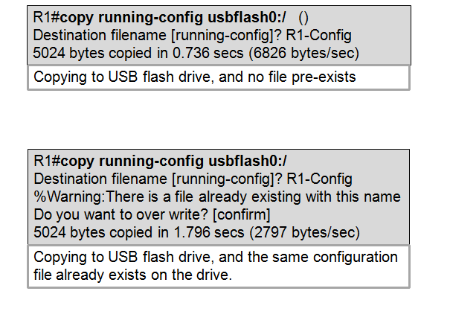
Backup and Restore Configuration Files
Backup and Restore Using USB
Backup to USB Drive
Notes:
11.4.2.4 Backup and Restore Using USB

Slide 54
11.5 Integrated Routing Services
Notes:
11.5 Integrated Routing Services

Slide 55
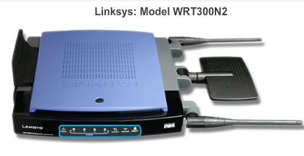
Integrated Router
Multi-function Device
Multi-function Device
Incorporates a switch, router, and wireless access point.
Provides routing, switching and wireless connectivity.
Linksys wireless routers, are simple in design and used in home networks
Cisco Integrated Services Router (ISR) product family offers a wide range of products, designed for small office to larger networks.
Notes:
11.5.1.1 Multi-function device
11.5.1.2 Types of Integrated Routers

Slide 56
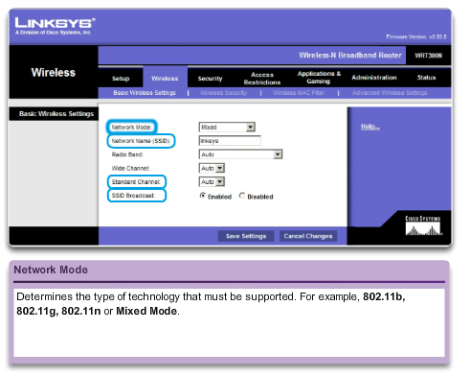
Integrated Router
Wireless Capability
Wireless Mode – Most integrated wireless routers support 802.11b, 802.11g and 802.11n.
Service Set Identifier (SSID) – Case-sensitive, alpha-numeric name for your home wireless network.
Wireless Channel – RF spectrum can be divided up into channels.
Linksys Wireless Settings
Notes:
11.5.1.3 Wireless Capability

Slide 57
Integrated Router
Basic Security of Wireless
Change default values
Disable SSID broadcasting
Configure Encryption using WEP or WPA
Wired Equivalency Protocol (WEP) - Uses pre-configured keys to encrypt and decrypt data. Every wireless device allowed to access the network must have the same WEP key entered.
Wi-Fi Protected Access (WPA) – Also uses encryption keys from 64 bits up to 256 bits. New keys are generated each time a connection is established with the AP; therefore, more secure.
Notes:
11.5.1.4 Basic Security of Wireless

Slide 58
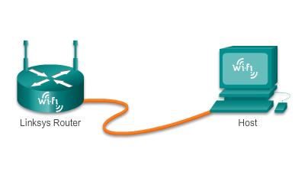
Integrated Router
Configuring the Integrated Router
Step 1 - Access the router by cabling a computer to one of the router’s LAN Ethernet ports.
Step 2 - The connecting device will automatically obtain IP addressing information from Integrated Router.
Step 3 - Change default username and password and the default Linksys IP address for security purposes.
Initial Access to the Router
Notes:
11.5.2.1 Configuring the Integrated Router

Slide 59
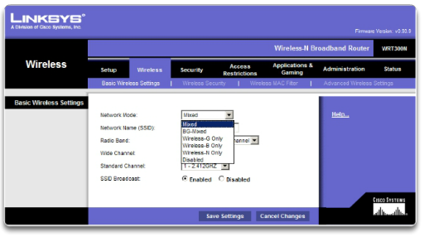
Integrated Router
Enabling Wireless
Step 1 - Configure the wireless mode
Step 2 - Configure the SSID
Step 3 - Configure RF channel
Step 4 - Configure any desired security encryption
Notes:
11.5.2.2 Enabling Wireless

Slide 60
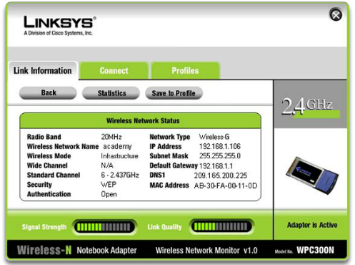
Integrated Router
Configure a Wireless Client
The wireless client configuration settings must match that of the wireless router.
  SSID
  Security Settings
  Channel
Wireless client software can be integrated into the device operating system or stand alone, downloadable, wireless utility software.
Notes:
11.5.2.3 Configure a Wireless Client

Slide 61
11.6 Summary
Notes:
11.6 Summary

Slide 62
Chapter 11: Summary
In this chapter, you learned:
Good network design incorporates reliability, scalability, and availability.
Networks must be secured from viruses, Trojan horses, worms and network attacks.
The importance of documenting Basic Network Performance.
How to test network connectivity using ping and traceroute.
How to use IOS commands to monitor and view information about the network and network devices.
How to backup configuration files using TFTP or USB.
Home networks and small business often use integrated routers, which provide the functions of a switch, router and wireless access point.
Notes:
11.6 Summary

Slide 63


