Slide 1



OLAP Cubes in Datawarehousing
Business Information Systems
Prithwis Mukerjee, Ph.D.
Acknowledgement
Hector Garcia Molina – Stanford
FORWISS - Bavarian Research Centre for Knowledge Based Systems

Slide 2
What is a Warehouse?
Collection of diverse data
Collection of tools
gathering data cleansing, integrating,
...
querying, reporting, analysis
data mining monitoring,
administering warehouse
subject oriented aimed at executive, decision maker
often a copy of operational data
with value-added data (e.g., summaries, history)
integrated time-varying non-volatile
■
■
■
■
■
■
■
■
■
■

Slide 3
Warehouse Architecture
Client
Client
Query & Analysis
Metadata
Warehouse
Integration
Source
Source
Source

Slide 4
OLTP vs. OLAP
OLTP: On Line Transaction Processing
OLAP: On Line Analytical Processing
Describes processing at warehouse
Mostly reads
Queries long, complex Gb-Tb of data
Summarized, consolidated data Decision-makers,
analysts as users
Describes processing at operational sites
Mostly updates
Many small transactions Mb-Tb of data
Raw data Clerical users Up-to-date data Consistency,
recoverability critical
■
■
■
■
■
■
■
■
■
■
■
■

Slide 5
Data Marts
Smaller warehouses Spans part of organization
e.g., marketing (customers, products, sales)
Do not require enterprise-wide consensus
but long term integration problems?

Slide 6
Warehouse Models & Operators
Data Models
relations
stars & snowflakes cubes
■
■
Operators
slice & dice
roll-up, drill down pivoting
other
■
■
■

Slide 7
Star Schema Terms
Fact table Dimension tables Measures
sale
orderId
date custId prodId storeId qty
amt
product
customer
prodId
name
price
custId
name
address city
store
storeId
city

Slide 8
Star
product | prodId | name | price
 | p1 | bolt | 10
 | p2 | nut | 5
store | storeId | city
 | c1 | nyc
 | c2 | sfo
 | c3 | la
sale | oderId | date | custId | prodId | storeId | qty | amt
 | o100 | 1/7/97 | 53 | p1 | c1 | 1 | 12
 | o102 | 2/7/97 | 53 | p2 | c1 | 2 | 11
 | 105 | 3/8/97 | 111 | p1 | c3 | 5 | 50
customer | custId | name | address | city
 | 53 | joe | 10 main | sfo
 | 81 | fred | 12 main | sfo
 | 111 | sally | 80 willow | la

Slide 9
Dimension Hierarchies
sType
store
city
region
sType | tId | size | location
 | t1 | small | downtown
 | t2 | large | suburbs
store | storeId | cityId | tId | mgr
 | s5 | sfo | t1 | joe
 | s7 | sfo | t2 | fred
 | s9 | la | t1 | nancy
city | cityId | pop | regId
 | sfo | 1M | north
 | la | 5M | south
➔ snowflake schema
➔ constellations
region | regId | name
 | north | cold region
 | south | warm region

Slide 10
Cube
Fact table view:
Multi-dimensional cube:
sale | prodId | storeId | amt
 | p1 | c1 | 12
 | p2 | c1 | 11
 | p1 | c3 | 50
 | p2 | c2 | 8
 | c1 | c2 | c3
p1 | 12 |  | 50
p2 | 11 | 8
dimensions = 2

Slide 11
3-D Cube
Fact table view:
Multi-dimensional cube:
sale | prodId | storeId | date | amt
 | p1 | c1 | 1 | 12
 | p2 | c1 | 1 | 11
 | p1 | c3 | 1 | 50
 | p2 | c2 | 1 | 8
 | p1 | c1 | 2 | 44
 | p1 | c2 | 2 | 4
day 2
c1
c2
c3
p1
44
4
day 1
p2
c1
12
11
c2
c3
50
p1 p2
8
dimensions = 3

Slide 12
ROLAP vs. MOLAP
ROLAP:
Relational On-Line Analytical Processing
MOLAP:
Multi-Dimensional On-Line Analytical Processing

Slide 13
Aggregates
Add up amounts for day 1
In SQL: SELECT sum(amt) FROM SALE WHERE date = 1
sale | prodId | storeId | date | amt
 | p1 | c1 | 1 | 12
 | p2 | c1 | 1 | 11
 | p1 | c3 | 1 | 50
 | p2 | c2 | 1 | 8
 | p1 | c1 | 2 | 44
 | p1 | c2 | 2 | 4
81

Slide 14
Aggregates
Add up amounts by day
In SQL: SELECT date, sum(amt) FROM SALE GROUP BY date
sale | prodId | storeId | date | amt
 | p1 | c1 | 1 | 12
 | p2 | c1 | 1 | 11
 | p1 | c3 | 1 | 50
 | p2 | c2 | 1 | 8
 | p1 | c1 | 2 | 44
 | p1 | c2 | 2 | 4
ans | date | sum
 | 1 | 81
 | 2 | 48

Slide 15

Another Example
 | Add up amounts by day, product In SQL: SELECT date, sum(amt) FROM SA GROUP BY date, prodId
 | sale | prodId | storeId | date | amt | sale prodId date p1 1 p2 1 p1 2
 |  | p1 | c1 | 1 | 12
 |  | p2 | c1 | 1 | 11
 |  | p1 | c3 | 1 | 50
 |  | p2 | c2 | 1 | 8
 |  | p1 | c1 | 2 | 44
 |  | p1 | c2 | 2 | 4
LE
 |  |  | amt
 |  |  | 62
 |  |  | 19
 |  |  | 48
rollup
drill-down

Slide 16
Aggregates
Operators: sum, count, max, min, median, ave
“Having” clause
Using dimension hierarchy
average by region (within store) maximum by month (within date)
■

Slide 17
Cube Aggregation
Example: computing sums
day 2
c1
c2
c3
. . .
p1
44
4
day 1
p2
c1
12
11
c2
c3
50
p1 p2
8
 | c1 | c2 | c3
sum | 67 | 12 | 50
 | c1 | c2 | c3
p1 | 56 | 4 | 50
p2 | 11 | 8
129
rollup
drill-down
 | sum
p1 | 110
p2 | 19

Slide 18
Cube Operators
day 2
c1
c2
c3
. . .
p1
44
4
day 1
p2
c1
12
11
c2
c3
50
p1 p2
sale(c1,*,*)
8
 | c1 | c2 | c3
sum | 67 | 12 | 50
 | c1 | c2 | c3
p1 | 56 | 4 | 50
p2 | 11 | 8
129
 | sum
p1 | 110
p2 | 19
sale(c2,p2,*)
sale(*,*,*)

Slide 19
Extended Cube
*
c1 c2 c3
*
p1 56
4
50 110
p2 11
8
19
day 2
c1*
c267
c312 * 50 129
p1 44
4
48
p2
* 44 4
*
50 62
19
day 1
c1
c2
c3
sale(*,p2,*)
p1 12
48
p2 11
8
* 23
8
50 81

Slide 20
Aggregation Using Hierarchies
day 2
c1
c2
c3
customer
p1
44
4
day 1
p2
c1
12
11
c2
c3
50
p1 p2
region
8
country
 | region A | region B
p1 | 56 | 54
p2 | 11 | 8
(customer c1 in Region A;
c stomers c2, c3 in Region B)

Slide 21
Pivoting
 | ^{Fact table view:} Multi-dimensional cub
s | ale | prodId | storeId | date | amt
 |  | p1 | c1 | 1 | 12
 |  | p2 | c1 | 1 | 11
 |  | p1 | c3 | 1 | 50
 |  | p2 | c2 | 1 | 8
 |  | p1 | c1 | 2 | 44
 |  | p1 | c2 | 2 | 4
e:
day 2
c1
c2
c3
day 2
p1
44
4
day 1
p2
c1
12
c2
c3
50
day 1
p1
p2
11
8
 | c1 | c2 | c3
p1 | 56 | 4 | 50
p2 | 11 | 8

Slide 22
What is a Multi-Dimensional Database?
A multidimensional database (MDDB) is a computer
software system designed to allow for the e ffic ie nt and convenient s torage and re trie val of large volumes of data that are
intimate ly re late d and
s tore d, v ie wed and analyzed from diffe re nt
perspectives . These perspectiv e s are calle d
dimens ions .

Slide 23
Relational and Multi-Dimensional Models: An Example
2
SALES VOLUMES FOR GLEASON DEALERSHIP
MODEL | COLOR | SALES VOLUME
MINI VAN | BLUE | 6
MINI VAN | RED | 5
MINI VAN | WHITE | 4
SPORTS COUPE | BLUE | 3
SPORTS COUPE | RED | 5
SPORTS COUPE | WHITE | 5
SEDAN | BLUE | 4
SEDAN | RED | 3
SEDAN | WHITE | 2
The Relational Structure

Slide 24
Multidimentional Structure
Sales Volumes Measurement
Dimension
6
5 4
M O D E L
Mini Van
3
5
5
Coupe
4
3
2
Sedan
Blue
Red
White
COLOR
Dimension
Positions

Slide 25
The “Classic” Star Scheme
Fact Table
STORE KEY PRODUCT KEY PERIOD KEY
Time Dimension
Store Dimension
PERIOD KEY
STORE KEY
Dollars Units Price
Period Desc Year Quarter Month
Day
Store Description City
State District ID
District Desc.
Region_ID Region Desc. Regional Mgr.
Product Dimension
PRODUCT KEY
Product Desc. Brand
Color Size
Manufacturer

Slide 26
Differences between MDDB and Relational Databases
Normalized Relational | MDDB
Data reorganized based on query. Perspectives are placed in the fields – tells us nothing about the contents | Perspectives embedded directly in the structure.
Browsing and data manipulation are not intuitive to user | Data retrieval and manipulation are easy
Slows down for large datasets due to multiple JOIN operations needed. | Fast retrieval for large datasets due to predefined structure.
Flexible. Anything an MDDB can do, can be done this way. | Relatively Inflexible. Changes in perspectives necessitate reprogramming of structure.

Slide 27
Relational Model and Multi
Dimensional Databases -Example 2
SALES VOLUMES FOR ALL DEALERSHIPS
MODEL | COLOR | DEALERSHIP | VOLUME
MINI VAN | BLUE | CLYDE | 6
MINI VAN | BLUE | GLEASON | 6
MINI VAN | BLUE | CARR | 2
MINI VAN | RED | CLYDE | 3
MINI VAN | RED | GLEASON | 5
MINI VAN | RED | CARR | 5
MINI VAN | WHITE | CLYDE | 2
MINI VAN | WHITE | GLEASON | 4
MINI VAN | WHITE | CARR | 3
SPORTS COUPE | BLUE | CLYDE | 2
SPORTS COUPE | BLUE | GLEASON | 3
SPORTS COUPE | BLUE | CARR | 2
SPORTS COUPE | RED | CLYDE | 7
SPORTS COUPE | RED | GLEASON | 5
SPORTS COUPE | RED | CARR | 2
SPORTS COUPE | WHITE | CLYDE | 4
SPORTS COUPE | WHITE | GLEASON | 5
SPORTS COUPE | WHITE | CARR | 1
SEDAN | BLUE | CLYDE | 6
SEDAN | BLUE | GLEASON | 4
SEDAN | BLUE | CARR | 2
SEDAN | RED | CLYDE | 1
SEDAN | RED | GLEASON | 3
SEDAN | RED | CARR | 4
SEDAN | WHITE | CLYDE | 2
SEDAN | WHITE | GLEASON | 2
SEDAN | WHITE | CARR | 3

Slide 28
Mutlidimensional Representation
Sales Volumes
M O D E L
Mini Van
Coupe
Sedan
Carr Gleason
DEALERSHIP
Clyde
Blue
Red White
COLOR

Slide 29
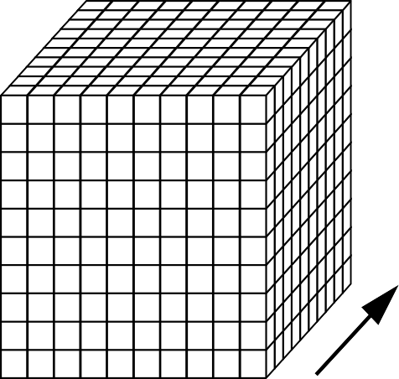
Viewing Data - An Example
Sales Volumes
M
O
D E L
DEALERSHIP
COLOR
Assume that each dimension has 10 positions, as shown in the cube above
How many records would be there in a relational table?
Implications for viewing data from an end-user standpoint?
29

Slide 30
Adding Dimensions- An Example
Sales Volumes
M O D E L
Mini Van
Mini Van
Mini Van
Coupe
Coupe
Coupe
Sedan
Carr Gleason
Clyde
Sedan
Carr Gleason
Clyde
Sedan
Carr Gleason
Clyde
DEALERSHIP
Blue Red White
Blue Red White
Blue Red White
COLOR
COLOR
COLOR
JANUARY
FEBRUARY
MARCH

Slide 31
When is MDD (In)appropriate?
First, consider situation 1
PERSONNEL
LAST NAME | EMPLOYEE# | EMPLOYEE | AGE
SMITH | 01 | 21
REGAN | 12 | 19
FOX | 31 | 63
WELD | 14 | 31
KELLY | 54 | 27
LINK | 03 | 56
KRANZ | 41 | 45
LUCUS | 33 | 41
WEISS | 23 | 19

Slide 32
When is MDD (In)appropriate?
Now consider situation 2
SALES VOLUMES FOR GLEASON DEALERSHIP
MODEL | COLOR | VOLUME
MINI VAN | BLUE | 6
MINI VAN | RED | 5
MINI VAN | WHITE | 4
SPORTS COUPE | BLUE | 3
SPORTS COUPE | RED | 5
SPORTS COUPE | WHITE | 5
SEDAN | BLUE | 4
SEDAN | RED | 3
SEDAN | WHITE | 2
Set up a MDD structure for situation 1, with LAST NAME and Employee# as dimensions, and AGE as the measurement.
Set up a MDD structure for situation 2, with MODEL and
COLOR as dimensions, and SALES VOLUME as the measurement.

Slide 33
When is MDD (In)appropriate?
MDD Structures for the Situations
Employee Age
Smith
Regan
 |  |  | 21
 |  |  |  |  |  |  | 19
63
 |  |  |  | 31
 |  |  |  |  | 27
 |  |  |  |  |  | 56
 | 45
 |  |  |  |  |  |  |  | 41
 |  | 19
Sales Volumes
Fox
Miini Van
6 | 5 | 4
3 | 5 | 5
4 | 3 | 2
L A S T
N A M E
Weld
M O D E L
Coupe
Kelly
Sedan
Link
Blue
Red
White
Kranz
COLOR
Lucas
Weiss
31
41
23
01 14 54
EMPLOYEE #
03
12
33
Note the sparseness in the second MDD representation

Slide 34
When is MDD (In)appropriate?
Highly interrelated dataset types be placed in a multidimensional data structure for greatest ease of access and analysis. When there are no interrelationships, the MDD structure is not appropriate.

Slide 35
MDD Features - Rotation
Sales Volumes
Mini Van
6 | 5 | 4
3 | 5 | 5
4 | 3 | 2
6 | 3 | 4
5 | 5 | 3
4 | 5 | 2
M O D E L
C O L O R
Blue
Coupe
Red
Sedan
o
White
( ROTATE 90 )
Mini Van Coupe Sedan
Blue Red White
COLOR
MODEL
View #1 View #2
Also referred to as “data slicing.”
Each rotation yields a different slice or two dimensional table of data – a different face of the cube.
35

Slide 36
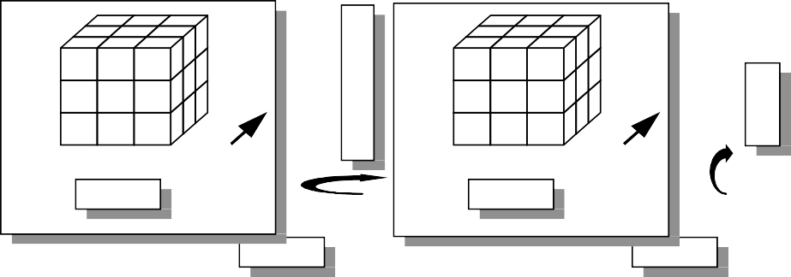
MDD Features - Rotation
Sales Volumes
M O D E L
Mini Van
Coupe Sedan
C O L O R
Blue
Red White
C O L O R
Blue
Red White
Carr Gleason
Clyde
Carr Gleason
Clyde
Mini Van Coupe
Sedan
Blue Red White
Sedan Coupe Mini Van
Carr Gleason Clyde
COLOR
o
MODEL
o
DEALERSHIP
o
( ROTATE 90 )
( ROTATE 90 )
( ROTATE 90 )
DEALERSHIP
DEALERSHIP
MODEL
View #1
View #2
View #3
D E A L E R S H I P
D E A L E R S H I P
Carr
Carr
M O D E L
Mini Van
Coupe
Gleason
Mini Van Coupe
Sedan
Gleason
Blue Red
White
Blue
Clyde
Clyde
Sedan
Red White
White Red Blue
Mini Van Coupe Sedan
Clyde Gleason Carr
COLOR
o
MODEL
o
DEALERSHIP
( ROTATE 90 )
( ROTATE 90 )
View #4
MODEL
View #5
COLOR
View #6
COLOR
36

Slide 37
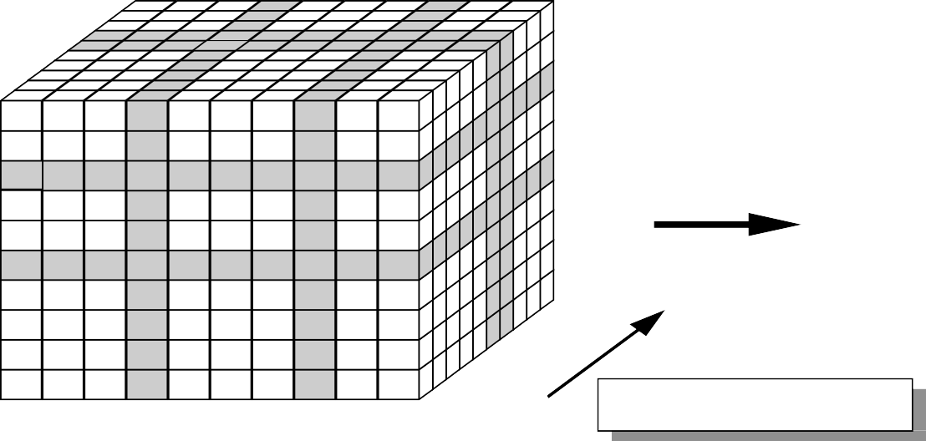
MDD Features - Ranging
Sales Volumes
M O D E L
Mini Van
Mini Van
Coupe
Coupe
Carr Clyde
Normal
Metal Blue
Carr
Blue
Clyde
DEALERSHIP
Normal Blue
Metal Blue
COLOR
The end user selects the desired positions along each dimension.
Also referred to as "data dicing."
The data is scoped down to a subset grouping
37

Slide 38
MDD Features - Roll-Ups & Drill Downs
ORGANIZATION DIMENSION
REGION
Midwest
DISTRICT
Chicago
St. Louis
Gary
DEALERSHIP
Clyde
Gleason
Carr
Levi
Lucas
Bolton
The figure presents a definition of a hierarchy within the organization dimension.
Aggregations perceived as being part of the same dimension.
Moving up and moving down levels in a hierarchy is referred to as “roll-up” and “drill-down.”

Slide 39
Multidimensional Computations
Well equipped to handle demanding mathematical functions.
Can treat arrays like cells in spreadsheets. For example, in a budget analysis situation, one can divide the ACTUAL array by the BUDGET array to compute the VARIANCE array.
Applications based on multidimensional database technology typically have one dimension defined as a "business measurements" dimension.
Integrates computational tools very tightly with the database structure.

Slide 40
The Time Dimension
TIME as a predefined hierarchy for rolling-up and drilling-down across days, weeks, months, years and special periods, such as fiscal years.
■
Eliminates the effort required to build sophisticated hierarchies every time a database is set up.
Extra performance advantages
■

Slide 41
Pros/Cons of MDD
Cognitive Advantages for the User
Ease of Data Presentation and Navigation, Time dimension
Performance
Less flexible
Requires greater initial effort

Slide 42
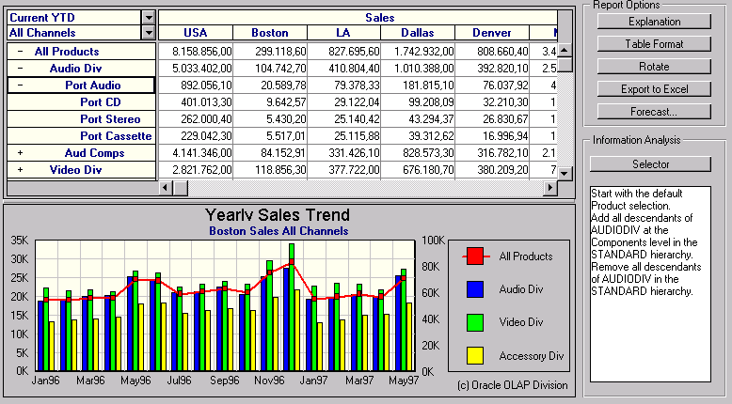
The User‘s view (OLAP Tool)

Slide 43




M ltidimensional OLAP (MOLAP)
specialized database technology multidimensional storage structures
E.g. Hyperion Essbase, Oracle Express, Cognos PowerPlay (Server)
Query Performance Powerful MD Model
  write access
Database Features
multiuser access/ backup and recovery
Sparsity Handling -> DB Explosion
Frontend Tool
Multidim. Database

Slide 44
MOLAP Server
Multi-Dimensional OLAP Server
City
Sales
A
B
Product
milk soda eggs soap
M.D. tools
1 2 3 4
Date
utilities
multi- dimensional server
could also sit on relational DBMS

Slide 45




Relational OLAP (ROLAP)
idea: use relational data storage
star (snowflake) schema
E.g. Microstrategy, SAP BW
+ advantages of RDBMS
Frontend Tool
MD-
Interface
+
scalability, reliability, security etc.
ROLAP-
Engine
Sparsity handling Query Performance
Meta Data
SQL
Data Model Complexity no write access
Relational DB

Slide 46
ROLAP Server
Relational OLAP Server
sale | prodId | date | sum
 | p1 | 1 | 62
 | p2 | 1 | 19
 | p1 | 2 | 48
tools
utilities
ROLAP
server
Special indices, tuning;
Schema is “denormalized”
relational DBMS

Slide 47




Client (Desktop) OLAP
proprietary data structure on the client
data stored as file
mostly RAM based architectures
E.g. Business Objects, Cognos
Client- OLAP
PowerPlay
+
+
mobile user
ease of installation and use
 data volume
 no multiuser capabilites

Slide 48












DW Integration
MOLAP
ROLAP
Client- OLAP
ROLAP-
Engine
Multidim. Database
DW-DB (mostly re
tional)

Slide 49




Combining Architectures I
Drill through
●highly aggregated data
●dense data
●95% of the analysis requirements
Multidim. Database
●detailed data (sparse)
●5% of the requirements
Relational Database

Slide 50



Combining Architectures II
Hybrid OLAP (HOLAP)
●equal treatment of MD and Rel Data
●Storage type at the discretion of the administrator
●Cube Partitioning
HOLAP System
Meta Data
Multidim. Storage
Relational Storage

Slide 51
SURPLUS SLIDES
Prithwis Mukerjee
51

Slide 52
Index Structures
Traditional Access Methods
B-trees, hash tables, R-trees, grids, …
Popular in Warehouses
inverted lists bit map indexes join indexes text indexes
■
■
■

Slide 53
Inverted Lists
18
19
r4
rId | name | age
r4 | joe | 20
r18 | fred | 20
r19 | sally | 21
r34 | nancy | 20
r35 | tom | 20
r36 | pat | 25
r5 | dave | 21
r41 | jeff | 26
20
r18
23
20
r34
21
r35
22
r5
23
r19
25
r37
26
r40
. . .
inverted lists
data records
age index

Slide 54
Using Inverted Lists
Query:
Get people with age = 20 and name = “fred”
List for age = 20: r4, r18, r34, r35 List for name = “fred”: r18, r52 Answer is intersection: r18

Slide 55
Bit Maps
18
19
1
1
0
1
1
0
0
0
0
id | name | age
1 | joe | 20
2 | fred | 20
3 | sally | 21
4 | nancy | 20
5 | tom | 20
6 | pat | 25
7 | dave | 21
8 | jeff | 26
20
23
20
0
0
1
0
0
0
1
0
1
1
21
22
23
25
26
. . .
age index
bit
data records
maps

Slide 56
Using Bit Maps
Query:
Get people with age = 20 and name = “fred”
List for age = 20: 1101100000
List for name = “fred”: 0100000001
Answer is intersection: 010000000000
●Good if domain cardinality small
●Bit vectors can be compressed

Slide 57
Join
 | “Combine” SALE, PRODUCT relations In SQL: SELECT * FROM SALE, PRODUCT
 | sale | prodId | storeId | date | amt
 |  | p1 | c1 | 1 | 12
 |  | p2 | c1 | 1 | 11
 |  | p1 | c3 | 1 | 50
 |  | p2 | c2 | 1 | 8
 |  | p1 | c1 | 2 | 44
 |  | p1 | c2 | 2 | 4
product | id | name | price
 | p1 | bolt | 10
 | p2 | nut | 5
joinTb | prodId | name | price | storeId | date | amt
 | p1 | bolt | 10 | c1 | 1 | 12
 | p2 | nut | 5 | c1 | 1 | 11
 | p1 | bolt | 10 | c3 | 1 | 50
 | p2 | nut | 5 | c2 | 1 | 8
 | p1 | bolt | 10 | c1 | 2 | 44
 | p1 | bolt | 10 | c2 | 2 | 4

Slide 58
Join Indexes
join index
product | id | name | price | jIndex
 | p1 | bolt | 10 | r1,r3,r5,r6
 | p2 | nut | 5 | r2,r4
sale | rId | prodId | storeId | date | amt
 | r1 | p1 | c1 | 1 | 12
 | r2 | p2 | c1 | 1 | 11
 | r3 | p1 | c3 | 1 | 50
 | r4 | p2 | c2 | 1 | 8
 | r5 | p1 | c1 | 2 | 44
 | r6 | p1 | c2 | 2 | 4

Slide 59
What to Materialize?
Store in warehouse results useful for common queries Example:
total sales
day 2
c1
c2
c3
. . .
p1
44
4
day 1
p2
c1
12
11
c2
c3
50
p1 p2
8
 | c1 | c2 | c3
p1 | 67 | 12 | 50
 | c1 | c2 | c3
p1 | 56 | 4 | 50
p2 | 11 | 8
129
materialize
 | c1
p1 | 110
p2 | 19

Slide 60
Materialization Factors
Type/frequency of queries Query response time Storage cost
Update cost

Slide 61
Cube Aggregates Lattice
129
all
city
product
date
city, product
city, date
product, date
use greedy algorithm to decide what to materialize
city, product, date
day 2
day 1

Slide 62
Dimension Hierarchies
all
state
cities | city | state
 | c1 | CA
 | c2 | NY
city

Slide 63
Dimension Hierarchies
all
city
product
date
city, product
city, date
product, date
state
city, product, date
state, date
state, product
state, product, date
not all arcs shown...

Slide 64
Interesting Hierarchy
all
years
time | day | week | month | quarter | year
 | 1 | 1 | 1 | 1 | 2000
 | 2 | 1 | 1 | 1 | 2000
 | 3 | 1 | 1 | 1 | 2000
 | 4 | 1 | 1 | 1 | 2000
 | 5 | 1 | 1 | 1 | 2000
 | 6 | 1 | 1 | 1 | 2000
 | 7 | 1 | 1 | 1 | 2000
 | 8 | 2 | 1 | 1 | 2000
weeks
quarters
months
conceptual dimension table
days

Slide 65
Design
What data is needed? Where does it come from? How to clean data?
How to represent in warehouse (schema)? What to summarize?
What to materialize? What to index?

Slide 66
Tools
Development
design & edit: schemas, views, scripts, rules, queries, reports
Planning & Analysis
what-if scenarios (schema changes, refresh rates), capacity planning
Warehouse Management
performance monitoring, usage patterns, exception reporting
System & Network Management
measure traffic (sources, warehouse, clients)
Workflow Management
“reliable scripts” for cleaning & analyzing data

Slide 67
Current State of Industry
Extraction and integration done off-line
Usually in large, time-consuming, batches
Everything copied at warehouse
Not selective about what is stored Query benefit vs storage & update cost
■
Query optimization aimed at OLTP
High throughput instead of fast response
Process whole query before displaying anything

