Slide 1
Data Warehousing
Data Warehouse Design & Multi-dimensional Models
Spring Term 2018 Dr. Andreas Geppert geppert@acm.org

Slide 2
Outline of the Course
Introduction
DWH Architecture
DWH-Design and multi-dimensional data models
Extract, Transform, Load (ETL)
Metadata
Data Quality
Analytic Applications and Business Intelligence
Implementation and Performance

Slide 3
Content
Application Development in Data Warehouses
Schema Design for Data Warehouses
Multi-dimensional Data Models
Logical Design for Data Marts
Appendix: Conceptual Design for Data Marts

Slide 4
Motivation
complex facts are represented in the DWH
DWH supports integration and analysis
  databases must be modeled accordingly
  without complete and adequate data models, DWH will not be a success
analytic databases (data marts) use multidimensional concepts
  how do you systematically design these databases?
  what is the analogon to the Entity Relationship Model and to the mapping ER
→ RM ?
notations and conceptual (meta) data models
modeling approaches

Slide 5
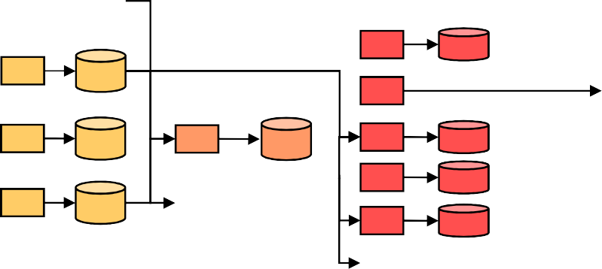
Reference Architecture V4 Applications
Encapsulation
Data Integration
Data Enrichment
Analysis
Data
Integration, Historization
Reusable Selection, Aggregation, Calculation
Selection, Aggregation, Calculation
Reporting, OLAP,
Data Mining
Web/App Servers
GUI
Sources
…
Applications
build "seed" IL containing most-needed data and integrated most important sources

Slide 6
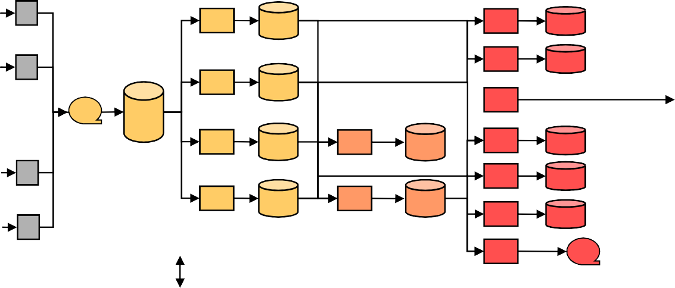
DWH Application Development
start with requirements of analysis applications
Layer:
Data Integration
Data Enrichment
Analysis
DWH Data Universe
Data Marts
Analysis Services
Presentation
Front End
Data
Integration, Historization
Reusable Selection, Aggregation, Calculation
Selection, Aggregation, Calculation
Reporting, OLAP,
Data Mining
Web/App Servers
GUI
Sources
…
Landing Zone
Staging Area
Subjec t Matter Areas
Reusable Measures & Dimensio ns Areas
Metadata Management
Legend:
relational database
multidimensional database
file
logic;
extract, transform, load
logic
(no ETL)
data flow

Slide 7
General Approach & Data Model Hierarchy
Analysis
modeling-driven approach
model/specify on abstract level and derive (or even generate) lower-level constructs
distinguish conceptual, logical, and physical model
the same hierarchy is applied to ETL processes / mappings
Requirements
Conceptual design
Conceptual model
Logical design
Logical model
Physical design Physical model

Slide 8
Data Models: Conceptual
The Conceptual Data Model serves the following purposes:
  Unambiguously represent business information structures and rules, enabling communication of this understanding to the entire development team
  Provide an implementation-independent set of requirements as input to the logical data model, and to the physical data model
  Clearly and uniquely identify all business entities in the system
Note that the conceptual data model should not be considered as an intermediate design document to be disregarded after logical and physical design; rather it
should remain as a part of the database specifications, organized with a variety of documents that also describe in detail the requirement acquisition and design process
Finally one of the possibly most important advantages of conceptual design shows up during the operation of the database when the conceptual model and
its documentation ease the understanding of data schemas and of applications that use them and thus facilitate their transformation and maintenance.

Slide 9
Data Models: Logical
The Logical Data Model (LDM) is a database-near data model that hides details of data storage and DBMS-specific idiosyncrasies but can nevertheless be implemented straightforward on a computer system
Its main purpose is to ensure a proper mapping from a high-level conceptual data model (i.e., an Entity Relationship Model) that focuses exclusively on business
entities and their relationships to the (principal) schema constructs used by a class of DBMSs (e.g., relational DBMSs). In other words logical design is conducted in the same way for all relational DBMSs (e.g., Oracle, DB2 etc.) because they all implement the relational data model. As a consequence a specific relational logical model can be used "as is" to design the physical data model of DB2, Oracle, SQL Server etc. whereas it cannot be used to design the physical data model for an IMS System.

Slide 10
Data Models: Physical
The purpose of the Physical Database Design is to ensure that database transactions and queries meet performance requirements while reflecting the semantics of the Logical Data Model
While the Logical Data Model contains the information requirements of the system in a normalized form, a direct implementation of the model is unlikely to meet performance requirements
Physical Database Design takes into account data and
transaction volume as well as typical queries to produce a schema and environment that will meet necessary performance requirements.

Slide 11
Application Development Processes Big Picture
analysis application development process analyze derive determine info req data req reuse potential
determine technology
model data mart
model mappings
enrichment application development process
analyze derive model model info req data req RMDA mappings
design logical schema
integration application development process
analyze data req
analyze source
def. incom. interf.
extend staging area
model SMA
model mappings
define quality checks
design SMA
design ETL
implement SMA
implement ETL
def. outgoing interfaces
implement interfaces
design mappings
implement log. schema
implement mappings
def. outgoing interfaces
implement interfaces
design logical schema
design mappings
implement data mart
implement ETL process
develop reports

Slide 12
Content
Application Development in Data Warehouses
Schema Design for Data Warehouses
Multi-dimensional Data Models
Logical Design for Data Marts
Appendix: Conceptual Design for Data Marts

Slide 13
Schema Design for Data Warehouses
database design must support goals of the data warehouse
integration
  schema integration
  target of ETL processes
historization
data quality
granularity
in most architectural styles (Hub-and-Spoke, etc.) the DWH is implemented relationally on the logical level (3NF)
the ER Model can/should be used for conceptual modeling

Slide 14
Schema Design for Data Warehouses
Requirements to the data warehouse result from requirements analysis of the analysis/reporting application
are the data that an application under construction needs already in the data warehouse (integration layer) and can be sourced from there?
  if not, those data have to be sourced from one or more data sources / operational systems
it is absolutely crucial to maintain accurate, timely, and complete information about the data in the data warehouse
  data in the DWH must be modeled (→ conceptual schemas !)
  semantics of data must be understood
  data ownership must be defined

Slide 15
Integration
the data warehouse integrates data from different sources
  different aspects of the same business entities are managed in different business processes with disjoint databases
  different business processes over the same business entity operate on disjoint databases
  the same business process is implemented by multiple applications (e.g., because of mergers and acquisitions); e.g., multiple CRM systems
"vertical" integration: integrate attributes from different sources
into the same entity
"horizontal" integration: integrate entities from different sources into the same entity collection (logically: relation)

Slide 16
Key Generation and Integration
different sources usually maintain different kinds of primary keys
  different types of keys (e.g., securities)
  overlapping sets of key values (no globally unique identifiers)
business keys vs. technical keys
use artificial/technical keys in the data warehouse ("surrogate keys")
  map business keys / source keys → surrogate
  maintain business keys as attributes
  surrogates are not visible to users and applications should not rely on the mapping of business keys onto surrogates
CSN (Valorennr) Apple Inc. (CUSIP) BEA Systems (ISIN)
Surrogate | VNr | CUSIP | ISIN

Slide 17
Historization
DWH must represent historical evolution of objects
differing states of objects on the timeline
bi-temporal time notion (temporal databases)
Validity time: Interval, during which an object has been in a specific state (e.g., during which an attribute has had a certain value)
Transaction time: point in time when the state of an object changed (e.g., an attribute has been modified). Could also be an interval.
Customer | Name | TX_Time | Valid_From | Valid_Until
12345 | Snoopy | 2004-04-04 | 2004-04-01 | 2006-04-30
12345 | Joe Cool | 2006-04-24 | 2006-05-01 | 9999-12-31

Slide 18
Modeling of "Time"
date and time are important properties in many applications
in addition to the data and time, further properties are important, depending on the application (e.g., holidays)
different calendars exists (we normally use the Gregorian Calendar)
in addition to the calendar year, other notions of "year" are common (e.g.,
fiscal year)
in many cases, the explicit modeling of data and time is recommended over simply using the database system's calendar
Fiscal Month
Fiscal Year
Date
Day
Month
Year

Slide 19
Data Vault Modeling
The Data Vault technique has been introduced in the 1990s
Today it is used in many DWH projects
Previous techniques (3NF-based data models) have issues with changing sources. Data Vault modeling has been designed to better cope with such changes
The Data Vault main components:
Hubs
Link Tables
Satellites

Slide 20
Data Vault Main Elements: Hub Entities
Represent an entity in the subject area of interest
Carries at a minimum a unique list of business keys
– invoice number, customer number, employee PID, …
In case the business uses multiple business keys, the hub contains multiple rows (one for each business key)
Surrogate key: optional (see surrogates above)
Load date timestamp: records when the key was first loaded into the data warehouse
Record source: reference to the source system where the business key came from, for traceability reasons

Slide 21
Data Vault Main Elements: Link Entities
Represent the relationship between two or more business components
Hub keys represent the relationship between the hubs
Surrogate key: optional component
Load date timestamp: indicates when the relationship was first created in the warehouse
Record source: indicates from which data source the relationship was loaded; for traceability reasons

Slide 22
Data Vault Main Elements: Satellite Entities
hub key context (descriptive) information
satellite data are subject to change over time; therefore the structure must be capable of storing new or altered data
Satellite primary key: Hub or link primary key
Load date timestamp: indicates when the context information was first created in the warehouse
Sequence surrogate number: optional. Useful for Satellites that have multiple values
Record source: indicates from which data source the satellite was loaded; for traceability reasons

Slide 23
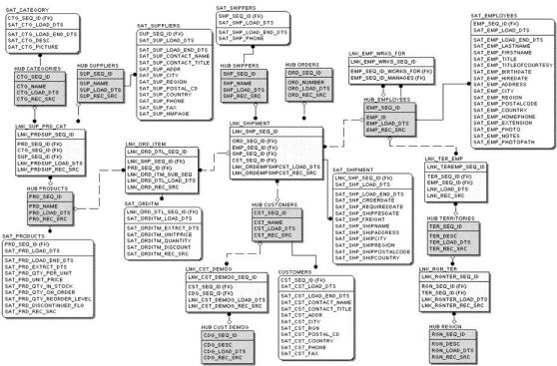
Data Vault Example
source: https://danlinstedt.com/solutions-2/data-vault-basics/

Slide 24
Inhalt
Application Development in Data Warehouses
Schema Design for Data Warehouses
Multi-dimensional Data Models
Logical Design for Data Marts
Appendix: Conceptual Design for Data Marts

Slide 25
Multi-dimensional Data Models
“Classical” relations:
  One-dimensional (not in the mathematical sense)
  Relation maps key onto attributes
However, in many cases in data warehousing one is interested in multiple perspectives („dimensions“)
  Example: Sales based on product, time, region, customer, store, manager/employee
Cannot be represented with normal relations
Multi-dimensional data models
Multi-dimensional database systems

Slide 26
Comparison: relational vs. Multi-dimensional DM
relational model
Simple, little semantics
Application-neutral
Less ostensive modeling (⇒ ERM)
standardized
Multi-dimensional data models
More complex, more semantics
Well-suited only for specific applications
Ostensive modeling ⇒ user- friendly
Caution: the multi-dimensional data model does not exist
  No uniform query language
  No standards
  No uniform formalization

Slide 27
Content
Application Development in Data Warehouses
Schema Design for Data Warehouses
Multi-dimensional Data Models
  Dimensions, Measures, Facts, Cubes
  Operators
Logical Design for Data Marts
Appendix: Conceptual Design for Data Marts

Slide 28
Multi-dimensional Data: Cubes
Multi-dimensional data are seen and represented as data cubes
More precisely: Hypercubes
Distinction into
  Qualifying and
  Quantifying information
Qualifying information identifies cell or sub-cube
Quantifying information contains
numbers
61
94
62
11
45 | 56 | 39 | 56
99 | 8 | 16 | 20
45 | 23 | 44 | 7
11 | 5 | 19 | 8
28
Produkt
23
24
Region
Quartal

Slide 29
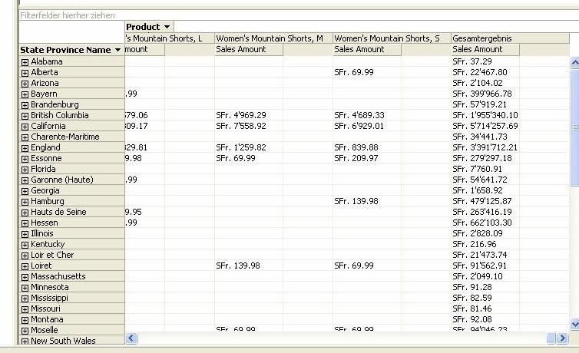
Multi-dimensional Data: Representation

Slide 30
Multi-dimensional Data: Dimensions
Dimension:
  Set of (at least two) dimension elements
    All articles, customers, ...
  Analysis perspective of an application area
  Qualifying information
  “cube axes”
Examples:
  Customer, Product, Time, Store, ...

Slide 31
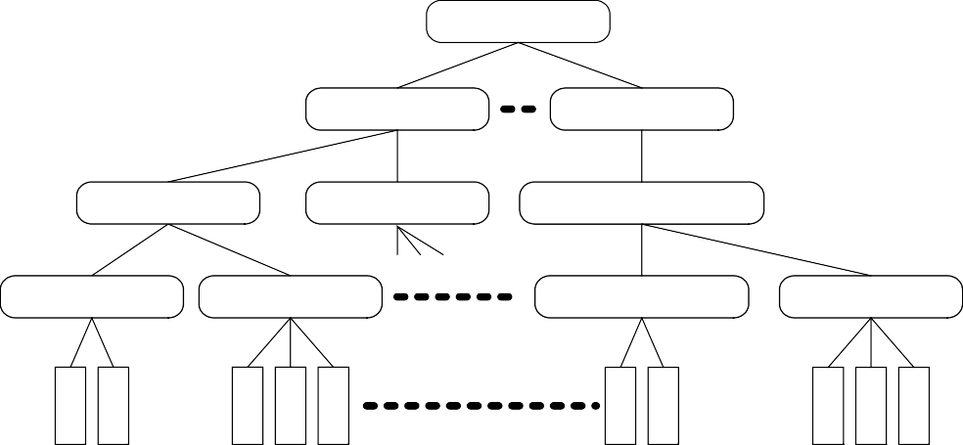
Multi-dimensional Data: Dimensions (2)
Dimensions are rarely flat
Attributes form a classification hierarchy
Examples: - Month
  City
  Product
→ Quarter
→ Canton
→ Product family
→ Year
→ Region
→ Product group
→ Area
Total
All
Total
Total
Bereich
Heimelektronik
Grossgeräte
Region
Jahr
Gruppe
Video
Audio
Haushaltsgeräte
Kanton
Stadt
Quartal
Familie
Heimrekorder
Camcorder
Waschmaschinen
Trockner
ArtikelNr
V-201
Classic I
TR-75
TS-78
A200
Duett
Lavamat
AB1043
Princess
SuperI
Geschäft
Monat
Marke
JVC
Grundig
Sony
Sony
JVC
Siemens
Zug
Miele
Bosch
Siemens

Slide 32
Dimension Schemas
Schema of a dimension hierarchy
Partially ordered set D of dimensional attributes
– ({D₁, …, D_{n}, Top_{D}}; →)
  → functional dependency
attribute A determines B (A → B), if the value of B is uniquely determined by the value of A
  Top_{D} is the maximum element regarding →
    ∀ D_{i}: D_{i} → Top_{D}
  There is a unique, smallest element D_{i}, which determines all others
    ∃ D_{i}: ∀ D_{k, k≠i}: D_{i} → D_{k}
Example:
  {Day, Month, Quarter, Year, Top}, →
  Day → Month → Quarter → Year → Top

Slide 33
Dimension Schemas
Partial ordering allows for parallel hierarchies
Example:
  {Day, Month, Quarter, Year, Calendar Week}, →
  Day → Month → Quarter → Year
  Day → Calendar Week → Year
Top
Year
Quarter
Month
Week
Orthogonality
– ¬ ∃ D.D_{i} → D’.D_{j}
Day

Slide 34
Dimension schemas: Examples Product and Store
Top
Top
P-Dep‘t
Country
P-Group
Brand
Region
State
P-Family
City
Manager
Article
Store

Slide 35
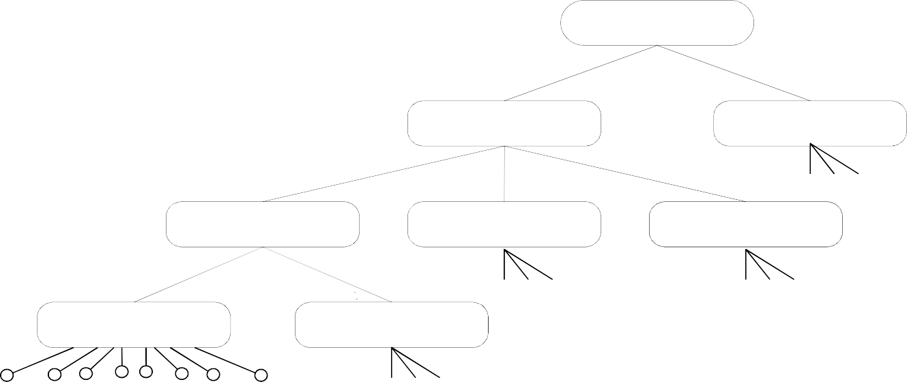
Dimension schemas and Instances
Functional dependencies determine instances structures
  1:n relationships
  Path to the root: consolidation path
    Camcorder → Video → Brown Goods → All
Top
Products
All
Area
Brown Goods
White Goods
Group
Video
Audio
Computers
Family
HomeVCR
Camcorder
Article

Slide 36
Dimension Schemas: Special Cases
Relationships between hierarchy levels not always 1:n
Element node has more than one predecessor
  No tree structure anymore, but acyclic graph
  Example: Product  Promotion
Gaps in the ancestor relation
  Node on level n+1 does not have predecessor on level n
  Tree is no longer balanced
  Example: Shop → City → State

Slide 37
Multi-dimensional Data: Measures
Quantifying information
  Usually numeric
Key figures, measures
Examples:
  sales figures
  turnover
  Measurements (temperature, rainfall, …)

Slide 38
Characteristics of Measures
Name, data type, range
Aggregation type
  Defines which aggregation operation are meaningful (hence, allowed)
  FLOW: can be aggregated in arbitrary ways (sales, turnover)
  Stock: cannot be summed up over time (inventory, ...)
  VPU (Value per Unit): cannot be summed up at all (price, tax, ...)
Average, minimum, maximum are always possible
  When semantically meaningful

Slide 39
Multi-dimensional Data: Facts
A fact is an element of the multi-dimensional space
Associates a set of dimension elements with measures
„cube cell“
  Granularity is given by dimension elements
  Fact is uniquely identified through a combination of dimension elements
Qualifying and quantifying information
Interesting occurrences
Sometimes misleading use of terms
Facts and measures are sometimes confused, but are not the same
Fact ≅ Cell, Measure ≅ cell content

Slide 40
Multi-dimensional Data: Cubes
A data cube is a multi-dimensional space of facts
Cubes, Hypercubes
61
94
62
11
28
23
24
45 | 56 | 39 | 56
99 | 8 | 16 | 20
45 | 23 | 44 | 7
11 | 5 | 19 | 8
Produkt
Region
Quartal

Slide 41
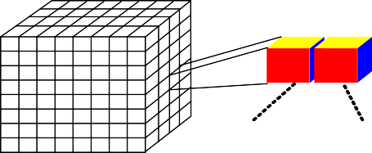
Data Cube Instances
Cube domain:
– dom(C) = ((dom(G₁) × … × dom(G_{n}))
× ((dom(M₁) × … × dom(M_{m}))
Instance:
  All cube cells from the cube domain
  Not: subset of existing facts as in the relational model
„cube“ is more like a metaphor
D a y
Shop
A rticle
S a le s T u rn o v e r
Rarely all cells are really present (in the sense of facts that occurred in the real world)
Implementation as null or 0

Slide 42
Content
Application Development in Data Warehouses
Schema Design for Data Warehouses
Multi-dimensional Data Models
  Dimensions, Measures, Facts, Cubes
  Operators
Logical Design for Data Marts
Appendix: Conceptual Design for Data Marts

Slide 43
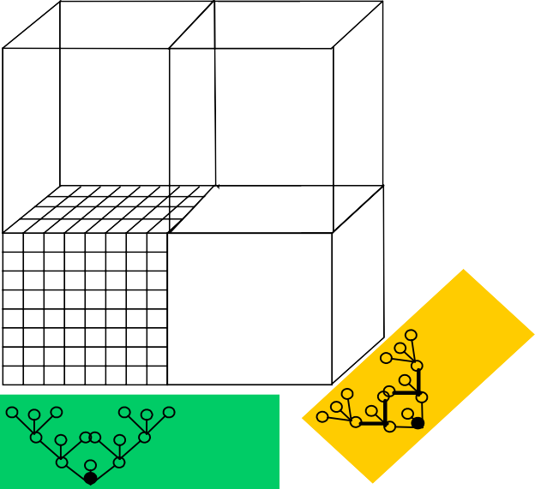

Multi-dimensional Operators: Slice and Dice
Cuts a cube
  Specification of a hierarchy node
  Example: sales in Germany
Time
Location
Product
Selection of a sub-cube
  Specification of nodes in the dimension hierarchies
  Sales for Consumer Electric in Germany in 1997
Germany
1997
Cons. Electric
shop
region
country
group
family article
day month year

Slide 44
Multi-dimensional Operators: Navigation
Drill-Down
  Start at coarser granularity
  Navigate to a representation with finer granularity (i.e., more detailed)
  Sums will be broken up in partial sums
  Example: Sales [Year, Kanton] -> Sales [Quarter, Kanton]
Drill down

Slide 45
Multi-dimensional Operators: Navigation (2)
Roll-up
  Start at finer granularity
  Navigate to a representation with coarser granularity (i.e., less detailed)
  Possibly first expansion of the data
  Example: Sales per year and state (2005, CA)
→ Sales per year and country (2005, USA)
Roll up

Slide 46


Multi-dimensional Operators: Pivot
Changes orientation of the dimensions
Rather an operation on presentation level, not of the data model
Location
Product
Pivot
Time
Location

Slide 47
Multi-dimensional Operators: Join
Combines two cubes into a new one
(G, M₁) ⊗ (G, M₂) = (G, M₁ ∪ M₂)
Example: Sales Cube ⊗ Price Cube
Possibly granularities need to be adjusted first
Verbund

Slide 48
Multi-dimensional Operators: Aggregation
Aggregation happens (implicitly) whenever granularity changes (e.g., rollup)
  By default, sums are computed
  Other standard aggregation operators are possible as well: average, minimum, maximum, count
  Further, application-specific calculations
  A multi-dimensional DBS can be used as a calculation engine

Slide 49
Multi-dimensionale Data Models: Summary
Several multi-dimensional data models
Dimensions & hierarchies, measures, facts, cubes
Cubes as the basis for ...
  Analysis
  Calculations
Some (subtle) restrictions
„Cube" is a concept, there are different instantiations on logical and physical level

Slide 50
Content
Application Development in Data Warehouses
Schema Design for Data Warehouses
Multi-dimensional Data Models
Logical Design for Data Marts
Appendix: Conceptual Design for Data Marts

Slide 51
Logical Design
Derive logical schema from conceptual one
express logical schema with the means of the logical (meta) data model (!)
  logical data model can be relational or multidimensional
Requirements (to logical (meta) data models and DBMSs
  adequate representation of data (types)
    dimensions and hierarchies
    facts
  operators support analysis adequately
  DBMS aspects
    large volumes of data
    performance
    multi user access
    security, ...

Slide 52
Relational Mapping of Multidimensional Structures
Storage of multidimensional data
in relations
only existing cube cells
Separation of structure and content (unlike as in cubes)
central fact table(s)
dimension tables
facts reference dimension tables
fact table contains measures
Zeit
TR-75
MediaMarkt 11. 11. 2001
Produkt | Geschäft | Zeit | Verkäufe
TR-75 | MediaMarkt | 11. 11. 2001 | 27
AC300 | ProMarkt | 23. 12. 2001 | 39
... | ... | ... | ...
Produkt
27

Slide 53
Snowflake Schemas
(central) fact table, dimension tables
dimension tables are normalized
n dimension hierarchy levels (within a dimension) → n dimension relations for this dimension
foreign key/primary key relationship between fact and dimension tables: fact table references dimension table representing most granular hierarchy level
primary key of fact table is composed out of foreign keys (i.e., primary keys of dimensions)
foreign key/primary key relationship between dimension tables (representing the hierarchy levels)

Slide 54
Snowflake Schema: Example
StateID State Country
...
RegionID Region State
...
ShopID ShopType Region
...
GroupID Group Area
...
FamilyID Family Group
...
ArticleID ShopID Day
ArticleID Family VSys
…
Load Temp
Sales Stock Turnover
Day Month
...
Month Quarter
...
Quarter Year
...

Slide 55
Snowflake Schemas: Implications for Queries
Example: Sum of sales by region, by month, by product group
7 join operations:
  3 between fact table and (most granular) dimension tables
  4 for rollup to higher hierarchy levels

Slide 56
Snowflake Schemas: Properties
correct update of dimension tables is easier
  because of normalization
  normalization avoids update anomalies
schema design is easier
  depending on conceptual design, snowflake design is obtained as a result of an automatic transformation
performance is worse
  many joins are required
  one join per involved dimension + one join per "rollup"
no redundancy
  again, because of normalization

Slide 57
Star Schemas
central fact table
one table per dimension, regardless of the number of hierarchy levels within the dimensions
denormalized dimension tables
foreign key/primary key relationship between fact and dimension tables: fact table references dimension tables
primary key of fact table is composed out of foreign keys (i.e., primary keys of dimensions)

Slide 58
Star Schema: Example
ShopID Region State Country ShopType Region
...
ArticleID
Family Group Area Brand VSys
… Load Temp
ArticleID ShopID Day
Sales Stock Turnover
Day Month Quarter Year
...

Slide 59
Star Schemas: Properties
Redundancy
  because of denormalization
  update anomalies are possible
Performance
  smaller number of joins
  because of denormalization
intuitive

Slide 60
Star Schemas: Implications for Queries
Example: Sum of sales by region, by month, by product group
3 join operations
  3 between fact table and dimension tables
  no joins for rollup to higher hierarchy levels
ShopID Region State Country ShopType Region
...
ArticleID
Family Group Area Brand VSys
… Load Temp
ArticleID ShopID Day
Sales Stock Turnover
Day Month Quarter Year
...

Slide 61
Comparison: Star vs. Snowflake
Advantages of Star schemas
☺faster query evaluation
  no difference between star and snowflake when for each dimension only the most granular hierarchy level is needed
  but: analytic queries are more often than not on a high (coarse) aggregation level
  one join per rollup
☺simpler structure
  important for the generation of OLAP-queries
☺additional data volume is negligible
☺updates to classifications are rare
  update anomalies are less of an issue

Slide 62
Special Cases: Factless Fact Tables
Fact table contains dimensions and measures
Special case:
– no measure
➔existence statement without numeric attributes
StudentKey VorlesungKey DozentKey ZeitKey
recording of events
Example: student attends course held by a lecturer on a certain day

Slide 63
Factless Fact Tables (2)
Non-occurrence of events
“Coverage table” contains possible events
fact table contains actual events
non-occurred events are obtained by computing the table difference
Example: which products have not been sold despite promotion campaigns?
ProductKey StoreKey PromoKey TimeKey

Slide 64


Galaxy Schemas
multiple independent fact tables
fact tables share some (but not all) dimension tables

Slide 65
Fact Constellation
Measures are needed on different aggregation levels within an analysis scenario
Computation of aggregated measures always possible, but possibly expensive
possible optimization: materialization of aggregate values
option 1: addition of aggregate values to fact table
  additional attribute for each aggregate value
  additional discriminator attribute
  correct linkage to dimension tables?

Slide 66
Fact Constellation (2)
Option 2: separate table for aggregate values (fact constellation)
„smaller“ fact table
also smaller dimension tables possible
more efficient queries against detailed and aggregated data
Customer
Sales
Date
Product
SalesbyMonth
MonthDate

Slide 67
Monster Dimensions
common problem: very big dimension tables
many attributes, many rows
example: product dimension
  10K-100K product articles, 20-50 attributes (warehouses, retail)
example: customer dimension
  up to 100M customers, many attributes
demography: often queried, rather frequent modifications
  example income, marital status

Slide 68
Monster Dimensions
demographic mini-dimensions
extract of the demographic information out of customer dimension
better performance
demographic information of a customer no longer in customer
dimension
Purchases
Demography
age_level income_level marital_status gender
Customer

Slide 69
Versioning of Dimension Tables
Problem: changes in dimension tables
Examples:
  Customers change address, name, marital status, ...
  products are abandoned
  product properties (classification) change
Dimensions are yet "rather constant"
  slowly changing dimensions (SCD)
changes are permitted in OLTP applications, because there the current state is of (sole) interest
  old values are overridden, update-in-place
changes are problematic in a DWH, they can lead to misleading, erroneous analysis results

Slide 70
Versioning of Dimension Tables (2)
Versioning of Dimension Tables: Solutions
Update-in-place
  old values are lost
  simple to implement
  no history is available
  misleading analysis results are possible
  SCD Type 1
Customer_key | name | status
1234 | Joe Cool | single married

Slide 71
Versioning of Dimension Tables (3)
Addition of a "status attribute"
  current and previous value
  rarely done
  useful?
  SCD Type 3
Customer_key | name | old_status | current | effective_date
1234 | Joe Cool | single | married | 04-10-1992

Slide 72
Versioning of Dimension Tables (4)
Addition of a version number
  clean modeling
  querying becomes more difficult
  temporal history not obvious
  version number must be added to fact table, too
  composite foreign/primary key
Customer_key | version | name | status
1234 | 001 | Joe Cool | single
1234 | 002 | Joe Cool | married

Slide 73








Versioning of Dimension Tables (5)
extension of primary key with version number
  questionable from a modeling point of view
  unique identification and reference, for instance for aggregation?

Slide 74








Versioning of Dimension Tables (6)
explicit addition of validity intervals
  eases historical and time-based queries
  at least one of the timestamps must be added to primary key
  or referential integrity cannot be maintained
  SCD Type 2

Slide 75
Summary
DWH application development
"standard" approach for DWH itself (ER-based)
conceptual data mart design
  no established notation (a la ER)
  patterns of logical design are used for conceptual one ("dimensional modeling")
relational implementation
  Star and Snowflake schemas
  Galaxy schema & Fact Constellation Schema
  Factless Fact Tables
  Slowly Changing Dimensions

Slide 76
APPENDIX

Slide 77
Content
Application Development in Data Warehouses
Schema Design for Data Warehouses
Multi-dimensional Data Models
Logical Design for Data Marts
Appendix: Conceptual Design for Data Marts

Slide 78
Conceptual Design for Data Marts
Multidimensional concepts: basic support considered in DWH and OLAP systems
☹ no common, widely accepted model
☹ no standardized modeling language and notation
☹ no common formalization
☺ methods and guidelines based on experience

Slide 79
Relational vs. Multidimensional Schema Design
Relationales Vorgehen
Multidimensionales Vorgehen
Externes Schema
Externes Schema
Benutzersicht
Benutzersicht
Konzeptuelles Schema
Konzeptuelles Schema
Semi-formal; ER
Semi-formal; mER, mUML
Logisches Schema
Logisches Schema
Formal; Relationen
Formal; Dimensionen, Cubes
Physisches Schema
Physisches Schema
Speicherungsstrukturen
Relationen (!), MD-Strukturen

Slide 80
Conceptual Design: Variants
Use of existing notations (and methods, tools)
  possibly with adapted semantics
  currently prevalent approach in practice
Extensions of existing notations
  ER
  UML
  typically academic/research proposals
Development of new notations
  typically academic/research proposals
☺ can be designed to optimally meet requirements
☹ additional notation

Slide 81
Notations: M-E/R
Extension of the ER model
additional entity type representing dimension hierarchy level
additional relationship types:
  relationship between dimension hierarchy levels
  relationship between dimensions and hierarchies

Slide 82
Notations: M-E/R
Fakten-Beziehungstyp
Dimensionsebenentyp
Rolls-Up-Beziehungstyp

Slide 83
M-E/R: Example
Land
Region
Bezirk
Stadt
Filiale
P.Kategorie
P.Familie
P.Gruppe
Artikel
Jahr
Quartal
Monat
Tag
Woche

Slide 84
Gold: Notation
developed on the basis of the Unified Modeling Language (UML)
Approach by Trujillo et al., prototypically implemented in the "Gold" tool
Usage of UML constructs for the modeling of:
fact classes
dimensions
relationships between
  facts and dimensions
  dimension hierarchy levels
cardinalities

Slide 85
Gold: Notation (2)
UML classes for the modeling of fact and dimension classes
UML-aggregation for the modeling of the relationship between facts and dimensions
Sales
price quantity
Product |  |  | Store |  |  |  | Customer |  |  | Time
name weight |  |  | name address |  |  |  | name address |  |  | day

Slide 86
Gold: Notation (3)
dimension hierarchies
general associations used for the modeling of relationships between dimension classes (dimension hierarchy levels)

Slide 87
Gold: Notation (4)
Gold supports shared hierarchies

Slide 88
Gold: Notation (5)
Gold supports parallel hierarchies
SalesRegion
name population
Store
City
Province
State
name address
name population
name population
name population

Slide 89
Gold: Notation (6)
relationship properties: Cardinalities
m:n relationship between facts and dimensions
Completeness: annotation of relationships
Customer
SalesRegion
name address
*
1..*
name population
1..*
1..*
1
1..*
Store
City
Province
State
name address
* 1
name population
* 1
name population
1..* 1
name population

Slide 90
Gold: Notation (7)
Product
name weight
Specialization of dimension classes using UML specialization
problem: which circumstances should be modeled as a classification hierarchy, which as a specialization hierarchy
Cleaning
Grocery
...
expire_date
Food
Beverage
preparation
volume
SoftDrink
Alcohol
sparkling
percentage

Slide 91
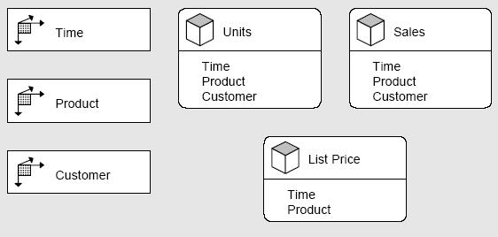
Adapt
Application Design for Analytical Processing Technologies
Trademark of Symmetry Corp.
intended as a conceptual model for OLAP-Applications
  Star schemas presume implementation
  ER and "dimensional Modeling" are biased towards relational implementations
Hypercube
Dimension

Slide 92
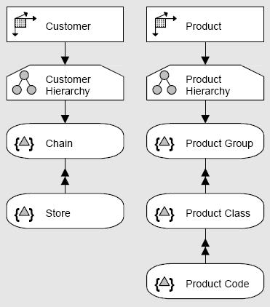
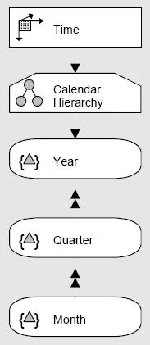
Adapt: Modeling of Hierarchies
Hierarchy (within a dimension), consisting of levels
{}
Level

Slide 93
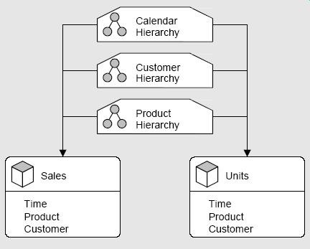
Adapt
Combination of dimensions and hierarchies into hypercubes

Slide 94
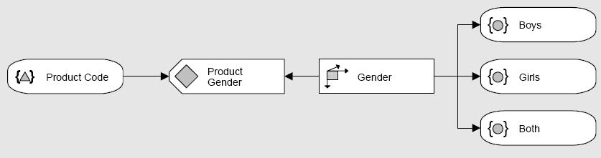
Adapt: Modeling of dimension details
Attribute
{}
Member

Slide 95

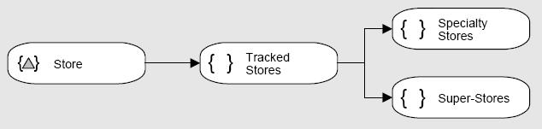
Adapt: Modeling of Dimension Scopes
{ }
Scope: set of dimension elements

Slide 96
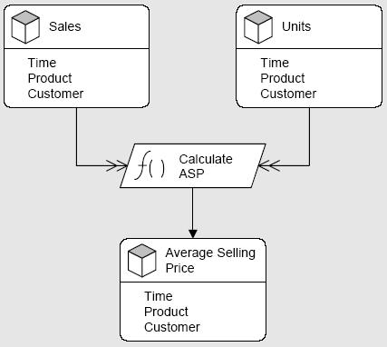
Adapt: Modeling of Calculations
f ( )
algebraic processes model calculations

Slide 97
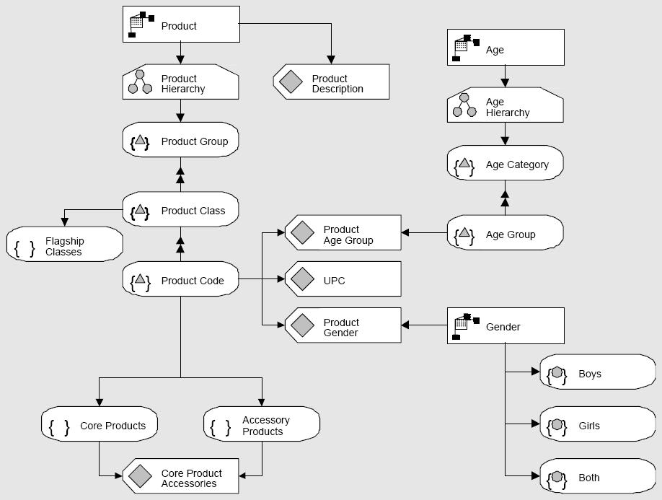
Adapt: Sample Product Dimension

