Slide 1

Dimensional Modeling
Prof. Sunita Sahu

Slide 2
Dimensional Modeling
Dimensional modeling (DM) names a set of techniques and concepts used in data warehouse design.
Dimensional modeling is one of the methods of data modeling, that help us store the data in such a way that it is relatively easy to retrieve the data from the database.
Dimensional modeling always uses the concepts of facts (measures), and dimensions (context).

Slide 3
Dimensional Models
A denormalized relational model
Made up of tables with attributes
Relationships defined by keys and foreign keys
Organized for understandability and ease of reporting rather than update
Queried and maintained by SQL or special purpose management tools.

Slide 4
Benefits of dimensional modeling
Understand ability –
Compared to the normalized model, the dimensional model is easier to understand and more intuitive.
In dimensional models, information is grouped into coherent business categories or dimensions, making it easier to read and interpret.
Simplicity also allows software to navigate databases efficiently.

Slide 5
Benefits of dimensional modeling
Query performance
Dimensional models are more denormalized and optimized for data querying, while normalized models seek to eliminate data redundancies and are optimized for transaction loading and updating.
The predictable framework of a dimensional model allows the database to make strong assumptions about the data which may have a positive impact on performance.
Each dimension is an equivalent entry point into the fact table, and this symmetrical structure allows effective handling of complex queries.
Query optimization is simple, predictable, and controllable.

Slide 6
Benefits of dimensional modeling
Extensibility
Dimensional models are scalable and easily accommodate unexpected new data.
Existing tables can be changed in place either by simply adding new data rows into the table or executing SQL alter table commands.
No queries or applications that sit on top of the data warehouse need to be reprogrammed to accommodate changes

Slide 7
Entity-Relationship vs. Dimensional
Models
Relational Modeling
Data is stored in RDBMS
Tables are units of storage
Data is normalized and used for OLTP. Optimized for OLTP processing
Several tables and chains of relationships among them
Volatile (several updates) and time variant Detailed level of transactional data
SQL is used to manipulate data Normal Reports
Dimensional Modeling
Data is stored in RDBMS or Multidimensional databases
Cubes are units of storage
Data is de normalized and used in data warehouse and data mart. Optimized for OLAP
Few tables and fact tables are connected to dimensional tables
Non volatile and time invariant Summary of bulky transactional data
(Aggregates and Measures) used in
business decisions
MDX is used to manipulate data
User friendly, interactive, drag and drop multidimensional OLAP Reports

Slide 8
Entity-Relationship vs. Dimensional Models
One table per entity
Minimize data redundancy
Optimize update
The Transaction Processing Model
One fact table for data organization
Maximize understandability
Optimized for retrieval
The data warehousing model

Slide 9
Facts & Dimensions
There are two main types of objects in a dimensional model
  Facts are quantitative measures that we wish to analyse and report on.
  Dimensions contain textual descriptors of the business. They provide context for the facts.

Slide 10

A Transactional Database
Countries
CountryID
Description
Addresses
AddressID
StateID
Street
States
StateID
CountryID
Desc
Customers
CustomerID
AddressID
Name
OrderHeader
OrderHeaderID
CustomerID
OrderDate
FreightAmount
Products
ProductID
Description
Size
OrderDetails
OrderHeaderID
ProductID
Amount

Slide 11
A Dimensional Model
Customers
CustomerID
Name
Street
State
Country
Time
TimeID
Date
Month
Quarter
Year
FactSales
CustomerID
ProductID
TimeID
SalesAmount
Products
ProductID
Description
Size
Subcategory
Category

Slide 12
Fact Tables
A fact table stores quantitative information for analysis and is often denormalized.
Contains two or more foreign keys.
Tend to have huge numbers of records.
Useful facts tend to be numeric and additive.
A fact table holds the data to be analyzed, and a dimension table stores data about the ways in which the data in the fact table can be analyzed. Thus, the fact table consists of two types of columns. The foreign keys column allows joins with dimension tables, and the measures columns contain the data that is being analyzed.

Slide 13
Example :Fact Table
Suppose that a company sells products to customers. Every sale is a fact that happens, and the fact table is used to record these facts. For example:
Time ID | Product ID | Customer ID | Unit Sold
4 | 17 | 2 | 1
8 | 21 | 3 | 2
8 | 4 | 1 | 1
5 | 20 | 2 | 5
3 | 4 | 4 | 7

Slide 14
Dimension Table
A dimension table stores attributes, or dimensions, that describe the objects in a fact table.
A data warehouse organizes descriptive attributes as columns in dimension tables.
For Example: A customer dimension’s attributes could include first and last name, birth date, gender, etc., or a website dimension would include site name and URL attributes.
A dimension table has a primary key column that uniquely identifies each dimension record (row).

Slide 15
Example:Dimension Table
Customer ID | Name | Gender | Income | Education | Region
1 | Brian Edge | M | 2 | 3 | 4
2 | Fred Smith | M | 3 | 5 | 1
3 | Sally Jones | F | 1 | 7 | 3
The dimension table is associated with a fact table using this PRIMARY key.
It is not uncommon for a dimension table to have 50 to 100 attributes;
Dimension tables tend to have fewer rows than fact tables

Slide 16
Dimension tables are referenced by fact tables using keys.
When creating a dimension table in a data warehouse, a system-generated key is used to uniquely identify a row in the dimension. This key is also known as a surrogate key.
The surrogate key is used as the primary key in the dimension table.
The surrogate key is placed in the fact table and a foreign key is defined between the two tables. When the data is joined, it does so just as any other join within the database.

Slide 17
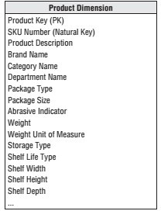
describe the “who, what, where, when, how, and why” associated with the event.

Slide 18
Facts and Dimensions
Criteria Fact Attributes
Dimension Attributes
Purpose Measurements for reporting or Constraints or
analysis
qualifiers for the measurements Textual, descriptive
Data type
Additive or semi-additive quantitative data
Larger number of records
Size
Smaller number of records
Row or report headers About time, people,
departments, objects, geographic units
Reporting use Examples
Main report contents Measurements for sales
18

Slide 19
Strengths of the Dimensional Model
Predictable, standard framework
Respond well to changes in user reporting needs
Relatively easy to add data without reloading tables
Standard design approaches have been developed
There exist a number of products supporting the dimensional model

Slide 20
Conceptual Modeling of Data Warehouses
Star schema
Snowflake schema
Fact constellations

Slide 21
Star schema
The star schema architecture is the simplest data warehouse schema.
It is called a star schema because the diagram resembles a star, with points radiating from a center.
The center of the star consists of fact table and the points of the star are the dimension tables.
Usually the fact tables in a star schema are in third normal form(3NF) whereas dimensional tables are de-normalized.

Slide 22
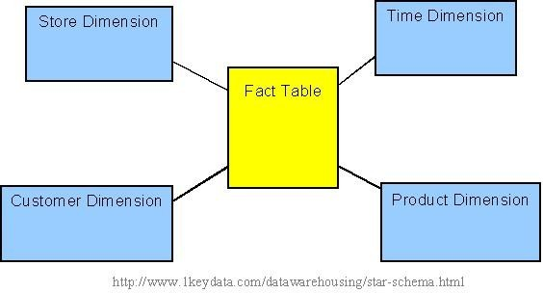
Star schema

Slide 23
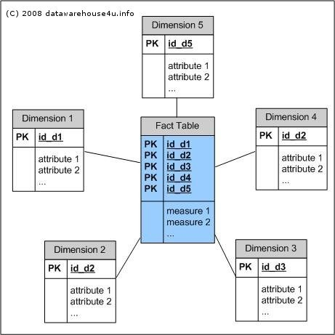
Star schema

Slide 24
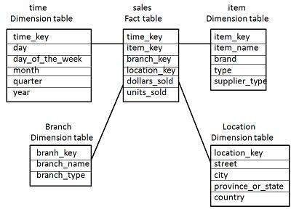
Star schema

Slide 25
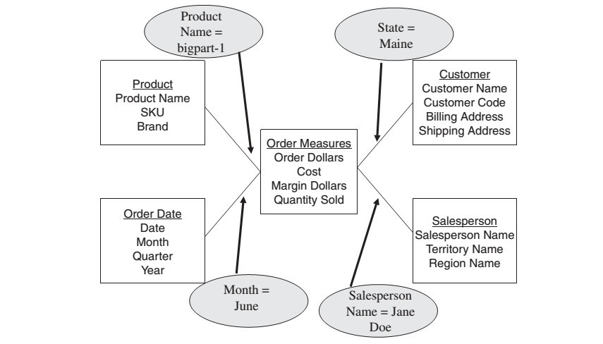
Querying Star Schema
If marketing department wants the quantity sold and order dollars for productbigpart-1, relating to customers in the state ofMaine, obtained by salesperson Jane Doe, during the month of June.

Slide 26
Snowflake Schema
Some dimension tables in the Snowflake schema are normalized.
The normalization splits up the data into additional tables.
Unlike Star schema, the dimensions table in a snowflake schema are normalized. For example, the item dimension table in star schema is normalized and split into two dimension tables, namely item and supplier table.

Slide 27
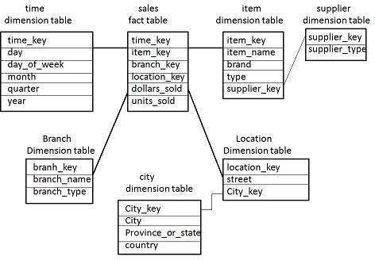
Snowflake Schema

Slide 28
Fact Constellation Schema
A fact constellation has multiple fact tables. It is also known as galaxy schema.
The following diagram shows two fact tables, namely sales and shipping.
It is also possible to share dimension tables between fact tables. For example, time, item, and location dimension tables are shared between the sales and shipping fact table.

Slide 29
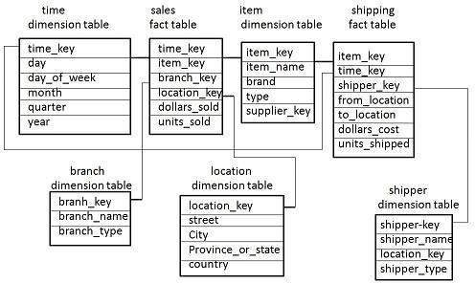

Slide 30
Business Model
As always in life, there are some disadvantages to 3NF:
Performance can be truly awful. Most of the work that is performed on denormalizing a data model is an attempt to reach performance objectives.
The structure can be overwhelmingly complex. We may wind up creating many small relations which the user might think of as a single relation or group of data.

Slide 31
The 4 Step Design Process
Choose the Data Mart
Declare the Grain
Choose the Dimensions
Choose the Facts

Slide 32
Building a Data Warehouse from a Normalized Database
The steps
Develop a normalized entity-relationship business model of the data warehouse.
Translate this into a dimensional model. This step reflects the information and analytical characteristics of the data warehouse.
Translate this into the physical model. This reflects the changes necessary to reach the stated performance objectives.

Slide 33
Structural Dimensions
The first step is the development of the structural dimensions. This step corresponds very closely to what we normally do in a relational database.
The star architecture that we will develop here depends upon taking the central intersection entities as the fact tables and building the foreign key => primary key relations as dimensions.

Slide 34
Steps in dimensional modeling
Select an associative entity for a fact table
Determine granularity
Replace operational keys with surrogate keys
Promote the keys from all hierarchies to the fact table
Add date dimension
Split all compound attributes
Add necessary categorical dimensions
Fact (varies with time) / Attribute (constant)

Slide 35
Converting an E-R Diagram
Determine the purpose of the mart
Identify an association table as the central fact table
Determine facts to be included
Replace all keys with surrogate keys
Promote foreign keys in related tables to the fact table
Add time dimension
Refine the dimension tables

Slide 36
Choosing the Mart
A set of related fact and dimension tables
Single source or multiple source
Conformed dimensions
Typically have a fact table for each process

Slide 37
Fact Tables
Represent a process or reporting environment that is of value to the organization
It is important to determine the identity of the fact table and specify exactly what it represents.
Typically correspond to an associative entity in the E-R model

Slide 38
Grain (unit of analysis)
The grain determines what each fact record represents: the level of detail.
For example
Individual transactions
Snapshots (points in time)
Line items on a document
Generally better to focus on the smallest grain

Slide 39
Facts
Measurements associated with fact table records at fact table granularity
Normally numeric and additive
Non-key attributes in the fact table
Attributes in dimension tables are constants. Facts vary with the granularity of the fact table

Slide 40
Dimensions
A table (or hierarchy of tables) connected with the fact table with keys and foreign keys
Preferably single valued for each fact record (1:m)
Connected with surrogate (generated) keys, not operational keys
Dimension tables contain text or numeric attributes

Slide 41
PRODUCT
SKU (PK)
description brand category
CUSTOMER
customer_ID (PK) customer_name purchase_profile credit_profile address
ERD
ORDER
order_num (PK) customer_ID (FK) store_ID (FK) clerk_ID (FK) date
ORDER-LINE
order_num (PK) (FK) SKU (PK) (FK)
promotion_key (FK) dollars_sold units_sold dollars_cost
STORE
store_ID (PK) store_name address district floor_type
CLERK
clerk_id (PK) clerk_name clerk_grade
PROMOTION
promotion_NUM (PK) promotion_name price_type
ad_type

Slide 42
DIMENSONAL MODEL
PRODUCT
product_key (PK) SKU
description brand category
TIME
time_key (PK) SQL_date day_of_week month
FACT
time_key (FK) store_key (FK) clerk_key (FK) product_key (FK) customer_key (FK) promotion_key (FK) dollars_sold units_sold dollars_cost
STORE
store_key (PK) store_ID store_name address district floor_type
CUSTOMER
customer_key (PK) customer_name purchase_profile credit_profile address
CLERK
clerk_key (PK) clerk_id clerk_name clerk_grade
PROMOTION
promotion_key (PK) promotion_name price_type
ad_type

Slide 43
Snowflaking & Hierarchies
Efficiency vs Space
Understandability
M:N relationships

Slide 44
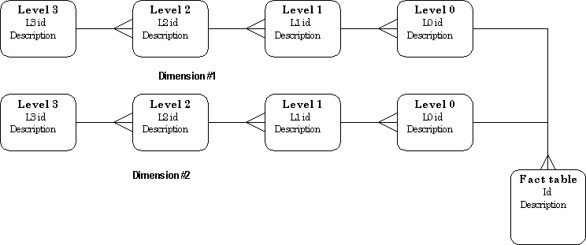
Simple DW hierarchy pattern.

Slide 45
Good Attributes
Verbose
Descriptive
Complete
Quality assured
Indexed (b-tree vs bitmap)
Equally available
Documented

Slide 46
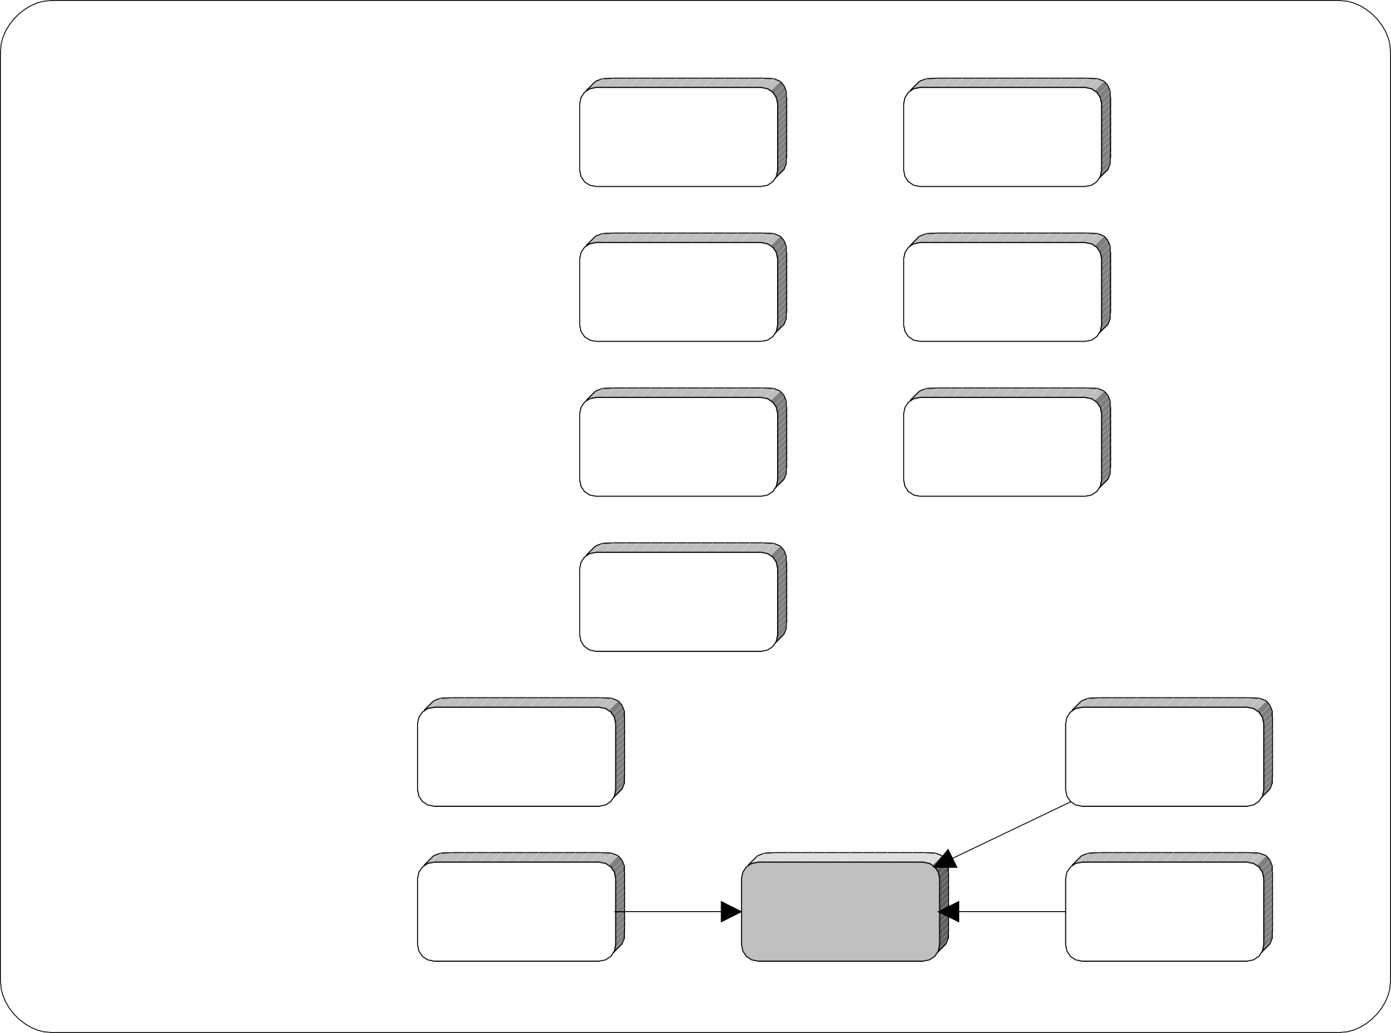
Date Dimensions
Fiscal Year
Calendar Year
Fiscal Quarter
Calendar Quarter
Fiscal Month
Calendar Month
Fiscal Week
Type of Day
Calendar Week
Day of Week
Day
Holiday

Slide 47
Attribute Name | Attribute Description | Sample Values
Day | The specific day that an activity took place. | 06/04/1998; 06/05/1998
Day of Week | The specific name of the day. | Monday; Tuesday
Holiday | Identifies that this day is a holiday. | Easter; Thanksgiving
Type of Day | Indicates whether or not this day is a weekday or a weekend day. | Weekend; Weekday
Calendar Week | The week ending date, always a Saturday. Note that WE denotes | WE 06/06/1998;
 |  | WE 06/13/1998
Calendar Month | The calendar month. | January,1998; February, 1998
Calendar Quarter | The calendar quarter. | 1998Q1; 1998Q4
Calendar Year | The calendar year. | 1998
Fiscal Week | The week that represents the corporate calendar. Note that the F | F Week 1 1998;
 |  | F Week 46 1998
Fiscal Month | The fiscal period comprised of 4 or 5 weeks. Note that the F in the data | F January, 1998;
 |  | F February, 1998
Fiscal Quarter | The grouping of 3 fiscal months. | F 1998Q1; F1998Q2
Fiscal Year | The grouping of 52 fiscal weeks / 12 fiscal months that comprise the financial year. | F 1998; F 1999

Slide 48
Slowly Changing Dimensions
(Addresses, Managers, etc.)
Type 1: Store only the current value
Type 2: Create a dimension record for each value (with or without date stamps)
Type 3: Create an attribute in the dimension record for previous value

Slide 49
Many to many
Use a Bridge Table
Add a weighting factor to correct fact addition
Fact (Acct Bal)
Bridge
acct-key (PK) customer-key (PK) weighting-factor
Dimension (Customer)

Slide 50
Recursive
Use a Bridge Table
Add a level count and bottom flag
Fact (Employee) employee-key (FK)
Navigation (Supervise) employee-key (PK) supervises-key number-levels-down bottom-most-flag
Dimension (Employee)

