Slide 1
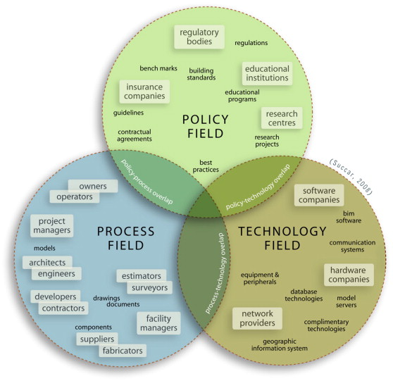
MODELLING/MODELAREA
.

Slide 2

MODELLING/MODELAREA
.

Slide 3
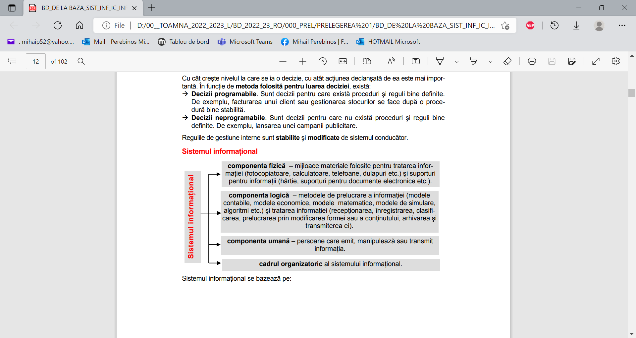

Slide 4
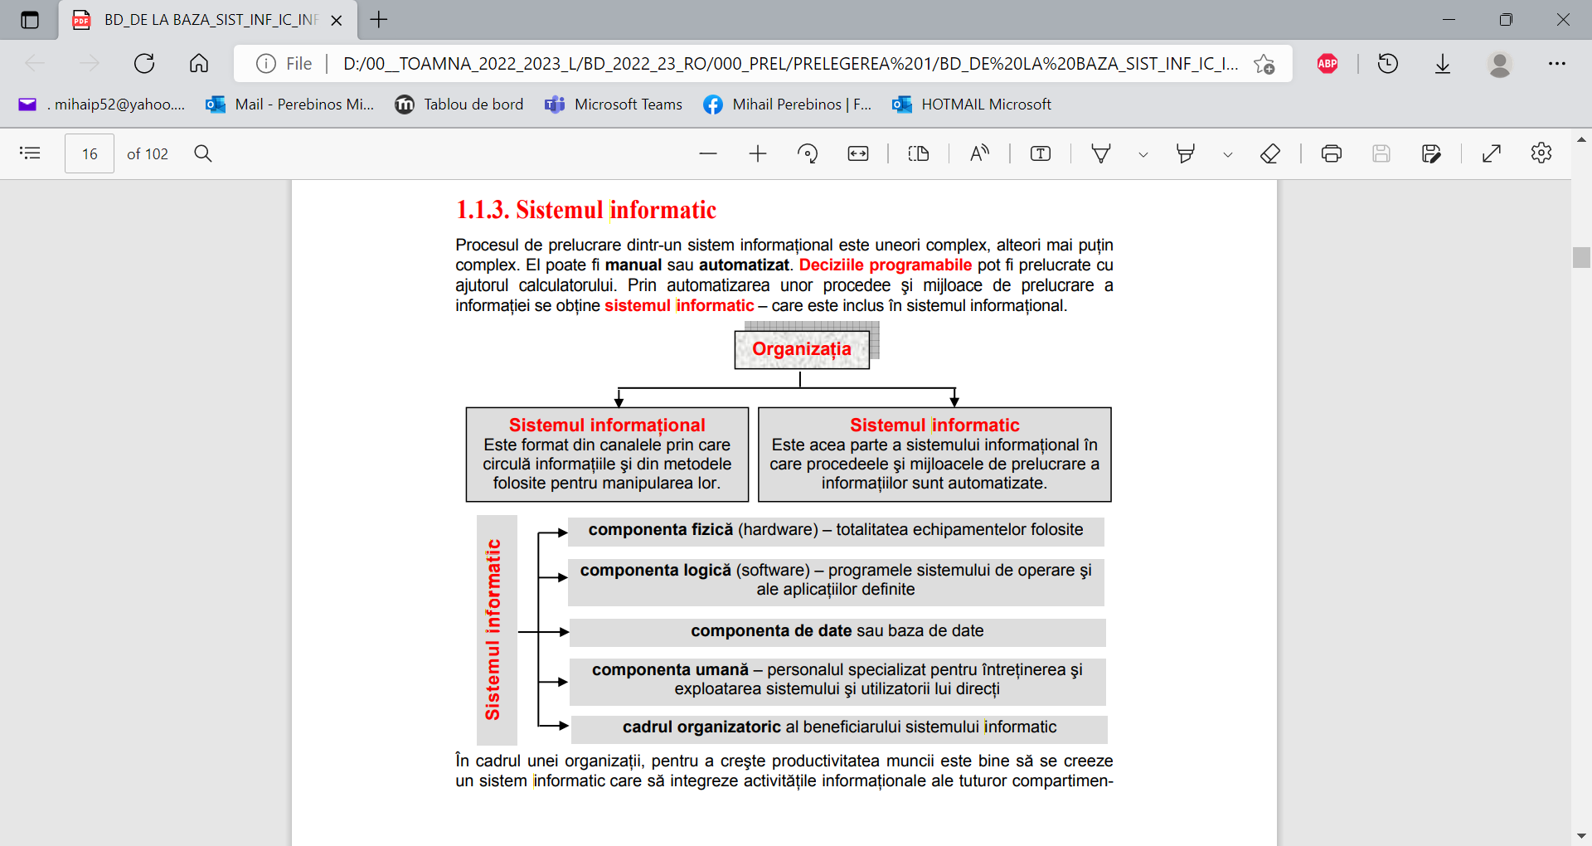

Slide 5
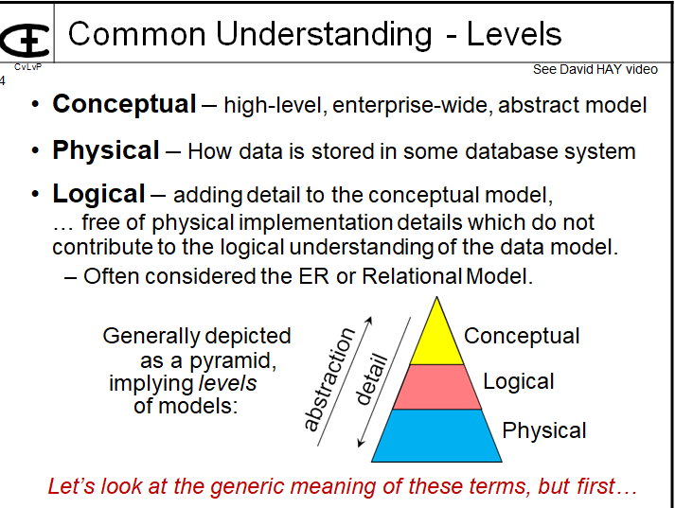

Slide 6
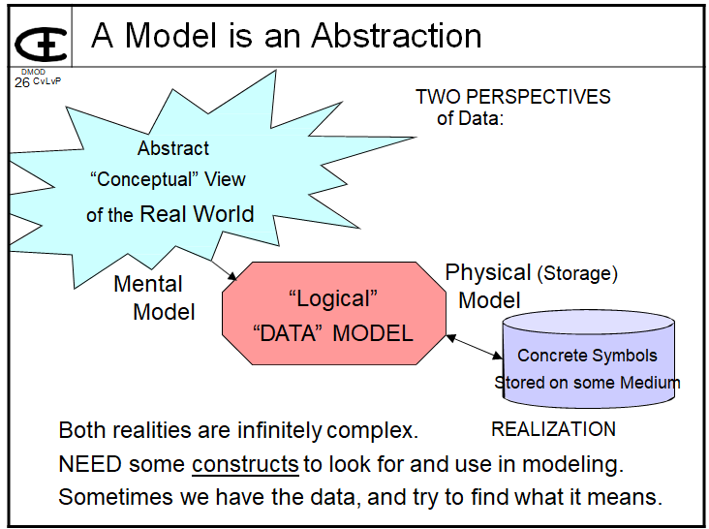

Slide 7
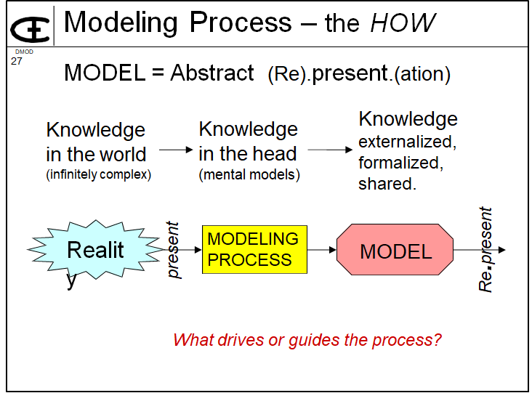

Slide 8
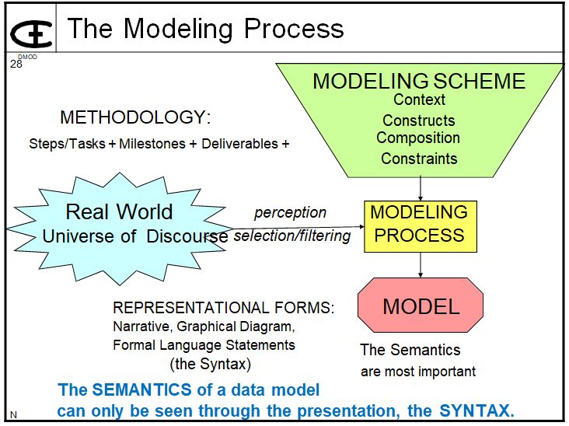

Slide 9
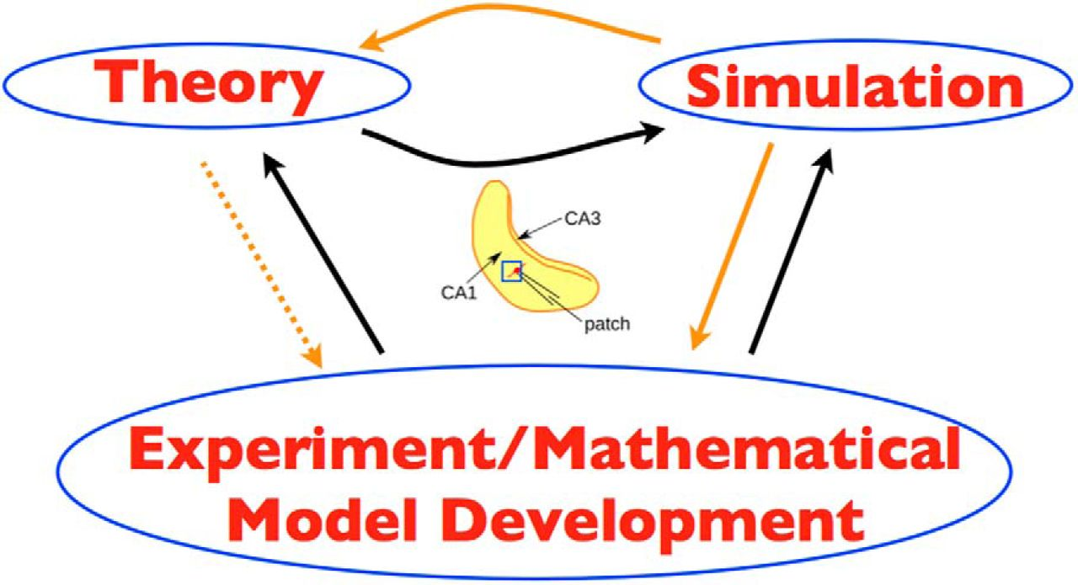
MODELLING/MODELAREA
.

Slide 10
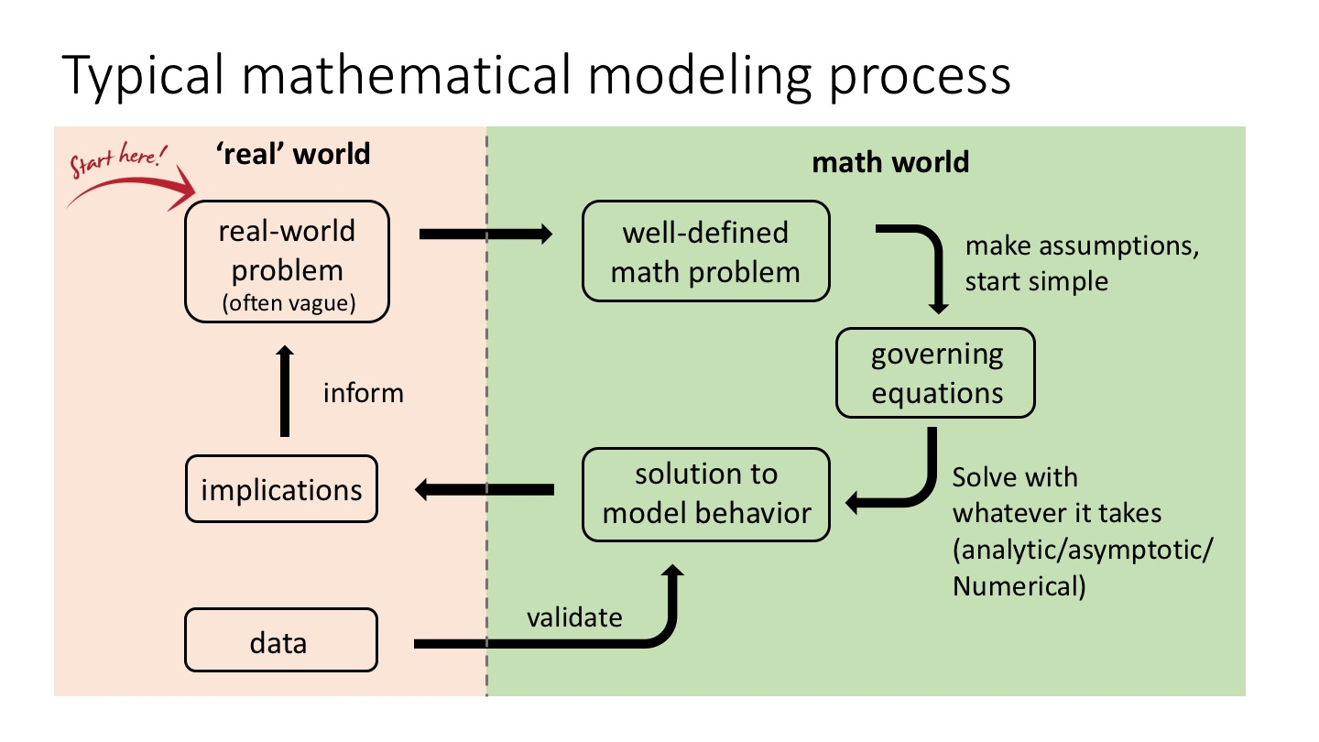
MODELLING/MODELAREA
.

Slide 11
Mathematical modelling
MODELAREA MATEMATICĂ
https://www.mat.univie.ac.at/~neum/model.html
  Mathematical Modeling
  Arnold Neumaier

Slide 12
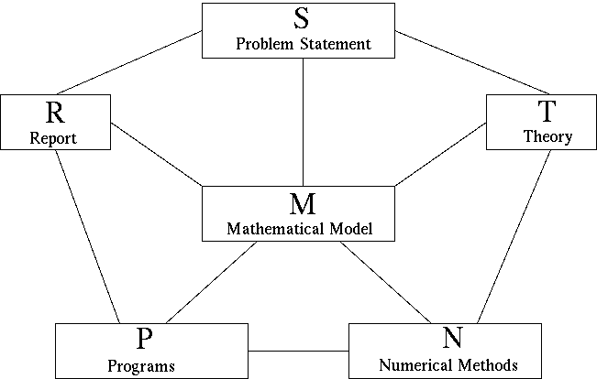
Mathematical modelling
MODELAREA MATEMATICĂ

Slide 13
Mathematical modelling
MODELAREA MATEMATICĂ
The edges of the diagram represent activities of two-way communication (flow of relevant information) between the nodes and the corresponding sources of information.
S. Problem Statement
Interests of customer/boss
Often ambiguous/incomplete
Wishes are sometimes incompatible

Slide 14
Mathematical modelling
MODELAREA MATEMATICĂ
M. Mathematical Model
Concepts/Variables
Relations
Restrictions
Goals
Priorities/Quality assignments

Slide 15
Mathematical modelling
MODELAREA MATEMATICĂ
T. Theory
of Application
of Mathematics
Literature search

Slide 16
Mathematical modelling
MODELAREA MATEMATICĂ
P. Programs
Flow diagrams
Implementation
User interface
Documentation

Slide 17
Mathematical modelling
MODELAREA MATEMATICĂ
N. Numerical Methods
Software libraries
Free software from WWW
Background information

Slide 18
Mathematical modelling
MODELAREA MATEMATICĂ
R. Report
Description
Analysis
Results
Validation
Visualization
Limitations
Recommendations

Slide 19
Mathematical modelling
MODELAREA MATEMATICĂ
Using the modeling diagram
The modeling diagram breaks the modeling task into 16=6+10 different processes.
Each of the 6 nodes and each of the 10 edges deserve repeated attention, usually at every stage of the modeling process.
The modeling is complete only when the 'traffic' along all edges becomes insignificant.
Generally, working on an edge enriches both participating nodes.
If stuck along one edge, move to another one! Use the general rules below as a check list!
Frequently, the problem changes during modeling, in the light of the understanding gained by the modeling process. At the end, even a vague or contradictory initial problem description should have developed into a reasonably well-defined description, with an associated precisely defined (though perhaps inaccurate) mathematical model.

Slide 20
MODELAREA MATEMATICĂ
General rules
Look at how others model similar situations; adapt their models to the present situation.
Collect/ask for background information needed to understand the problem.
Start with simple models; add details as they become known and useful or necessary.
Find all relevant quantities and make them precise.
Find all relevant relationships between quantities ([differential] equations, inequalities, case distinctions).
Locate/collect/select the data needed to specify these relationships.
Find all restrictions that the quantities must obey (sign, limits, forbidden overlaps, etc.). Which restrictions are hard, which soft? How soft?
Try to incorporate qualitative constraints that rule out otherwise feasible results (usually from inadequate previous versions).

Slide 21
MODELAREA MATEMATICĂ
General rules
Find all goals (including conflicting ones)
Play the devil's advocate to find out and formulate the weak spots of your model.
Sort available information by the degree of impact expected/hoped for.
Create a hierarchy of models: from coarse, highly simplifying models to models with all known details. Are there useful toy models with simpler data? Are there limiting cases where the model simplifies? Are there interesting extreme cases that help discover difficulties?
First solve the coarser models (cheap but inaccurate) to get good starting points for the finer models (expensive to solve but realistic)
Try to have a simple working model (with report) after 1/3 of the total time planned for the task. Use the remaining time for improving or expanding the model based on your experience, for making the programs more versatile and speeding them up, for polishing documentation, etc.

Slide 22
MODELAREA MATEMATICĂ
General rules
Good communication is essential for good applied work.
The responsibility for understanding, for asking the questions that lead to it, for recognizing misunderstanding (mismatch between answers expected and answers received), and for overcoming them lies with the mathematician. You cannot usually assume your customer to understand your scientific jargon.
Be not discouraged. Failures inform you about important missing details in your understanding of the problem (or the customer/boss) - utilize this information!
There are rarely perfect solutions. Modeling is the art of finding a satisfying compromise. Start with the highest standards, and lower them as the deadline approaches. If you have results early, raise your standards again.
Finish your work in time.
Lao Tse: ''People often fail on the verge of success; take care at the end as at the beginning, so that you may avoid failure.''

Slide 23
MODELAREA MATEMATICĂ
Conflicts
Most modeling situations involve a number of tensions between conflicting requirements that cannot be reconciled easily.
fast - slow
cheap - expensive
short term - long term
simplicity - complexity
low quality - high quality
approximate - accurate
superficial - in depth
sketchy - comprehensive
concise - detailed
short description - long description

Slide 24
MODELAREA MATEMATICĂ
Einstein: ''A good theory'' (or model) ''should be as simple as possible, but not simpler.''
perfecting a program - need for quick results
collecting the theory - producing a solution
doing research - writing up
quality standards - deadlines
dreams - actual results

Slide 25
MODELAREA MATEMATICĂ
The conflicts described are creative and constructive, if one does not give in too easily. As a good material can handle more physical stress, so a good scientist can handle more stress created by conflict.
''We shall overcome'' - a successful motto of the black liberation movement, created by a strong trust in God. This generalizes to other situations where one has to face difficulties, too.
Among other qualities it has, university education is not least a long term stress test - if you got your degree, this is a proof that you could overcome significant barriers. The job market pays for the ability to persist.

Slide 26
MODELAREA MATEMATICĂ
Attitudes
Do whatever you do with love. Love (even in difficult circumstances) can be learnt; it noticeably improves the quality of your work and the satisfaction you derive from it.
Do whatever you do as a service to others. This will improve your attention, the feedback you'll get, and the impact you'll have.
Take responsibility; ask if in doubt; read to confirm your understanding. This will remove many impasses that otherwise would delay your work.
Jesus: ''Ask, and you will receive. Search, and you will find. Knock, and the door will be opened for you.''

