Slide 1
Tema Tehnici nanometrologie
Company Name

Slide 2
Nanometrology Techniques

Slide 3
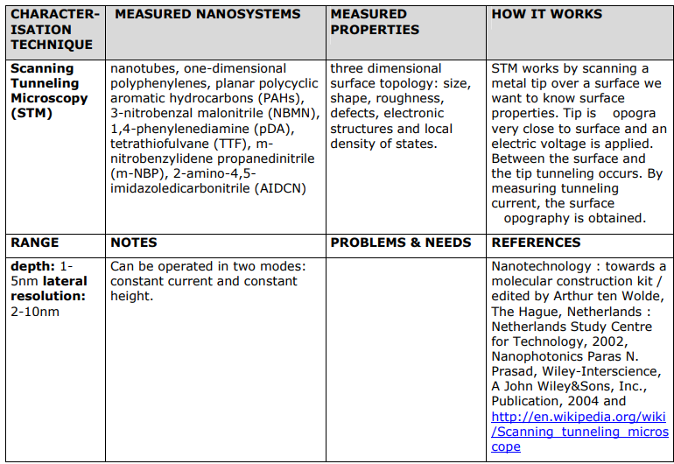

Slide 5
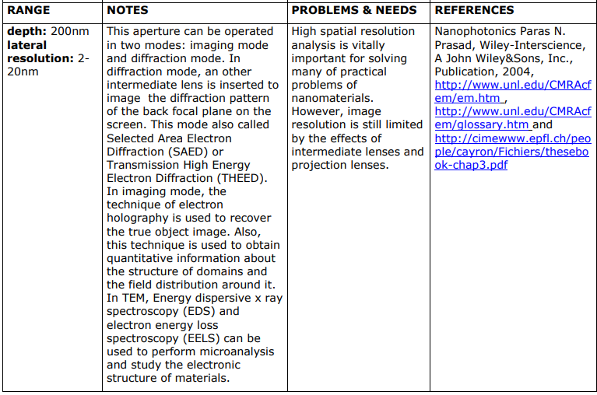

Slide 7
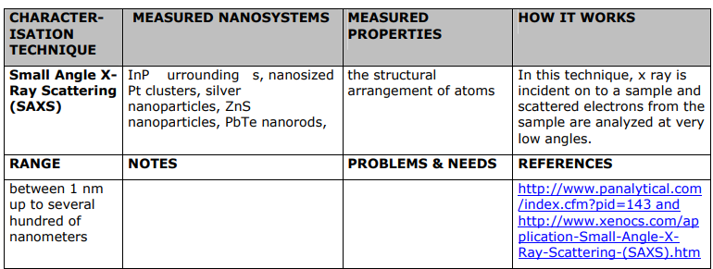

Slide 23
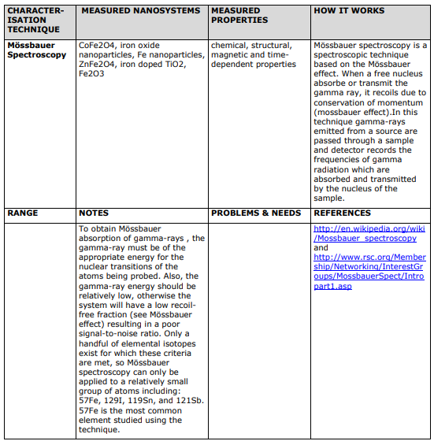

Slide 27
Description of selected nanotechnology techniques

