Slide 1
Tema : Nanoelectronica

Slide 2
Fenomenului electronului singular
Ce este efectul blocării Coulomb-iene? Efect de sarcină care blochează injectarea sau rejectează unei sarcini elementare din sau în quantum dot

Slide 3
Conditii necesare pentru blocarea efectului coulomb-ian

Slide 4
Single-electron transistor

Slide 5
Blocarea Coulomb-iana

Slide 6
Blocarea Coulob-iana

Slide 7
Conductibilitatea cuantică

Slide 8
Conductanța cuantificată

Slide 9
Conductanța cuantificată

Slide 10
Blocarea Coulomb-iana

Slide 15
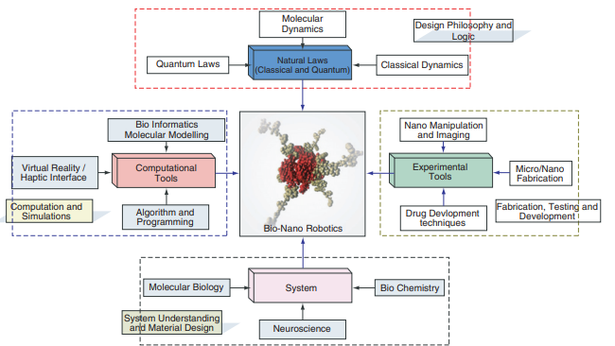
BIONANOROBOTIC

Slide 16
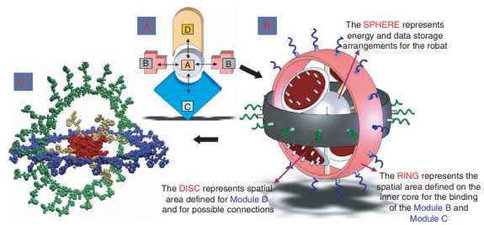
A Bio-nano robotic entity ‘ABCD’, where A, B, C, D are the various biomodules constituting the bio-nanorobot. In our case these bio-modules will be set of stable configurations of various proteins and DNAs.
A bio-nanorobot as a result of the concept of modular organization. All the modules will be integrated in such a way so as to preserve the basic behavior (of self-assembly and self-organization) of the biocomponents at all the hierarchies. The number of modules employed is not limited to four or any number. It is a function of the various capabilities required for a particular mission.
A molecular representation of the figure in part B. It shows the red core and green and blue sensory and actuation bio-modules.

Slide 17
Feedback path from nano- to macro-world route

Slide 18
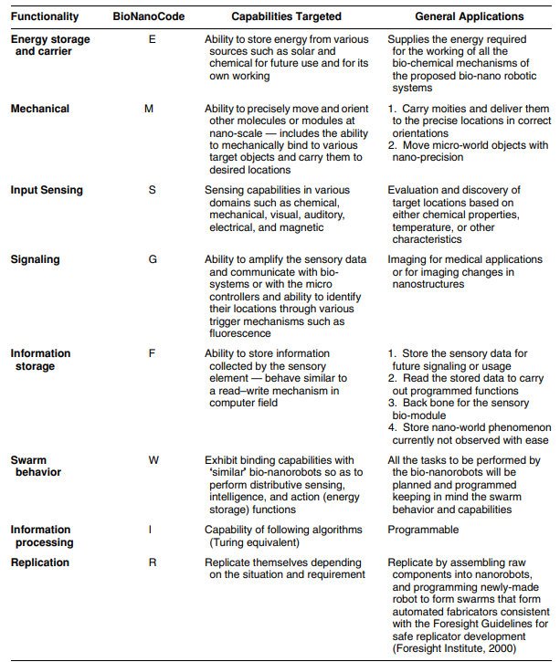
Defining the Capability Matrix for the Bio-Modules

Slide 19
We can classify the self-replicating mechanisms in the order we classify our main mechanisms or machines.
Mechanical self-replicating mechanisms; .
Electrical self-replicating mechanisms; .
Chemical or biological self-replicating mechanisms.

