Slide 1
PRESENTATION: CBC - Attack
University Politehnica of Bucharest
Faculty of Applied Sciences

Slide 2
Agenda
1. What is CBC? Features
2. Scenario
3. Simulation with Cryptool 2
4. Conclusions

Slide 3
1. What is CBC? Features
In cryptography, a block cipher mode of operation is an algorithm that uses a block cipher to provide information security such as confidentiality or authenticity.
The earliest modes of operation, ECB, CBC, OFB, and CFB, date back to 1981 and were specified in FIPS 81, DES Modes of Operation.
The block cipher modes ECB, CBC, OFB, CFB, CTR, and XTS provide confidentiality, but they do not protect against accidental modification or malicious tampering. Modification or tampering can be detected with a separate message authentication code such as CBC-MAC, or a digital signature. Regarding error propagation properties, integrity protection had been seen as an entirely separate cryptographic goal.

Slide 4
In CBC mode, each block of plaintext is XORed with the previous cipher text block before encrypted. This way, each cipher text block depends on all plaintext blocks processed up to that point.
To make each message unique, an initialization vector – IV is used at first encipherment. It is an unique binary sequence, it must be non-repeating and random. The resultant block is the first block of the ciphertext. The IV is used to ensure distinct ciphertext are produced even when the same plaintext is encrypted multiple times independently with the same key.
Block ciphers may be capable of operating on more than one block size, but during transformation the block size is always fixed. Because messages come in a variety of lengths, CBC requires that the final block be padded before encryption. There are several padding schemes. The simplest is to add null bytes to the plaintext to bring its length up to a multiple of the block size.
XOR ed blocks between plaintext and previous ciphertext are encrypted with symmetric keys. Due to this XOR process, the same block of plaintext will no longer result in identical ciphertext being produced.

Slide 5
Cipher block chaining (CBC)
Encryption rule: C_{i} = E_{k} (C_{i-1} ⊕ M_{i}),C₀ = IV
In CBC mode, the plaintext of a block is combined with the ciphertext of the previous block through an XOR operation, and the result is encrypted. The result is the cipher text of that block, and will also be used in the encryption of the following block.
An initialization vector IV acts as the “previous ciphertext block” for the first plaintext block. This IV can be made public, but ideally should not be reused for encryption of different messages, to avoid having the same ciphertext prefix for two messages with the same plaintext prefix.

Slide 6
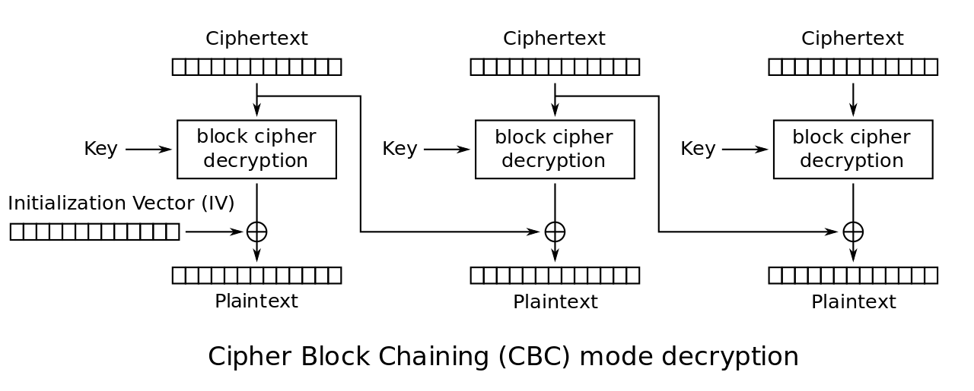
Cipher block chaining (CBC)
Decryption rule: D_{k}(C_{i}) = C_{i-1}⊕M_{i} => M_{i} =C_{i-1} ⊕ D_{k}(C_{i})
Decryption reverses the process. The first block of ciphertext is decrypted and then XORed with the initialization vector; the result is the first plaintext block.
The next ciphertext blocks are decrypted and then XORed with the ciphertext of the previous block.
Decrypting with the incorrect IV causes the first block of plaintext to be corrupt but subsequent plaintext blocks will be correct. So, a plaintext block can be recovered from two adjacent blocks of ciphertext. As a consequence, decryption can be parallelized.

Slide 7
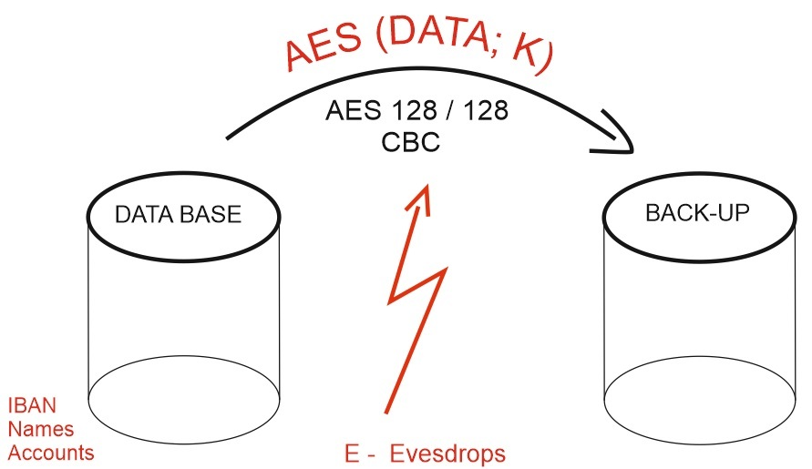
2. Scenario
A bank makes the periodical back-up for data base using AES 128/128 - CBC operation mode.
We have an eavesdrop attacker on the communication chain, a former bank technical employee, which already knows information like: data base structure, personal data - IBAN, names, accounts values, the back-up protocol, but he doesn’t know the cipher key.
The attacker’s plan is to replace the packages on the encrypted channel and to substitute his former boss’s personal data with his own, in order to steal money.

Slide 8
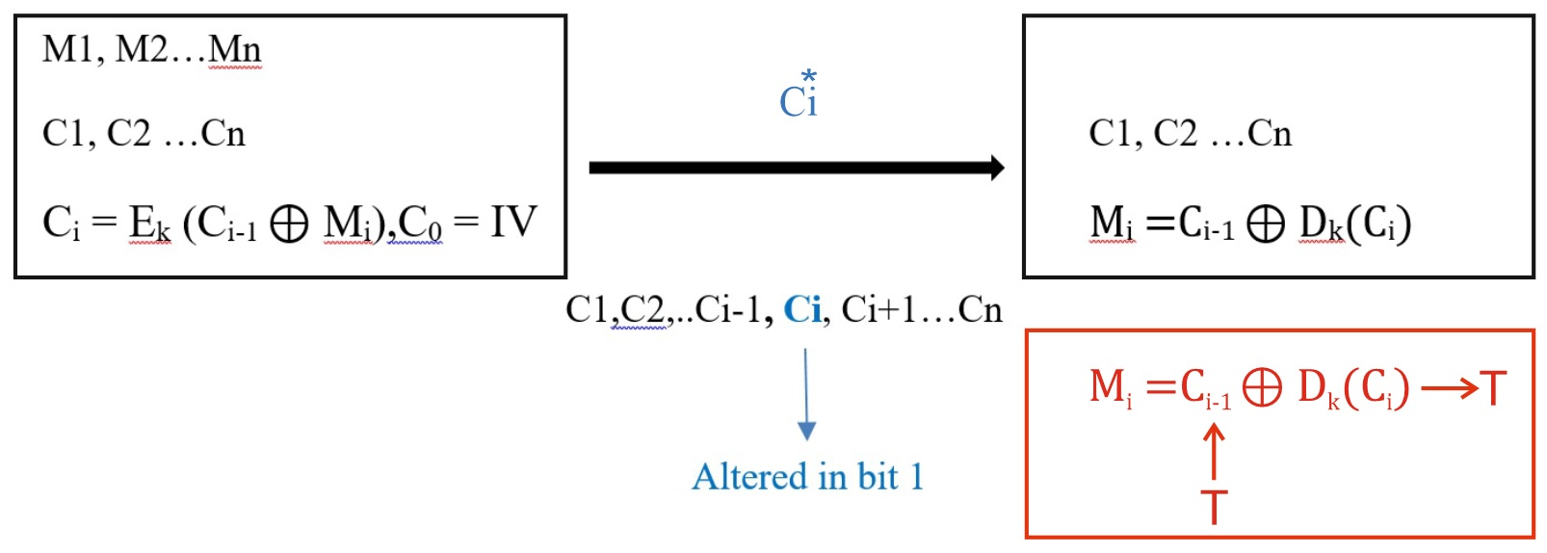
Description of the intrusion process
Instead of
Mi (original data)
it will be
T (the attacker’s data)

Slide 9
Remarks
A 1-bit error in a plaintext or initialization vector affects all following ciphertext blocks; decryption will correct all except the invert bit.
A 1-bit change in the ciphertext feed will affect two blocks:
Complete corruption of the corresponding block of plaintext;
Inverts the corresponding bit in the following block of plaintext, but the rest remain intact.
A 1-bit error in the initialization vector only invert 1 bit in the first block, no altered block, and that is hard to detect.

Slide 10
3. Simulation with Cryptool 2
In the following slides, it is presented step by step the process of intrusion in communication chain in order to modify records in database’s back-up.
The target is to replace the string Julius with Virus.
The steps are shown in the next slides

Slide 11
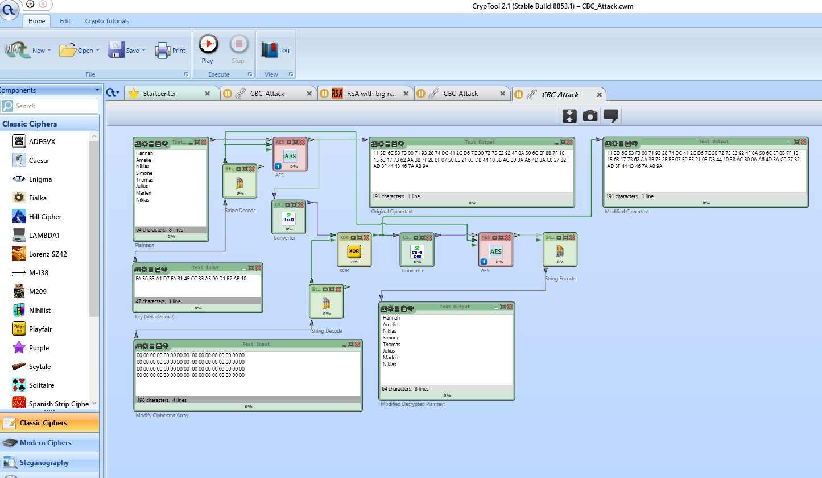

Slide 12
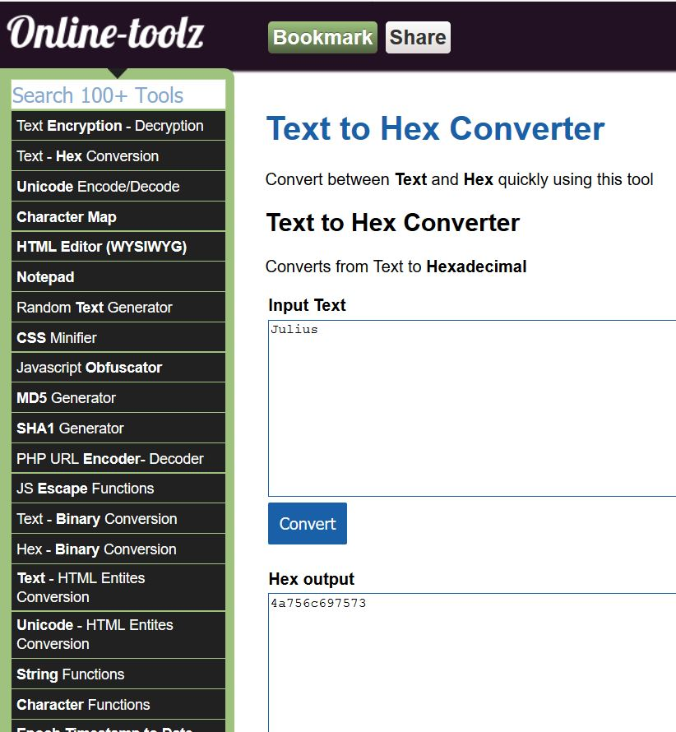
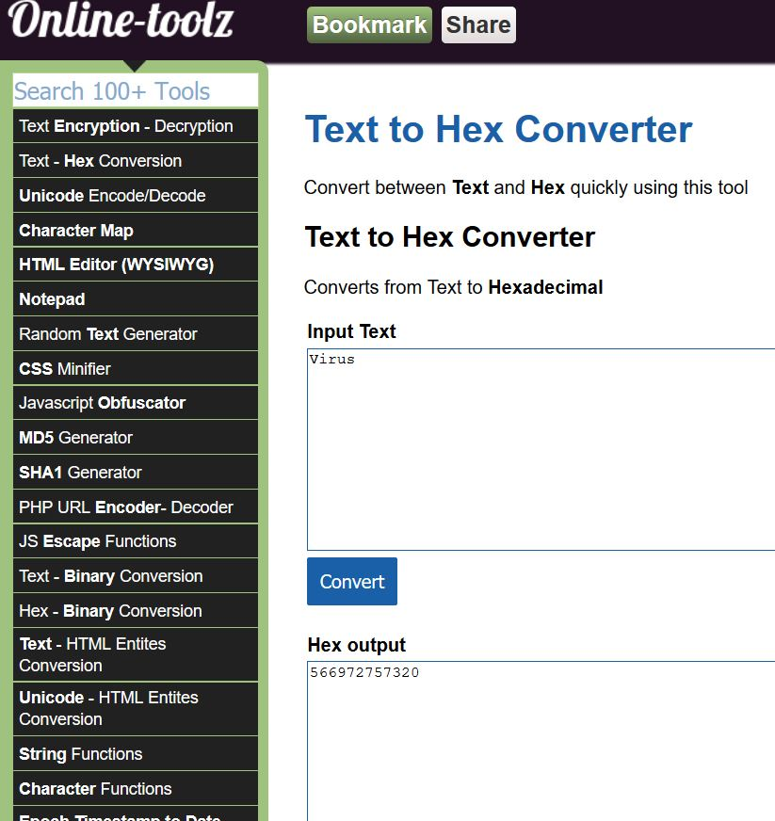

Slide 13
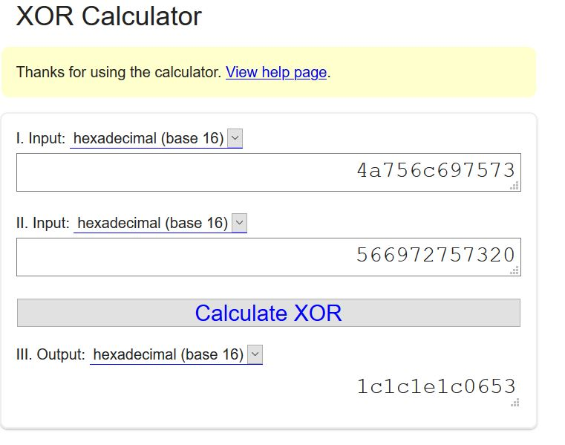

Slide 14
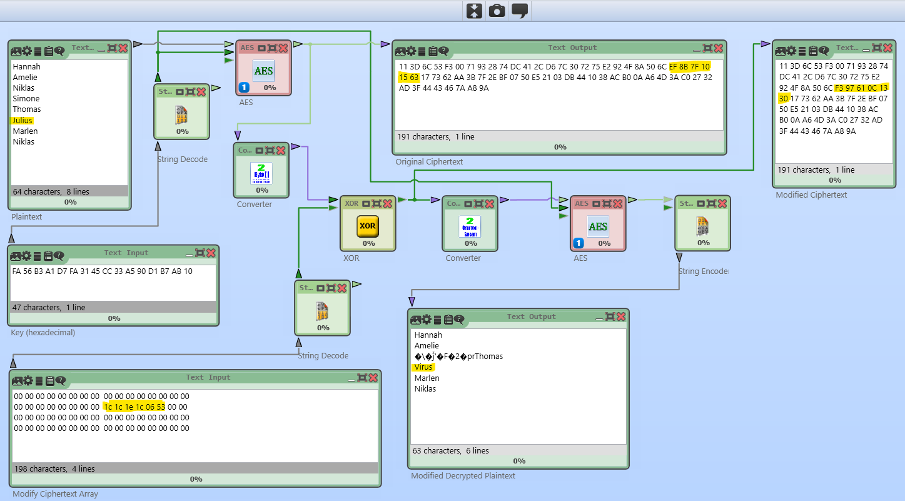

Slide 15
4. Conclusions
CBC has been the most commonly used mode of operation.
Weak points:
Slower, because encryption is sequential (It can not be parallelized).
It doesn’t provide authenticity.
Strong points:
It provides confidentiality.
CBC is self – synchronizing: a transmission error in one block will result in an error in one block and the following block, but will not affect subsequent blocks.

